Slide 1

ROUTINE HEALTH INFORMATION SYSTEMS
A Curriculum on Basic Concepts and Practice
MODULE 6:
RHIS Data Demand and Use
SESSION 1:
Using Data to Inform Policies, Program Planning, and Service Delivery
The complete RHIS curriculum is available here:
https://www.measureevaluation.org/our-work/ routine-health-information-systems/rhis-curriculum

Slide 2
Session 1: Learning Objectives
Raise awareness of the importance of using data to inform program planning, policy development, and service delivery
Appreciate how data-use interventions can improve a health information system

Slide 3
Overview
Value of data-informed decision making
Data-informed decision-making process
Contextual elements of the decision process
Strengthening health systems with information (a theory of change)
Data demand and use interventions
Notes:
First, discuss the value of data in efforts to address health problems and why we want to improve data demand and use.
Then present the process by which data are used to make a decision.
Then describe the fundamental elements that must be in place in order for a data demand and use intervention to be effective.
Then introduce a conceptual model to inform and structure interventions that strengthen the decision making process and the health system as a whole.

Slide 4
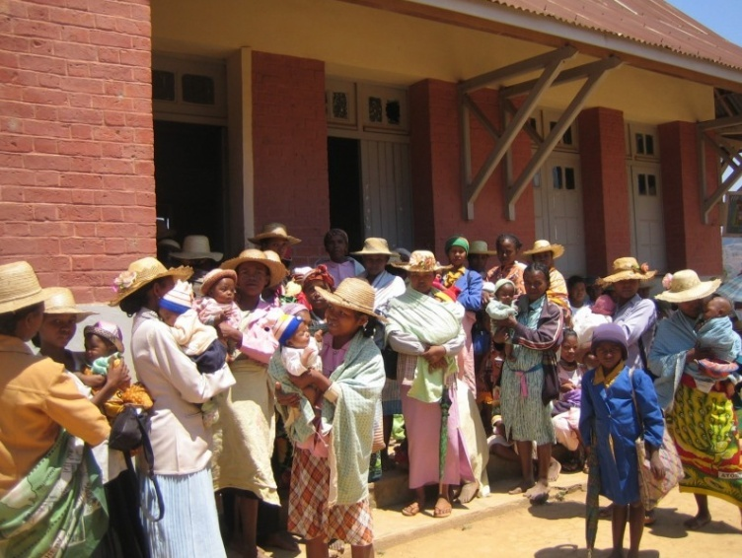
Context
Pressing need to develop health policies, strategies, and interventions
Notes:
We are all well-aware of the need for health policies, strategies, and interventions that will effectively impact the major health problems of today.
Globally, the dominant health burden remains with communicable diseases, such as HIV, malaria, and tuberculosis. With population growth and an increase in the average age of the world’s population, we also see growth in deaths from noncommunicable diseases such as cancer, heart disease, diabetes, and unintended injuries.
In much of sub-Saharan Africa, the transition from high to low fertility has been a slow progression. Young people—those below the age of 20—account for the largest proportion of the population. As this cohort grows, ages, and has families of their own, we will see more and more people needing health services in the future.
In the face of this growing demand for health services, many countries are experiencing shortages and poor distribution of qualified health workers, as well as an inadequate human resources system to support the health workers.
Iin this context of a high disease burden, a growing population, and insufficient health services, it becomes extremely important for governments to make the best use of their limited resources to have the greatest impact on improving public health. The need to develop strategies, policies, and interventions that are based on good-quality data and information is urgent.

Slide 5
The Value of Data
… without information, things are done arbitrarily, and one becomes unsure of whether a policy or program will fail or succeed. If we allow our policies to be guided by empirical facts and data, there will be a noticeable change in the impact of what we do.
―National policymaker, Nigeria
Notes:
The quote on this slide is how a national policymaker in Nigeria summarized the value of data during a data use assessment interview with MEASURE Evaluation.
This statement nicely summarizes why we are here today to discuss the importance of improving data-informed decision making.

Slide 6
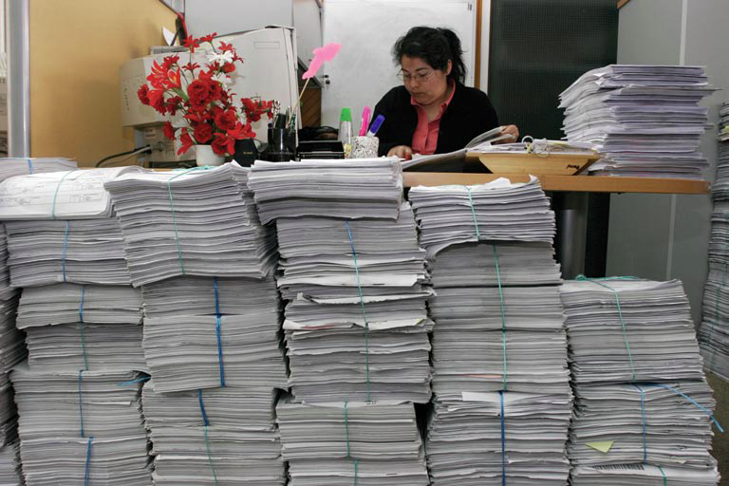
Why Improve Data Demand and Use?
Notes:
In today’s environment, many health professionals have become overwhelmed with collecting and using data related to services they deliver. In some contexts, data requirements from government and donors have grown exponentially, to the point where some providers and implementing partners have pages and pages of forms to fill in daily (CLICK ANIMATION).
Rarely are data sufficiently used to monitor programs and make decisions beyond individual patient care. This is a huge lost opportunity, because data are critical to the program improvement and decision-making process.

Slide 7
Definition: Data Use
Data are used in the decision-making process in the following ways:
  Create or revise program or strategic plan
  Develop or revise policy
  Advocate support for a policy or program
  Allocate resources
  Monitor and evaluate a health program/intervention
  Conduct client management to ensure good-quality delivery of care
  Review of data should be linked to a specific decision-making process.
Notes:
Now, let’s take a minute to discuss exactly what we mean by using data to inform program and policy decision making.
ENGAGE PARTICIPANTS: How do you think data can be used for health programs or policies? Examples are:
Create or revise a program or strategic plan
Develop or revise a policy
Advocate support for a policy or program
Allocate resources
Follow-up a chronic disease patient
A common data use approach among each of these tasks is that each review of data is linked to a specific decision-making process.
Using data to populate a report to send to the national level or to a donor is not data use. That is data reporting. The presentation of data at a technical conference also is not data use, as we define it. That is data dissemination.
Both data reporting and data dissemination are important precursors to data use, but they are not linked specifically to decision-making processes.

Slide 8
Definition: Data Demand
Decision makers…
specify what kind of information they need…
to inform the decision-making process…
then seek it out.
Notes:
Data demand starts with a question or problem that a stakeholder has about a type of health service or a particular health problem. To address this question or make a decision, stakeholders need to educate themselves about the available data or a summary of data sources in order to develop an informed solution. Therefore, data demand comes from decision makers who specify what kinds of information they need to inform a decision making process and how to seek it out.. If the information they need to inform a decision doesn’t exist or is not available, they take steps to get it.
ENGAGE PARTICIPANTS: Why do you think we should concern ourselves with the demand for data?
SAY: In order to motivate key decision makers to use data, we first want to know the following things:
Does information exist that is specific to their needs?
Do they know how to navigate the vast amount of information available to focus only on what they need to know in order to run their health program?
Those of us who design information systems need to link our efforts to specific and significant decisions being made about health services today in this country, in this context. Using an approach that first considers the demand for data will encourage greater data use by key decision makers.

Slide 9
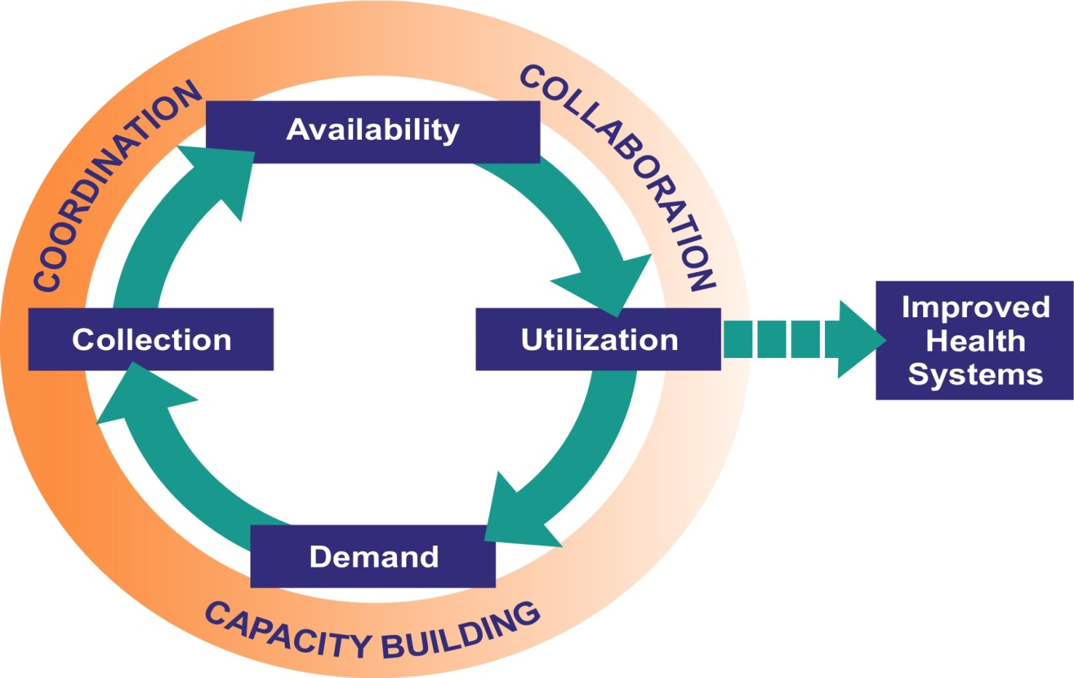
Data-Informed Decision-Making Process
Notes:
This visual model is what we are all striving for: a data-informed decision-making process.
In the inner circle are the activities that need to take place:
Demand for data to manage a health program, develop a health policy, or improve service delivery
This leads to a data collection effort.
These data are analyzed, synthesized, and made available to the users.
A decision based on data is better than one that is not.
The outer circle explains the way in which the activities that make up this process get done:
Secure the technical and human capacity to understand the demand for data, as well as manage, analyze, and distribute data.
Need for coordination among many people with different job functions and at different levels of the health system
Finally, need to management systems in support of collaboration among those who produce the data and those who use the data in order for the data-informed decision-making process to be complete.
We need to find ways in which to strengthen the data-informed decision making process [CLICK ANIMATION], so that the health system as a whole benefits.

Slide 10
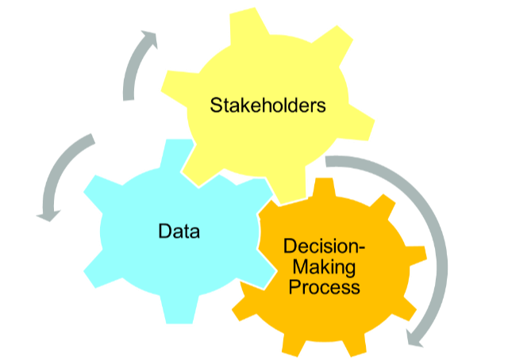
Context of Decision Making
Agency, Policymaker, Donor, Civil Society, or Service Provider
Beneficiaries
Data Users
Data Producers
P
P
Questions
Notes:
How can we strengthen the data-informed decision-making process?
Some basic elements that have to be in place are: (1) the involvement of stakeholders; (2) data; and (3) questions.
ALL THREE elements are equally important to a data-demand-and-use intervention. These three elements need to function in unison for data-informed decision making to happen.
We define a stakeholder as anyone who has an interest in your intervention. Examples are government agencies, policymakers, funding agencies, civil society, district management teams, providers, and beneficiaries of the interventions (they make decisions about seeking services and continuing care.
When we talk about targeting stakeholders as part of the decision-making process, we often talk about data users and data producers.
Data users are those who use data to inform the design, implementation, monitoring, and improvement of health interventions: program managers, policymakers, district managers, service providers, and civil society.
Data producers are those people who collect and analyze health data. They prepare the data for distribution to an audience of users. Data producers can be M&E officers; data clerks, and researchers.
Sometimes one person is both a data user AND a data producer, depending on the context and the task at hand.

Slide 11
Context of Decision Making
Promotion of Data Sources
Access
P
P
Questions
Information Flow
Notes:
The data themselves are essential to a data-demand-and-use intervention. This will typically involve:
The promotion of available data sources that meet the information needs of potential users and outlining the types of information contained in each source
How easy it is for others to access and use the data
Ensuring regular sharing and feedback to improve the flow of information in a health information system

Slide 12
Context of Decision Making
P
P
Questions
Decisions
Notes:
Finally, the questions asked by data users in the decision-making process are also important. The answers to these questions will lead to a decision. Simply put, decisions are:
Choices that lead to action
All decisions are informed by questions
All questions should be based on data
For example, every day you need to make a decision about what clothes to wear out of the house. To make this decision, you may ask yourself some questions that will inform it:
What’s the temperature outside?
Is it raining?
What events do I have planned for the day?
To answer these questions, you may consult the thermometer or the weather report or your daily calendar. You consult a data source to inform your decision.
To make a decision about a program or policy, decision makers must first understand what is happening in their programs. They must ask questions about what is happening in the facilities, if disease rates are going down, and if the needs of their target populations are being met. The answers to these questions will help them to decide what they should do.

Slide 13
Why Consider Decisions?
Data overload
Focus on information needs: What do you need to know?
Ultimate goal is not to gain information but to improve action
Notes:
Why do we need to focus on decisions?
Decision makers tend to be overwhelmed with data. They often don’t know how to interpret data in the program or policy context, or they are unsure which data source is most important for a decision.
Decision makers may move ahead without consulting data at all, or they may spend precious resources on data analysis and interpretation that are not linked to action or programmatic needs.
By focusing on the priority decisions for a specific program area, decision makers can identify their information needs. This will allow them to narrow down the number of data sources they need to review and consider. It allows them to prioritize their data use activities so that they can improve programs.

Slide 14
Conceptual Theory: Data Use to Strengthen Health Systems
Assumptions
  Commitment exists at the national level to improve the health information system
  Data use leads to improved health systems
  Positive experiences in data use lead to demand for more data
  Data use activities are tailored to context
Notes:
Now that I have explained the data-informed decision-making process and the basic elements needed for interventions to strengthen this process, I would like now to talk about how data-use interventions can improve an information system and, ultimately, the effectiveness of a health system.
Before I explain our theory of change in the health system through data use interventions, I would like to list some assumptions:
We assume there exists commitment at the national level to improve the health information system.
Increased use of data leads to improvement in the function of a health system.
Positive experiences in data use lead to demand for more data.
Activities to improve data demand and use must be tailored to the decision-making context.

Slide 15
Role of Data-Use Interventions in Health Systems
Data-demand-and- use interventions for individuals and organizations
Data reviewed and used in decision-making process
Stronger health-system building blocks:
Service delivery
Workforce
Medical products, vaccines, technology
Financing
Leadership and governance
Notes:
Our ultimate vision is to improve health outcomes. According to the WHO framework,* this involves strengthening the 6 building blocks that make up a health system:
Service delivery
Workforce
Medical products, vaccines, and technologies
Financing
Leadership and governance
And, finally, the health information system itself.
In fact, health data are prerequisites for improving each of the five other building blocks of a health system. In order to improve the condition of a health system, the action of regularly demanding, analyzing, synthesizing, reviewing, and using data in the decision-making process must take place. An improved health system, therefore, is the goal or long-term outcome of a data demand and use intervention.
In order to achieve this outcome, there must be a concerted effort in the form of data demand and use Interventions that aim to improve individual skills and organizational capacity, attitudes, and behavior, as well as ensure that organizational procedures, policies, and support mechanisms are institutionalized and functioning.
*World Health Organization. (WHO). (2007). Everybody’s business: Strengthening health systems to improve health outcomes: WHO’s framework for action. Geneva, Switzerland: WHO. Retrieved from http://www.who.int/healthsystems/strategy/en/.

Slide 16
Data-Demand-and-Use Interventions
Activities
Outputs
Assess and improve DDU context
Identify and engage data users and producers
Improve data quality
Improve data availability
Barriers to data use overcome
Users and producers regularly review data and programs
Quality data available and information formatted for target audience
Notes:
The following data-demand-and-use interventions (used under the MEASURE Evaluation project) should help you start to understand what is involved in a data-demand-and-use intervention:
1) A data-use assessment looks at the technical, behavioral, and organizational factors that affect decision making. The assessment identifies barriers to data use and develops plans to overcome them.
2) Identify, engage, and involve data users and producers. The output of this activity is greater collaboration between data users and data producers.
3) Activities to improve data quality:
Data quality assessments
Trainings in data entry, management, and quality assessments
Development of data quality protocols and standard operating procedures
4) Activities to improve data availability:
Linking many databases together to make them interoperable
Developing data dissemination and communication plans
Putting in place feedback mechanisms for data and information sharing
Producing a national system to register and make accessible new research

Slide 17
Data-Demand-and-Use Interventions
Activities
Outputs
Identify information needs for decision making
Build capacity in data use core competencies
Strengthen organization’s data demand and use (DDU) infrastructure
Information relevant to decision-making regularly identified
DDU knowledge and skills increased
DDU procedures and policies operationalized
Notes:
5) Identify information needs:
Identify upcoming decisions and questions needed to plan programs
Link decisions and questions to data sources, and identify any data gaps
Create a plan to manage the review of data linked to program questions and take action based on recommendations
6) Build capacity in data use core competencies, which enable a person to apply:
Skills in data analysis, interpretation, synthesis; presentation, and developing a communication strategy
Ability to advocate data use activities
Implementation of data-demand-and-use procedures, guidelines, policies, and support mechanisms
7) Strengthen an organization’s data-demand-and-use infrastructure. Examples are:
Ensuring that the organizational mission and vision reflect data demand and use
Advocate funding for data-demand-and-use activities
Institutionalize working groups to review data and identify data needs
Develop guidelines for data user and producer engagement in M&E activities and program review
Refine procedures for cleaning, managing, storing, and sharing data
Revise job descriptions to clarify data use roles

Slide 18
ROUTINE HEALTH INFORMATION SYSTEMS
A Curriculum on Basic Concepts and Practice
This presentation was produced with the support of the United States Agency for International Development (USAID) under the terms of MEASURE Evaluation cooperative agreement AID-OAA-L-14-00004. MEASURE Evaluation is implemented by the Carolina Population Center, University of North Carolina at Chapel Hill in partnership with ICF International; John Snow, Inc.; Management Sciences for Health; Palladium; and Tulane University. The views expressed in this presentation do not necessarily reflect the views of USAID or the United States government.

