Slide 1

ROUTINE HEALTH INFORMATION SYSTEMS
A Curriculum on Basic Concepts and Practice
MODULE 10:
RHIS Design and Reform
SESSION 1.
RHIS Design and Reform: Guiding Principles and Roadmap
The complete RHIS curriculum is available here:
https://www.measureevaluation.org/our-work/ routine-health-information-systems/rhis-curriculum

Slide 2
Session 1: RHIS Design and Reform
Guiding Principles and Roadmap
Learning Objectives
Describe the six components of an RHIS, categorized as inputs, processes, and outputs
Explain the guiding principles of RHIS reform/strengthening
Understand the roadmap to RHIS reform/strengthening
Topics Covered
6 components of an HIS applied to RHIS and categorized as inputs, processes, and outputs
Guiding principles of HIS/RHIS development/strengthening
RHIS strengthening/change pathways
Notes:
The first session of this module is focusing on the principles and roadmap for design and reform of RHIS; and for that we consider the six components of RHIS as laid down in the Health Metrics Network’s framework. Like any system, for building RHIS we need to understand the inputs, processes, and outputs of RHIS, as well as the guiding principles for RHIS design or reform. These two concepts help us to follow a roadmap for RHIS strengthening. In this first session of this module we will cover these concepts.

Slide 3
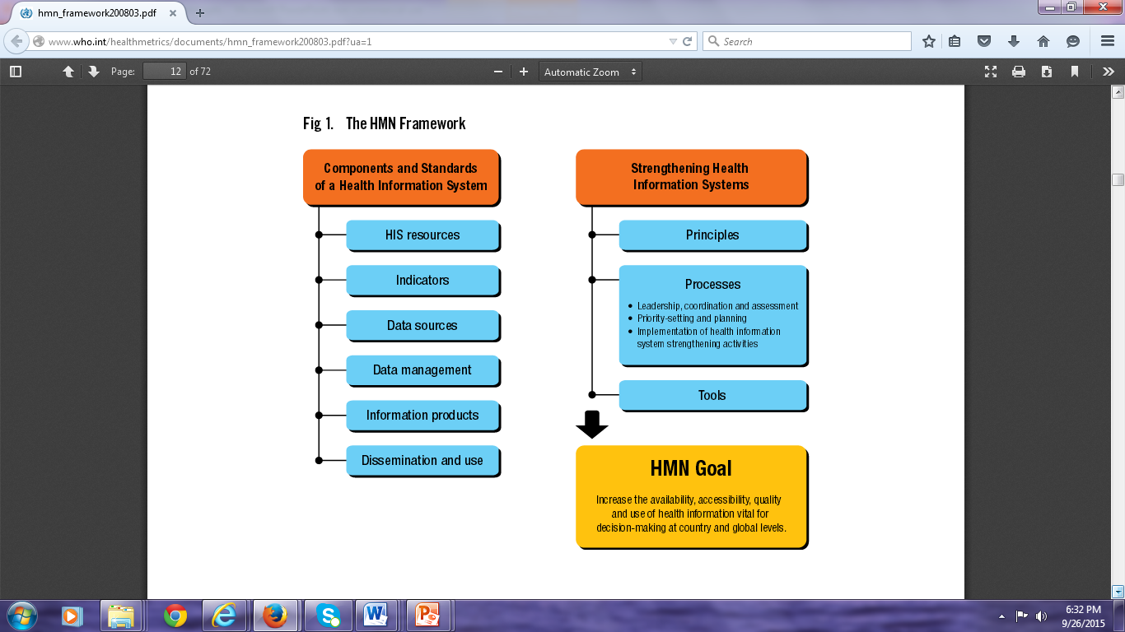
The 6 Components of (R)HIS
(from the HMN Framework)
Inputs
  1. Resources
    RHIS leadership, governance, and management
    Financial, logistic, human, and ICT resources
Processes
  2. Indicators
  3. Data sources
  4. Data management
Outputs
  5. Information products
  6. Dissemination and use
Notes:
In follow-up of Module 1, where the six components of an HIS were presented and discussed, this module is about how we can strengthen each of the components.
In order to do so, we need to ask the participants what is their experience in HIS strengthening in their country.
Ask participants to give examples of RHIS leadership and governance structures in their country, capacity building mechanisms, forums for bringing in various stakeholders for sharing RHIS strengthening work, and coordinating efforts to design/improve RHIS resources; what ICT resources are available in their country and who is managing / governing them. Similarly, what are the various data sources in their country, and how are they managed? Is it by a forum where different stakeholders come together and collaborate/cooperate, or is it done individually by each partner without any linkages?
Similarly, ask what RHIS products they have that are regularly produced in their country, such as an annual health bulletin, policy briefs, web-based dashboards on important indicators. Are these products at national levels? Do they have anything at district / state level? How is the RHIS information disseminated and used? Do the participants have any examples to share?
Record their responses on a large display paper and reiterate the richness of examples across the countries and show that one country might not have all the good examples, but can learn from all the good examples across the countries.

Slide 4
Case Study: Bangladesh
Answer the following questions:
  Who is leading the RHIS strengthening process in Bangladesh?
  Are the RHIS strengthening efforts responsive to the country needs and demands?
  Is the RHIS reform a total rehashing? Or is it building on what exists?
  Was there stakeholder engagement and broad-based consensus?
  Is RHIS integration part of the strategies?
Notes:
Before showing this slide, provide the handout “Case Study: Strengthening the RHIS of the Ministry of Health and Welfare, Bangladesh” to the participants for their review. Once they have read the case study, show them this slide and ask, who is leading the RHIS strengthening process in Bangladesh?

Slide 5
The Guiding Principles for HIS/RHIS Development/Strengthening
Country leadership and ownership
Responsive to country needs and demands
Building on existing initiatives and systems
Broad-based consensus and stakeholder involvement
Gradual and incremental process with long-term vision
Integration
Notes:
Use this slide to summarize and emphasize that any effort to design, reform, and strengthen the country’s RHIS should have the country in the lead and they should own the process in terms of making themselves accountable for the RHIS reform; setting reform objectives and goals; and harnessing collaboration and inclusiveness.
One basic principle is to build on the existing systems and initiatives and do it in a gradual, incremental manner.
Ask the participants why it is important to have broad-based consensus and stakeholder involvement and to encourage integration as a basic principle of RHIS reform. Ask the participants to give some examples from their countries where they have gone for (or did not go for) broad-based engagement of stakeholders and how that was helpful for (or an impediment to) bringing in the RHIS reform.

Slide 6
How Would You Go About RHIS Strengthening?
How will you change the existing rhis to make it a stronger and more effective one?
How can we make sure it is sustainable?
Notes:
Inform the participants that having discussed the higher-level guiding principles and components of RHIS strengthening, we will now focus on the pathways to RHIS strengthening.
Remind the participants of the PRISM framework and how the RHIS outputs are affected by RHIS inputs and the technical, organizational, and behavioral determinants of RHIS performance. Based on that concept, ask the participants to develop a theory of change for RHIS.
Allow some time for the participants to reflect on their thoughts. Then show the next slide and the handout.

Slide 7
RHIS Strengthening Theory of Change
Notes:
Refer participants to the handout “RHIS Strengthening Theory of Change.”
Explain that there are three main thematic pathways to strengthen RHIS: improving data quality; improving data use; and improving RHIS management; and that various technical, organizational and behavioral intervention are necessary in each pathway to strengthen the RHIS.

Slide 8
ROUTINE HEALTH INFORMATION SYSTEMS
A Curriculum on Basic Concepts and Practice
This presentation was produced with the support of the United States Agency for International Development (USAID) under the terms of MEASURE Evaluation cooperative agreement AID-OAA-L-14-00004. MEASURE Evaluation is implemented by the Carolina Population Center, University of North Carolina at Chapel Hill in partnership with ICF International; John Snow, Inc.; Management Sciences for Health; Palladium; and Tulane University. The views expressed in this presentation do not necessarily reflect the views of USAID or the United States government.

