Slide 1
ROUTINE HEALTH INFORMATION SYSTEMS
A Curriculum on Basic Concepts and Practice
MODULE 10:
RHIS Design and Reform
SESSION 3. RHIS Reform in the Context of Scalability and Sustainability
The complete RHIS curriculum is available here: https://www.measureevaluation.org/our-work/ routine-health-information-systems/rhis-curriculum

Slide 2
Session 3: RHIS Reform in the Context of Scalability and Sustainability
Learning Objectives
By the end of this module, participants will be able to:
Describe data requirements and data collection and reporting tools at different levels (including ICT)
Describe key considerations in the design of data recording and reporting tools (especially in the context of scalability and sustainability)
Explain the core elements of an RHIS strengthening/scale-up plan
Notes:
Explain the learning objectives of Session 3 of Module 10.

Slide 3
Session 3: RHIS Reform in the Context of Scalability and Sustainability
Topics Covered
Key considerations for data collection and reporting tools (including ICT)
Match data requirements to data sources/tools
Translate an assessment result into an action plan
Notes:
Explain the topics covered in Session 3 of Module 10.

Slide 4
Examples of Key Considerations in the Design of RHIS Data Collection and Reporting Tools
Purpose of data collection and reporting (three management levels)
Participatory design of data collection and reporting instruments through an iterative process
Task oriented to and integrated in users’ workflow:
Identification of users’ functions;
Meeting the users’ data needs for those functions;
Supporting service quality or system management
Cost: monetary (one-time and recurrent); staff time; technical assistance requirements (one-time and recurrent);
Notes:
Inform the participants that in the previous session (and also in Module 2), we talked about indicator selection, prioritization, and deciding on the data elements. In this session, we will be talking about the design of the data collection and reporting tools.
Ask the participants what would be their key considerations when design such tools. Show this slide and summarize some of the key considerations when developing data collection and reporting tools.

Slide 5
Exercise: Design of RHIS Data Collection and Reporting Tools
Based on previous work on maternal survival strategies in this module, discuss:
Types of tools (paper-based, electronic, combined, longitudinal patient record, and service registry) that would be most appropriate in a health facility and a community healthcare setting
Ease of extracting data from such tools for reporting on the indicators selected in the previous activity
After 45 minutes, each group presents its work to the plenary group.
Notes:
Refer participants to the handout “Maternal Survival Strategies.”
Pick a few indicators and ask the participants to consider:
Data elements that should be collected for meeting those information needs
Types of tools (paper-based, electronic, combined, longitudinal patient record, and service registry) that would be most appropriate in a health facility and a community healthcare setting
Ease of extracting data from such tools for reporting on the indicators selected in the previous activity
After 45 minutes, each group presents its work to the plenary group.
Acknowledge and summarize the activity and reiterate that the purpose of this exercise was to walk participants through the process of designing data collection tools to help them understand the key considerations involved.

Slide 6
Core Processes of RHIS Strengthening/Scale-Up
Assessment & analysis
Statement of the problem
Root cause analysis
Prioritize: List RHIS components that need strengthening
Planning
Define objectives
Propose interventions
Technical (including ICT)
Organizational
Behavioral
Decide timeline and assign responsibilities
Implementation
Monitoring & evaluation
Notes:
Note:
Use this slide to relate the RHIS strengthening/scale-up process to the Assess-Plan-Implement (See-Plan-Do) cycle.

Slide 7
Problem Statement
Good problem statement should be:
Specific in explaining the existing situation or phenomenon
Measurable: compare the situation with a target or standards to show the gap
Helpful for writing effective management objectives
Notes:
Here the intention is to move from present to future. Thus, the management objective should be able to specify change over a period of time. For example, data quality is 30% and will improve to 60% in six months.

Slide 8
Problem Statement: Examples
HIS Performance and Processes | Problem Statement
Data quality | Data quality is 70%, but the target was 90%+5%, indicating a gap of 20%.
Use of information | Information use is 40%, but the target was 60%+5%, indicating a gap of 20%.
Management information needs/ indicators | The information is collected through different channels, creating duplication, redundancies, and waste of time.
Data collection | 70% of the facilities filled out all data cells/items in the monthly report form, but the target was 95%, indicating a gap of 25%.
Data transmission | 80% of the facilities submitted their report on time, but the target was 95%, indicating a gap of 15%.
Data processing | 70% of the districts have two or more people trained in data entry, but the target was 100%, indicating a gap of 30%.

Slide 9
Problem Statements: Examples
HIS Performance and Processes | Problem Statement
Data analysis | 60% of the districts produced standardized tables based on management questions, indicating 40% have not met the target.
Information display | 40% of the facilities displayed updated information, but the target was 70%, indicating a gap of 30%.
Data quality check | 40% of the facilities carried out data quality checks before submitting reports, but the target was 80%. No tool exists for checking data quality at district or higher levels. 20% of the districts carry out data quality assessments on a quarterly basis.
Feedback | 10% of the districts provide feedback reports on a monthly basis, but the target was 100%.

Slide 10
What Makes a Good Management Objective?
Specific: Identifies concrete events or actions that will take place
Measurable: Quantifies the amount of resources, activity, or change to be expended and achieved
Appropriate: Logically relates to the overall problem statement and desired effects of the program
Realistic: Provides a realistic dimension that can be achieved with the available resources and plans for implementation
Time-bound: Specifies a time within which the objective will be achieved

Slide 11
Guidance to Write Objectives
To | [action] | What
The | [specify what knowledge, attitudes, skills, behaviors]
Among | [specify population or segment] | Who
From–to | [from baseline to desired level] | How much
Or by | [x percent]
Or to | [specific level]
By | [timeframe] | When

Slide 12
Deciding Solutions/Interventions
Use the following criteria to prioritize alternative solutions:
Time required to implement the solution
Cost of implementation
Potential for improving the situation
Availability of resources
Notes:
Ask participants: Once the root cause is identified, what is the next step?
The next step is to decide on solution(s) or intervention(s) to resolve the problem.

Slide 13
Prioritizing Solutions and Interventions
Criteria (Rank 1–3) | Action 1 | Action 2 | Action 3
Time to implement 1=most; 3=least time
Cost to implement 1=highest; 3=least
Potential for improving in the long term 1= least; 3=most potential
Availability of resource 1= least; 3=most available
Total
Notes:
Other things you might want to add to this list are feasibility, magnitude, and existing capacity. Various scaling mechanisms can be used (1–4, or 1–5, etc.)
Pick up the intervention that scored higher in the total.

Slide 14
Interventions to Improve RHIS Performance
Technical interventions
Organizational interventions
Behavioral interventions

Slide 15
Examples of Technical Interventions
Define a set of essential indicators
Information needs to be adapted to management functions of the health system at all levels
Standardize data generation architecture based on best practices
Revising/simplifying data collection instruments
Developing computerized data entry/data processing applications
Streamlining data flows within the MOH

Slide 16
Examples of Technical Interventions
Development of a computerized data analysis/presentation application: DSS
Build a data warehouse

Slide 17
Examples of Organizational and Behavioral Interventions
Let us go a step further...
Create incentives for use of information (Pakistan; Uganda)
Promote HMIS self-assessment (Uganda)
Capacity building of health professionals (pre-service and in-service) in using information for data management based on a problem-solving approach (Thailand)
Undertake participatory decision space analysis in decentralized district-managed health systems (Pakistan)
Notes:
But technical interventions are not sufficient. We need to go a step further.
Create incentives for use of information (Pakistan; Uganda):
In Uganda district level indicators were published in the local newspaper. It created incentives for the DHMT to take action and improve the service delivery indicators
Promote HMIS self-assessment (Uganda)
Monthly data review meetings were organized where district health management teams were examining the data for the previous month and taking action on gaps in data quality and in use of information for decision making
Capacity building of health professionals (pre-service and in-service) in using information for data management based on a problem-solving approach (Thailand)
Undertake participatory decision space analysis in decentralized district-managed health systems (Pakistan)
Decision space analysis helped to better identify roles and responsibilities at national versus district level
This in turn led to better use of information for decision making

Slide 18
Examples of Organizational and Behavioral Interventions
Let us go a step further...
Provide sufficient and appropriate resources: staffing, equipment/supplies, ICT, financial resources
Integration of public/private RHIS
Provide advocacy skills to district and facility managers (Honduras; Paraguay)
Notes:
But technical interventions are not sufficient. We need to go a step further.
These are other examples of organizational interventions:
Provide advocacy skills to district and facility managers (Honduras, Paraguay)
Discuss with participants examples of advocacy
This will be followed by Slides 10.3.18 through10.3.21

Slide 19
Advocacy for RHIS Improvement
Advocacy is focused on handling those causes that have been prioritized as “not under your control” and “need assistance” from others to be resolved
RHIS improvement needs involvement of other people within and outside the organization
Advocacy assumes that change can be achieved by overcoming obstacles through assistance from others

Slide 20
Advocacy Chart for Improving Data Quality
HIS information for advocacy | Expected outcomes (specify what you want) | Whom to influence (who will bring the desired outcome) | Strategy (how to influence the decision maker)
Data quality is only 40%. No training plan or manuals exist. MOH does not have the capacity or funds to hire a consultant to develop a training plan and manual. | Availability of funds to implement training plan, human resources, training curriculum, and supplies to train staff on data quality | Donors | Build alliance within the MOH Build alliance with a training institute Network with donors

Slide 21
RHIS Implementation
Will depend on types of planned and approved interventions such as:
Hiring dedicated and highly skilled staff
Developing/adapting or using appropriate HMIS tools to bring changes
Applying sound and proven strategies and approaches on the ground (supportive supervision/targeted supervision)
Capacity building at individual, institutional, and system levels

Slide 22
M&E of RHIS Scale-Up
Selection of inputs, process, outputs, and outcome indicators for RHIS implementation
Early monitoring of progress on activities to enable corrective action and modifications if needed
Mid- and end-term evaluations of the implementation’s progress (an example is the PRISM assessment in Liberia—next slide)
Research when identified gaps are difficult to address

Slide 23
Group Work: Effect of RHIS Strengthening on RHIS Performance in Liberia
Participants will read the PRISM assessment report from Liberia in the handout.
In Liberia, a PRISM assessment was conducted in 2012 and an action plan was drafted to improve identified gaps in RHIS performance. A second PRISM assessment was implemented in 2014.
QUESTIONS:
Did the 2012 RHIS strengthening plan improve RHIS performance? Explain why or why not.
What would you recommend after the 2014 PRISM assessment? Propose at least one technical/organizational/behavioral intervention.
Notes:
Ask participants to read the handout “Performance of Routine Health Information System Management in Liberia: PRISM Assessment, October 2014."
The facilitator divides the participants in four groups.
Read the questions out loud and explain time management:
Read the paper (mainly starting on page 32) (20 min)
Group discussion (40 minutes)
Put answers to the two questions on flip chart paper and stick it to the wall (15 minutes)
Gallery walk (30 minutes)
Groups walk around to read one another’s answers

Slide 24
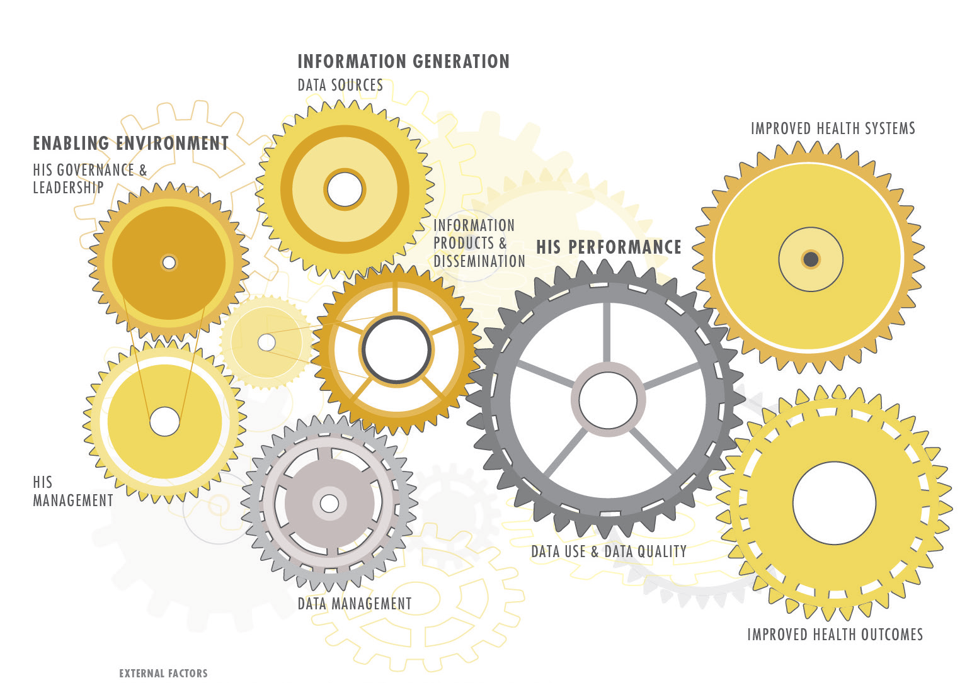
HEALTH INFORMATION SYSTEM
STRENGTHENING MODEL
ICT support
DONORS • GLOBAL INITIATIVES • CIVIL/POLITICAL UNREST • DECENTRALIZATION • DISEASE OUTBREAKS • SOCIOECONOMIC STATUS • NATURAL DISASTERS • UTILITIES
Notes:
FINAL SUMMARY SLIDE
The HISS Model (MEASURE Evaluation)

Slide 25
ROUTINE HEALTH INFORMATION SYSTEMS
A Curriculum on Basic Concepts and Practice
This presentation was produced with the support of the United States Agency for International Development (USAID) under the terms of MEASURE Evaluation cooperative agreement AID-OAA-L-14-00004. MEASURE Evaluation is implemented by the Carolina Population Center, University of North Carolina at Chapel Hill in partnership with ICF International; John Snow, Inc.; Management Sciences for Health; Palladium; and Tulane University. The views expressed in this presentation do not necessarily reflect the views of USAID or the United States government.

