Slide 1

ROUTINE HEALTH INFORMATION SYSTEMS
A Curriculum on Basic Concepts and Practice
MODULE 3:
Data Management Standards for Routine Health Information Systems
SESSION 1:
Introduction to RHIS Data Management
The complete RHIS curriculum is available here:
https://www.measureevaluation.org/our-work/ routine-health-information-systems/rhis-curriculum

Slide 2
Learning Objectives and Topics Covered
Learning Objectives
Appreciate the importance of good RHIS data management practices
Describe data management needs at the three RHIS management
levels
Describe data management standards
Understand how a standards-based approach to RHIS data
management can improve RHIS performance (and help create a
culture of information)
Topics Covered
Introduction to RHIS data management
Data-management needs of the different RHIS management levels
Overview of data management standards, themes, and guidelines

Slide 3
Importance of Data Management
Good data management practices ensure that data are of high quality (reliable, consistent, and complete) as well as readily available to stakeholders.
Data management entails putting personnel, policies, procedures, and organizational structures in place to ensure that data are accurate, consistent, secure, and available.
Notes:
In the context of RHIS, data management is defined as “the development, execution, and supervision of plans, policies, programs, and practices that control, protect, deliver, and enhance the value of data and information assets” for decision making.

Slide 4
RHIS Data Management: Four Domains
4 DOMAINS
Management & Governance
Data Collection & Processing
Data Analysis, Dissemination, & Use
Data & Decision Support Needs
Notes:
Governance of RHIS Data Management
This domain is covered in detail in Module 7.
Users’ Data and Decision Support Needs
This domain is covered in detail in Module 2.
Data Collection AND Processing
Data are collected in two ways—routinely and nonroutinely—and all national systems use both routinely and nonroutinely collected data for planning and managing their health services. The choice of appropriate data collection methods is linked to the frequency of decision making and the complexity and cost of data collection. (More details are given in Module 2.)
DATA ANALYSIS, DISSEMINATION, and USE
After data are collected, they need to be processed, checked for quality, and transmitted to higher levels. At all levels, data need to be stored in a way that ensures confidentiality and that encourages regular analysis at the local level and regular use to improve service delivery.
Once analyzed, data need to be disseminated to data collectors through feedback and, through modern web portals, to users: other health workers and managers, policymakers, and the international community. (More details on this are in modules 5 and 6.)

Slide 5
Data Needs are Different at Different Levels
Beneficiary-Level Use
Facility-Level Use
Systems-Level Use
Clinical practitioners need clinical data on a daily basis during primary care encounters and ward rounds and they use local laboratory and other diagnostic data to monitor patients’ health improvement (preventive, curative, and promotional)
Facilities managers regularly need data to improve facility infrastructure, equipment, commodities, and human resources
From the district level to the national level, system managers need data to monitor and plan for health service delivery: data on health status, on services provided, and on management of resources such as personnel, equipment, supplies, transport, drugs and vaccines, and finances.
Notes:
Beneficiary-Level Use
Clinical practitioners need clinical data on a daily basis during ward rounds and use local laboratory and other diagnostic data to monitor patients’ clinical improvement. They particularly need data to follow up on patients with significant needs, such as pregnant women, children under five, and patients with chronic infectious diseases and chronic noncommunicable diseases.
Facility-Level Use
Facilities managers regularly need data to improve facility infrastructure, equipment, and human resources. They need to know norms for infrastructure and basic service packages and staffing and equipment standards, and then calculate indicators that will give them a picture of the resources required for their service areas.
Systems-Level Use
From the district level up to the national level, system managers need data to monitor and plan for health service delivery: data on health status, on services provided, and on management of resources such as personnel, equipment, supplies, transport, drugs and vaccines, and finances.
The more data are used at lower levels, the better the quality of the entire HIS.
For Data Sources, see RHIS Data Collection and Reporting Tools (Module 2, Session 2).

Slide 6
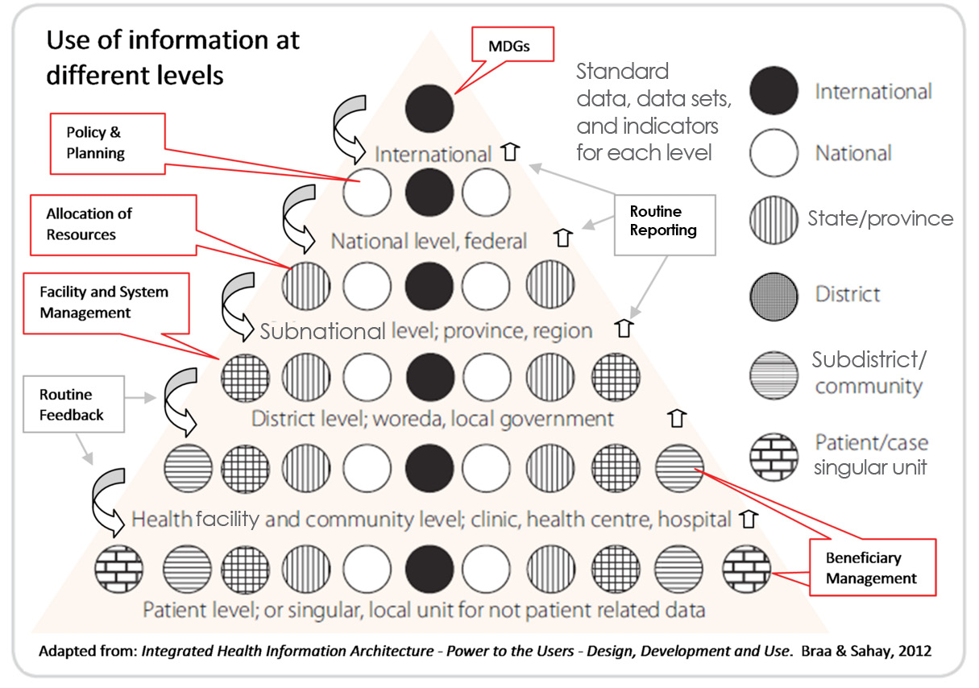
Data Needs at Different Levels

Slide 7
Data Management at Different Health System Management Levels
Beneficiary Management Level
  Provision of healthcare
Health-Facility Management Level
  Health facility functions
System Management Level
  Planning; M&E
  Governance
  Public health interventions
Notes:
When we talk about data management, it also helps to think about the different data management responsibilities that are performed at different levels of the health system. This will help define the standards at each level. Here we use the health-services system model with three management levels:
Beneficiary Management Level
Beneficiaries comprise patients and clients, including the community. We show how information is managed to benefit the health of individuals and groups of individuals through prevention, promotion, rehabilitation, and cure.
Health-Facility Management Level
One purpose of managing information is to improve the functioning of the health facility (i.e., the dispensary, health post, health center, or hospital) to ensure adequate human, material, and financial resources—equipment, infrastructure, and organization—to provide services for the beneficiaries.
System Management Level
We also take a system-level look at the four domains, exploring the topics from district level and subnational levels (i.e., province, state, and region) through national and international levels. In covering system management, we look at inputs, processes, outputs, and outcomes, and occasionally measure impact.

Slide 8
Information Needs and Indicators
Step 1: Conduct an Analysis of Management Functions
Participative analysis of management functions and decision-making processes of all levels of the health system. The analysis should take into account:
Priority health problems and national goals and strategies, addressing them in national health policies and strategic plans
Existing indicators and their current use in management and M&E
Management processes to plan, monitor, and control the services and resources
Health resources (e.g., manpower, materials, and money) available for carrying out these essential services
The essential package of health services defined for prevention, promotion, and management of these priority problems
Notes:
Step 1: A Functional Analysis of Management
Defining information needs starts with a participative analysis of management functions and decision-making processes (i.e., business process analysis) of all levels of the health system. The analysis should include both individual client care and essential public health functions for institution and system management. The analysis should take into account:
Priority health problems and national goals and strategies addressing them in national health policies and strategic plans
The essential package of health services defined for prevention, promotion, and management of these priority problems
Health resources (e.g., manpower, materials, and money) available for carrying out these essential services
Management processes to plan, monitor, and control the services and resources
Existing indicators and their current use in management and M&E

Slide 9
Information Needs and Indicators
Step 2: Identify Information Needs and Select Indicators
Information should be identified to be relevant to managing and monitoring RHIS functioning.
Indicators should be SMART (Specific, Measurable, Agreed upon, Relevant, Time-Bound).
Indicators should be balanced and economical, improve the quality of routine data, be operationally feasible, and meet national needs.
Indicators should be extensively used to monitor and evaluate plans and must be closely aligned to the planning process.
Notes:
Step 2: Identify Information Needs and Select Indicators
After priority services and available resources have been defined, it is possible to identify the information that would be relevant to managing and monitoring RHIS functioning.
Based on these information needs and an evaluation of existing indicators’ use, a limited number of additional indicators can be developed or adapted. These additions should be based on indicators’ reliability, validity, specificity, and sensitivity, as well as on the resources needed to collect the data and the decisions that could be based on the indicators.
The final indicator set should be balanced and economical, improving the quality of routine data and defining indicators that are operationally feasible and that will meet national needs. These indicators should then be rigorously field-tested and regularly reviewed.
Indicators are extensively used to monitor and evaluate plans and must be closely aligned to the planning process.

Slide 10
Data Collection and Storage
Health records, reports, registers, and other data collection instruments should be archived at health facilities after their use and preserved typically for five to 10 years, depending on the policy established by a country’s health ministry.
These data and records are useful for documenting medical histories, maintaining continuity of care, monitoring and evaluating service delivery, resolving legal disputes, and performing data quality assessments and audits.
Notes:
Increasingly, programs are being audited to document a return on investment to investors (e.g., taxpayers). Data quality audits help develop confidence in the results reported by programs, ensuring that the availability of program documentation facilitates auditing. Historical records are also useful for resolving data quality problems that may be detected only after a significant passage of time.

Slide 11
Types of Data Storage
Paper Storage
Decision as to whether to allow clients to keep their own record cards (e.g., child health program), or whether to build and maintain appropriate facility filing and archiving systems
Electronic Storage
Collection of individual electronic health records (EHRs) and ranges from storage on simple Excel spreadsheets to storage on standard servers or sophisticated servers in the cloud
Server Hosting
A server is a system comprising software and suitable computer hardware that responds to requests across a computer network to provide, or help to provide, a network service (such as data storage)

Slide 12
Pros and Cons: Data Storage by Type
TYPE | PROS | CONS
Paper Storage (Client-Held Records) | Stimulate patients to take responsibility for their own healthcare Enable clients to go to the facility of their choice | Patients can lose their cards, or forget to bring them when visiting a facility. Cards get wet and deteriorate. Follow-up of chronic patients is more difficult.
Paper Storage (Storage System) | Keep all patients’ information in the facility for treatment and follow-up | Storage systems need to be well-designed and properly maintained, or patients will suffer delays while records are retrieved.

Slide 13
Pros and Cons: Data Storage by Type
TYPE | PROS | CONS
Electronic Storage (Excel) | Widely available and simple to use. | Not suitable for continuous regular entry of data from multiple sources. Applications in Access, Oracle, etc. should be used.
Server Hosting (Conventional ) | Perform better than most cloud servers | If fails, have to build a new server, reinstall the operating system, and restore data. High monthly costs
Server Hosting (Cloud) | Cost-efficient Almost unlimited storage Backup and recovery Quick deployment | Technical issues Security in the cloud Susceptible to attack

Slide 14
Data Confidentiality Principles
Health data must be kept confidential at service delivery sites to ensure that sick people are treated fairly and with the respect they deserve.
Ensuring data confidentiality should be prioritized when data are collected, transmitted, and stored.
Clear guidelines and policies specific to each level should be observed.

Slide 15
Data Confidentiality Rules
Data should be kept in a secure location.
Access permissions must be controlled.
Where paper records can be taken must be limited. For example, rules should prescribe where they can be accessed and removing them from secure locations should be prohibited.
Electronic records and files should be password-protected.
Only aggregate data should be transmitted, because patient-level data serve little purpose at higher levels.
A confidentiality agreement must be signed, and renewed annually, by all staff members who access confidential records.
Notes:
Data are kept in a secure location: for paper records, a locked filing cabinet in a locked room.
Access permissions must be controlled; only staff at a certain level have access to records.
Where paper records can be taken must be limited. For example, rules should prescribe where they can be accessed and removing them from secure locations should be prohibited.
Electronic records and files should be password protected: each file and each computer. Only specific cadres should be given access to passwords.
Only aggregate data should be transmitted, because patient-level data serve little purpose at higher levels. In the context of health research, where patient-level data are needed, records must be guarded well and specific protocols must be maintained to ensure data confidentiality.
A confidentiality agreement must be signed, and renewed annually, by all staff members requiring access to confidential records. The agreement should state the conditions under which records can be accessed.

Slide 16
Data Management Governance
Definition: The development and implementation of administrative policies, procedures, and processes that define workflow, program inputs and outputs, management structure, and the methods and frequency of performance evaluation
Dictates how different levels and components of the RHIS work together to achieve a common goal: high-quality health data for decision making
Ensures that data are high-quality—reliable, consistent, complete, and timely—as well as readily available to stakeholders
RHIS governance is mainly addressed in Module 7
Notes:
The fourth domain is governance of RHIS data management. This will be addressed again in Module 7, which deals more broadly with the governance of the RHIS. Here we will take a few minutes to discuss what governance means in the context of data management and why it is relevant.
In the context of RHIS data management, governance can be defined as the development and implementation of administrative policies, procedures, and processes that define workflow, program inputs and outputs, management structure and oversight functions, and the methods and frequency of performance evaluation.
Data management governance dictates how the different levels and components of the RHIS work together to achieve a common goal: high-quality health data for decision making.
Data management governance ensures that data are high-quality—reliable, consistent, complete, and timely—as well as readily available to stakeholders (i.e., consumers, or those who require health information to inform decision making). In practical terms, that means putting personnel, policies, procedures, and organizational structures in place to ensure that data are accurate, consistent, secure, and available.
Interventions to improve governance should address the institutional, behavioral, and technical determinants of RHIS performance and focus on improving the desired RHIS output of good-quality data that are regularly used to improve service delivery.

Slide 17
Information Culture and Demand for Data
The most visible outcome of a successful information culture is that information is in demand, valued as an important resource, and used at all levels to:
Improve service delivery to clients
Manage systems at that level
Strengthen facility management
Notes:
Well-designed data management systems, combined with appropriate skills, adequate local resources, and effective standard operating procedures are the most important factors in ensuring information use. If the system is designed primarily to support district-level decision making and if some of these data flow up collaterally, then there is a high chance that data quality will consistently improve and that data will be used effectively for informed decision making. The health system’s organization is intimately linked to information demand. The more that decision making and funding are decentralized, the better the chance that information will be in demand and used at lower levels to improve service delivery. Moreover, decentralized capacity and resources for decision making, combined with increased granularity of data and availability of user-friendly analysis and display tools, enhance the quality of decision making at all levels.

Slide 18
Plenary Discussion
Q/A

Slide 19
ROUTINE HEALTH INFORMATION SYSTEMS
A Curriculum on Basic Concepts and Practice
This presentation was produced with the support of the United States Agency for International Development (USAID) under the terms of MEASURE Evaluation cooperative agreement AID-OAA-L-14-00004. MEASURE Evaluation is implemented by the Carolina Population Center, University of North Carolina at Chapel Hill in partnership with ICF International; John Snow, Inc.; Management Sciences for Health; Palladium; and Tulane University. The views expressed in this presentation do not necessarily reflect the views of USAID or the United States government.

