Slide 1

ROUTINE HEALTH INFORMATION SYSTEMS
A Curriculum on Basic Concepts and Practice
MODULE 4:
RHIS Data Quality
SESSION 1:
Introduction to Data Quality
The complete RHIS curriculum is available here:
https://www.measureevaluation.org/our-work/ routine-health-information-systems/rhis-curriculum

Slide 2
Learning Objectives and Topics Covered
Objectives
Understand the data quality conceptual framework
Become familiar with the dimensions and metrics of data quality
Understand what different RHIS management levels can do to ensure data quality
Identify the main types of data quality problems
Topics Covered
Define data quality
Link between data quality and quality assurance
Data-quality conceptual framework
Metrics of data quality
Common threats to data quality

Slide 3
What Is Data Quality?
Data quality is often defined as “fitness for use.”
What does this mean?
Data are fit for their intended uses in operations, decision making, and planning.
Data reflect real value or true performance.
Data meet reasonable standards when checked against criteria for quality.

Slide 4
Importance of Data Quality
High-quality data help providers and managers:
  Form an accurate picture of health needs, programs, and services in specific areas
  Inform appropriate planning and decision making (such as staffing requirements and planning healthcare services)
  Inform effective and efficient allocation of resources
  Support ongoing monitoring, by identifying best practices and areas where support and corrective measures are needed
Notes:
Emphasize the importance of high-quality data for effective decision making: Good decisions cannot be based on bad data.
Explain that bad data may mislead management about the true circumstances of a situation (health status), such as data gaps and gross errors.
Explain the meaning and use of high-quality data (what high-quality data are, and why they are important).
Examine the importance of high-quality data from different perspectives, and how high-quality data provide clues to health status and can help identify problems.

Slide 5
Symptoms of Data Quality Problems
Different people supply different answers to the same question.
Data are not collected in a standardized way or objectively measured.
Staff suspect that the information is unreliable, but they have no way of proving it.
There are parallel data systems to collect the same indicator.
Notes:
Ask participants: What are some signs that can alert you that there might be a problem with data quality? Listen to their responses. Then discuss the bullet points on the slide.

Slide 6
Symptoms of Data Quality Problems (2)
Data management operational processes are not documented.
Data collection and reporting tools are not standardized; different groups have their own formats.
Too many resources (money, time, and effort) are allocated to investigate and correct faults after the fact.
Mistakes are spotted by external stakeholders (during audits).
Notes:
Here are some more symptoms of a data quality problem.

Slide 7
What Is Quality Assurance?
“A program for the systematic monitoring and evaluation of the various aspects of a project, service, or facility (and taking actions accordingly) to ensure that standards of quality are being met” (Merriam-Webster Dictionary)
Notes:
Facilitator: Read the Merriam-Webster Dictionary definition and add "That means doing the right thing the right way"

Slide 8
What Is Data Quality Assurance?
A systematic monitoring and evaluation of data to uncover inconsistencies in the data and data management system, and making necessary corrections to ensure quality of data
Notes:
This slide adapts the quality assurance definition on the previous slide to data quality assurance. After reading the definition on the slide, explain "This means that the data are fit for their purpose and use.”

Slide 9
Quick Plenary Discussion
What are the roles and responsibilities that should be carried out at each level of the health system
to assure production of high-quality data?
Notes:
Because data quality is a product of systemic M&E of data and data production, ask participants to volunteer their ideas about what needs to be in place to support high-quality data at each management level of the health system.
Discussion should be 10 minutes.

Slide 10
Maintaining Data Quality by RHIS Management Level
Health Facilities
(Service Delivery Sites)
Intermediate Level
Central Level
Provide guidelines on data collection, reporting, and management procedures
Review reports received; submit aggregated reports
Ensure timeliness and completeness of reporting
Collect and enter initial data
Ensure timeliness and completeness of reporting
Monitor quality of data throughout all levels
Summarize patient data and check quality of registers
Monitor quality of data captured and reported
Monitor quality of data captured and reported
Complete, verify, and submit summary reports on time
Conduct routine supervisory visits
Conduct routine supervisory visits
Routinely analyze and use data
Routinely analyze and use data
Routinely analyze and use data
Notes:
Service delivery site responsibilities:
Make the first data registration. Depending on the indicator type, this can be patient/client records, registers, training participant list, prevention activity participant list, etc.
Summarize patient/client information on tally sheets, when appropriate, and then complete summary reporting forms (monthly or quarterly), and check the data quality of each.
Submit the validated summary reporting form to the next level of the information system.
Analyze and use data on a regular basis to improve quality of care.
Intermediate site responsibilities:
Collate summary reports and their associated quality checks, including review and approval of aggregate numbers prior to their submission to the next level of the information system.
Ensure that all data, whether paper-based or captured electronically, reach the next reporting level for each established reporting period defined by a given indicator.
Conduct regular supervisory visits (at least quarterly) to lower levels.
Monitor the quality of the data captured by the information systems in place.
Analyze and use data on a regular basis for strategic planning and/or any other related activity.
Central level responsibilities:
Provide the subreporting levels with clear written instructions/guidelines on the completion of data collection and reporting forms and tools, to ensure a common standard response.
Collate summary reports provided by subreporting levels (such as aggregation-level sites or service delivery sites), depending on the type of indicator and how the data flow is organized.
Perform quality checks on reports, including review and approval of aggregate numbers prior to their dissemination.
Conduct regular supervisory visits (at least quarterly) to monitor data quality.
Monitor the quality of data captured by the information systems in place.
Provide written guidelines on reporting requirements and deadlines.

Slide 11
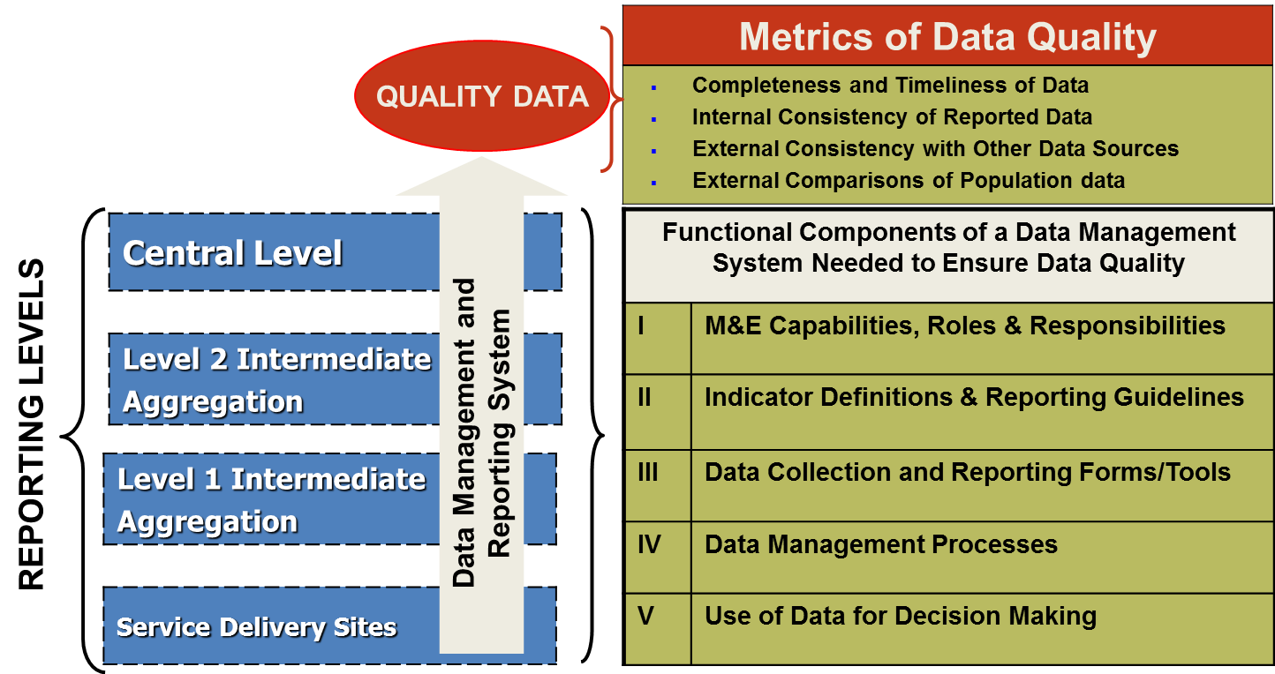
Data Quality Conceptual Framework
Notes:
A conceptual framework is presented that supports the M&E data management and reporting system. This framework is based on three parts:
Reporting levels (such as service delivery sites), intermediate levels, and national M&E (shown in blue on the slide)
Metrics of data quality (shown in rust and green in the top right part of the slide)
Functional components of data management systems (shown in the green section at the bottom right of the slide)
The quality of reported data is often dependent on the underlying data management and reporting systems at the various levels of the information system. Stronger systems routinely produce better-quality data. Data quality problems can occur at any level of the system and systematic efforts should be made to ensure high-quality data at all levels.

Slide 12
Metrics of Data Quality
Completeness and Timeliness of Data: Availability of reports and availability of complete data (up-to-date, available on time, and found to be correct)
Internal Consistency of Reported Data: Plausibility of reported results, trends over time, and consistency between related indicators and potential outliers
External Consistency with Other Data Sources: Level of agreement between two sources of data measuring the same health indicator
External Comparisons of Population Data: Consistency between denominators from different sources used to calculate health indicators
Notes:
Facilitator: Ask volunteers to read the definition of data quality metrics and to provide an explanation for the whole group.

Slide 13
Group Work
Instructions:
In your small subgroups, identify the five most common problems that you think affect data quality.
For each problem, propose actions that could lead to improvements in data quality.
You have 15 minutes to discuss in your subgroups before reporting back for plenary discussion.

Slide 14
Most Common Problems Affecting Data Quality across System Levels
Technical determinants
  Lack of guidelines to fill out the data sources and reporting forms
  Data collection and reporting forms are not standardized
  Complex design of data collection and reporting tools
Behavioral determinants
  Personnel not trained in the use of data sources & reporting forms
  Misunderstanding of how to compile data, use tally sheets, and prepare reports
  Math errors occur during data consolidation from data sources, affecting report preparation
Organizational determinants
  Lack of a reviewing process, before report submission to next level
  Organization incentivizes reporting high performance
  Absence of culture of information use

Slide 15
ROUTINE HEALTH INFORMATION SYSTEMS
A Curriculum on Basic Concepts and Practice
This presentation was produced with the support of the United States Agency for International Development (USAID) under the terms of MEASURE Evaluation cooperative agreement AID-OAA-L-14-00004. MEASURE Evaluation is implemented by the Carolina Population Center, University of North Carolina at Chapel Hill in partnership with ICF International; John Snow, Inc.; Management Sciences for Health; Palladium; and Tulane University. The views expressed in this presentation do not necessarily reflect the views of USAID or the United States government.

