Slide 1

ROUTINE HEALTH INFORMATION SYSTEMS
A Curriculum on Basic Concepts and Practice
MODULE 4:
RHIS Data Quality
SESSION 2:
Data Quality Metrics
The complete RHIS curriculum is available here:
https://www.measureevaluation.org/our-work/ routine-health-information-systems/rhis-curriculum

Slide 2
Learning Objectives and Topics Covered
Objectives
Understand data quality dimensions and metrics
  Completeness and timeliness
  Internal consistency
  External consistency
  External comparisons
Be able to calculate and interpret data quality metrics
Understand data triangulation and how it can strengthen analysis and information use
Topics Covered
Data-quality metrics, with examples
Measurement and analysis of data-quality metrics
Data triangulation

Slide 3
Metrics for Data Quality Performance
Completeness and timeliness
    Completeness of reports
    Completeness of data
    Timeliness of reports
Internal consistency
    Accuracy
    Outliers
    Trends
    Consistency between indicators
External consistency
    Data triangulation
    Comparison with data surveys
    Consistency of population trends
External comparisons (population denominators)
Notes:
Accuracy: Measured against a reference and found to be correct
Completeness: Present, available, and usable
Timeliness: Up-to-date and available on time

Slide 4
Completeness and Timeliness of Data
This examines the extent to which:
Data reported through the system are available and adequate for the intended purpose
All entities that are supposed to report are actually reporting
Data elements in submitted reports are complete
Reports are submitted/received on time through the levels of the information system data flow

Slide 5
Availability and Completeness of Data
Availability of reports (%) =
  # total reports available or received
# total reports expected
Completeness of reports (%) =
# reports that are complete
        (all data elements filled out)
# total reports available or received
Notes:
This slide shows how to measure reporting performance to determine the extent to which data reports are appropriately available, complete, and timely.

Slide 6
Completeness and Timeliness of Data
Completeness of data (%) =
        # values entered (not missing) in the report
        # total data elements in the report
Timeliness (%) =
        # reports submitted or received on time
        # total reports available or received
Notes:
This slide shows how to measure reporting performance to determine the extent to which data reports are appropriately available, complete, and timely.

Slide 7
Internal Consistency of Reported Data
This dimension examines:
The accuracy of reporting of selected indicators, by reviewing source documents
Whether data are free of outliers (within bounds), by assessing whether specific reported values within the selected period (such as monthly) are extreme, relative to the other values reported
Trends in reporting over time, to identify extreme or implausible values year-to-year
The program indicator compared to other indicators with which they have a predicable relationship, to determine whether the expected relationship exists between the two indicators

Slide 8
Accuracy: Data Verification
Quantitative:
Compares recounted to reported data
Assess on a limited scale if sites are collecting and reporting data accurately and on time
In-depth verifications at the service delivery sites
Implement in 2 stages
Follow-up verifications at the intermediate and central levels

Slide 9
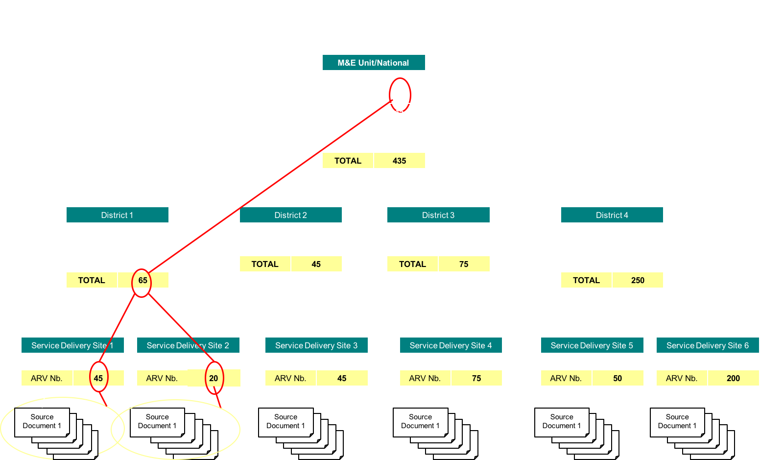
Data Verification Following Data Flow
Notes:
This chart shows that the trace-and-verify protocol starts with data at the level of service delivery. Data are then “traced” to the “intermediate aggregation level” (in this case a district), and then to the central level.

Slide 10
Accuracy: Verification Factor
Verification Factor
Numerator: Recounted data
  Over-reporting: <100%
  Under-reporting: >100%
Denominator: Reported data
Suggested range of acceptability:
100% +/- 10%
(90% –110%)
Notes:
At the heart of the data quality (DQ) process are two important components: data verification (DV) and report performance.
Data verification is derived through quantitative comparison of recounted data and reported data.
The verification factor (VF) is calculated by dividing the recounted number by the reported number, giving a percentage.
*Facilitators: Ask participants, “What would 85% mean? How about 125%?”
Refer to Module 9: RHIS Performance Assessment, concerning the PRISM tools. The diagnostic tool also measures data quality for district and health facility levels.

Slide 11
Verification Factor Example
Data accuracy by district
Indicators flagged in red are verification factors ≥ ±10% of 1.
v | Indicator 1 |  |  | Indicator 2
 | Recounted | Reported | VF | Recounted | Reported | VF
A | 1212 | 1065 | 1.14 | 4009 | 4157 | 0.96
B | 1486 | 1276 | 1.16 | 3518 | 3686 | 0.95
C | 357 | 387 | 0.92 | 672 | 779 | 0.86
D | 2987 | 3849 | 0.78 | 1361 | 1088 | 1.25
E | 4356 | 4509 | 0.97 | 4254 | 3970 | 1.07
Notes:
Recounted data/reported data = VF (verification factor)
When VF is ≥ ±10%, data are considered inaccurate.

Slide 12
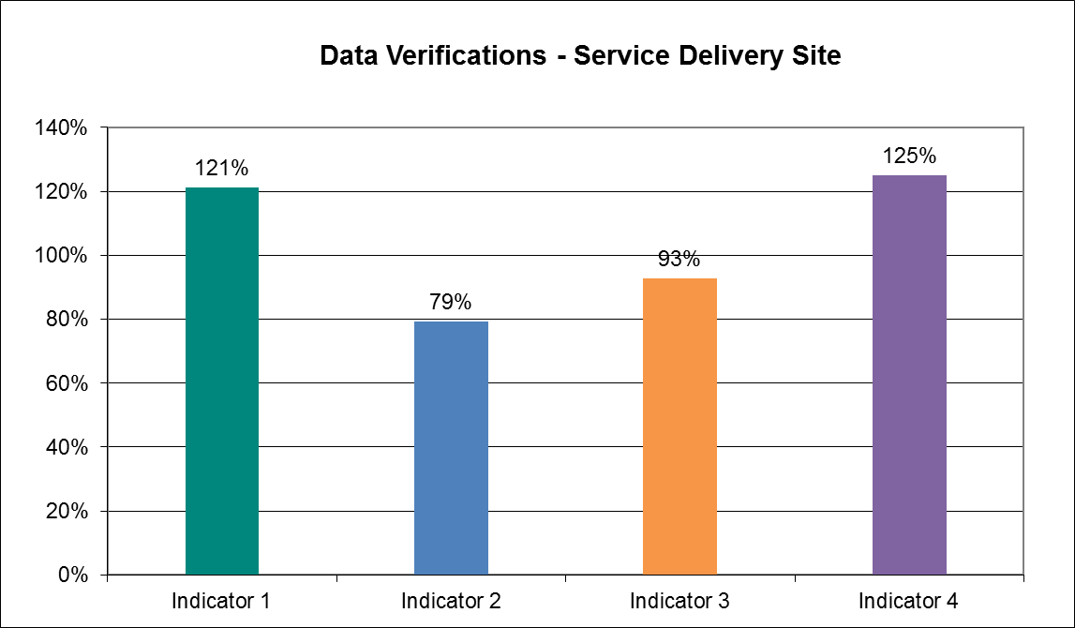
Verification Factors Plotted Graphically DT: Is this animated? See notes.
underreported
over-reported
Notes:
This graph shows the verification factors for four indicators at a service delivery site.
First, we can see that there is a wide variation in the accuracy of these indicators. [CLICK here to animate.] The area marked with red horizontal lines shows a margin of acceptability: plus or minus 10% of 100%, the global standard. However, individual programs can select their own ranges of acceptability, as deemed appropriate.
We also can see that, of the four indicators, three are outside the acceptable margins. [Ask participants:] What would you say about indicators 1 and 4? [After someone answers, CLICK here to animate.]
What about indicator 2? [After someone answers, CLICK here to animate.]
Ideally, we would see no under-reporting or over-reporting of data, with indicators as close to 100% as possible. [CLICK here to animate.]

Slide 13
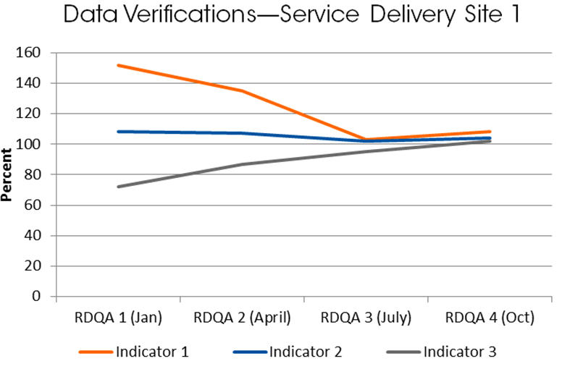
Monitoring Data Quality Assessment
Results over Time
You can use a line graph to plot verification factors over time to show improvements or other changes. This can guide future planning and action.

Slide 14
Internal Consistency: Outliers
Metric | Severity | Definition
 |  | National Level | Subnational Level
Outliers (Analyze each indicator separately.) | Extreme (At least 3 standard deviations from the mean) | % of monthly subnational unit values that are extreme outliers | # (%) of subnational units in which ≥1 of the monthly subnational unit values over the course of 1 year is an extreme outlier value
 | Moderate (Between 2–3 standard deviations from the mean, or >3.5 on modified Z-score method) | % of subnational unit values that are moderate outliers | # (%) of subnational units in which ≥2 of the monthly subnational unit values over the course of 1 year are moderate outliers
Notes:
Outliers = Deviation from the mean

Slide 15
Example: Outliers in a Given Year
Months with at least one moderate outlier on the district monthly reports are shown in red.
Dist | Month |  |  |  |  |  |  |  |  |  |  |  | Total Outliers | % Outliers
 | 1 | 2 | 3 | 4 | 5 | 6 | 7 | 8 | 9 | 10 | 11 | 12
A | 2543 | 2482 | 2492 | 2574 | 3012 | 2709 | 3019 | 2750 | 3127 | 2841 | 2725 | 2103 | 1 | 8.3%
B | 1184 | 1118 | 1195 | 1228 | 1601 | 1324 | 1322 | 711 | 1160 | 1178 | 1084 | 1112 | 2 | 16.7%
C | 776 | 541 | 515 | 527 | 857 | 782 | 735 | 694 | 687 | 628 | 596 | 543 | 0 | 0%
D | 3114 | 2931 | 2956 | 4637 | 6288 | 4340 | 3788 | 3939 | 3708 | 4035 | 3738 | 3606 | 1 | 8.3%
E | 1382 | 1379 | 1134 | 1378 | 1417 | 1302 | 1415 | 1169 | 1369 | 1184 | 1207 | 1079 | 0 | 0%
Nat’l | 0 | 0 | 0 | 0 | 2 | 0 | 0 | 1 | 0 | 0 | 0 | 1 | 4 | 6.7%
Notes:
The table shows moderate outliers for a given indicator. There are four identified moderate outliers. They are highlighted in red. Three of the districts have at least one occurrence of a monthly value that is a moderate outlier.
Nationally, this indicator is a percentage of values that are moderate outliers for the indicator. The numerator for the equation is the number of outliers across all administrative units [in this case, 4]. The denominator is the total number of expected reported values for the indicator for all the administrative units. That value is calculated by multiplying the total number of units (in the selected administrative unit level) with the expected number of reported values for one indicator for one administrative unit. In this case, we have 5 districts and 12 expected monthly reported values per district for one indicator, so the denominator is 60 [5 × 12]. Thus, about 6.7% are moderate outliers [4/60 = 0.0666 × 100, or 6.7 %].
Subnationally, see if you can calculate the number of outliers for each district. Count the districts where there are two or more outliers (for moderate outliers) among the monthly values for the district [1]. Divide by the total number of administrative units [1/5 = 0.25 × 100 = 25%].

Slide 16
Internal Consistency: Trends Over Time
Metric | Definition
 | National Level | Subnational Level
Trends/ Consistency over Time (Analyze each indicator separately.) | Conduct one of the following, based on indicator’s expected trend: Indicators or programs with expected growth: Compare current year to the value predicted from the trend in the 3 preceding years Indicators or programs expected to remain constant: Compare current year to the average of 3 preceding years | # (%) of districts whose ratio of current year to predicted value (or current year to average of preceding 3 years) is at least ± 33% of national ratio
 | Graphic depiction of trend to determine plausibility based on programmatic knowledge

Slide 17
Example: Trends over Time
Consistency trend: Comparison of district ratios to national ratios
Any difference between district and national ratio that is ≥33% is highlighted in red.
District | Year |  |  |  | Mean of Preceding 3 Years (2010-2012) | Ratio of 2013 to Mean of 2010-2012 | % Difference between National and District Ratios
 | 2010 | 2011 | 2012 | 2013
A | 30242 | 29543 | 26848 | 32377 | 28878 | 1.12 | 0.03
B | 19343 | 17322 | 16232 | 18819 | 17632 | 1.07 | 0.08
C | 7512 | 7701 | 7403 | 7881 | 7539 | 1.05 | 0.09
D | 15355 | 15047 | 14788 | 25123 | 15063 | 1.67 | 0.44
E | 25998 | 23965 | 24023 | 24259 | 24662 | 0.98 | 0.16
National | 98450 | 93578 | 89294 | 108459 | 93774 | 1.16
Notes:
Mean of preceding three years (2010, 2011, and 2012) is 93,774 [98,450 + 93,578 + 89,294)/3]
Ratio of current year to the mean of the past three years is 1.16 [108,459/93,774 ≈ 1.16].
The average ratio of 1.16 shows that there is an overall 16% increase in the service outputs for 2013 when compared to the average service outputs for the preceding three years of the indicator.
Subnationally, try to evaluate each district, by calculating the ratio of the current year (2013) to the average of the previous three years (2010, 2011, and 2012). For example, the ratio for District 1 is 1.12 [32,377/28,878].
Then calculate the % of difference between the national and district ratios for each district. For example, for district A:
$\left|\frac{District 1 Ratio − National Ratio}{National Ratio}\right|$ = $\left|\frac{1.121−16}{1.16}\right|$ = 0.03 = 3.0%
The difference between the district ratio and the national ratio for District A is less than 33%. However, there is a difference of approximately 44% for District D between the deliveries ratio and the national ratio.
To calculate this indicator subnationally, all administrative units whose ratios are different from the country’s ratio by ±33%, or more are counted. In this example, only District D has a difference greater than ±33%. Therefore, 1 out of 5 districts (20%) has a ratio that is more than 33% different from the national ratio.

Slide 18
Internal Consistency: Comparing Related Indicators
Metric | Definition
 | National Level | Subnational Level
Consistency among related indicators | Maternal Health: ANC1 - IPT1 or TT1 (should be roughly equal) | # (%) of subnational units where there is an extreme difference (≥ ± 10%)
 | Immunization: DTP3 dropout rate = (DTP1 - DTP3)/DTP1 (should not be negative) | # (%) of subnational units with # of DTP3 immunizations > DTP1 immunizations (negative dropout)
 | HIV/AIDS: ART coverage - HIV coverage (should be <1) | # (%) of subnational units where there is an extreme difference (≥ ± 10%)
 | TB: TB cases notified - TB cases on treatment (should be roughly equal) | # (%) of subnational units where there is an extreme difference (≥ ± 10%)
 | Malaria: # confirmed malaria cases reported - cases testing positive (should be roughly equal) | # (%) of subnational units where there is an extreme difference (≥ ± 10%)

Slide 19
Example: Internal Consistency
% difference between ANC1 and IPT1, by district
Districts with % difference ≥10% are flagged in red.
District | ANC1 | IPT1 | Ratio of ANC1 to IPT1 | % Difference between National & District Ratios
A | 20995 | 18080 | 1.16 | 0.02
B | 18923 | 16422 | 1.15 | 0.02
C | 7682 | 6978 | 1.10 | 0.07
D | 12663 | 9577 | 1.32 | 0.12
E | 18214 | 15491 | 1.18 | 0
National | 78477 | 66548 | 1.18
Notes:
The annual number of pregnant women started on antenatal care each year (ANC1) should be roughly equal to the number of pregnant women who receive intermittent preventive therapy for malaria (IPT1) in ANC, because all pregnant women should receive this prophylaxis. First, we will calculate the ratio of ANC1 to IPT1 for the national level, and then for each district. At the national level, the ratio of ANC1 to IPT1 is about 1.18 [78,477/66,548].
At the subnational level, we can calculate the ratio of ANC1 to IPT1 and the % difference between the national and district ratios.
We see that there is one district (D) with a ratio of ANC1 to IPT1 greater than 20%. We also see that the % difference between the national and district ratios for district D is more than 10%.

Slide 20
External Consistency with Other Data Sources
This dimension examines the level of agreement between two sources of data measuring the same health indicator.
The two sources of data are:
The routinely collected and reported data from the health management information system (HMIS) or program-specific information system
A periodic population-based survey

Slide 21
External Consistency: Compare with Survey Results
Examples of Indicators | Definition
 | National Level | Subnational Level
ANC 1st visit | Ratio of facility ANC1 coverage rates to survey ANC1 coverage rates | # (%) of aggregation units used for the most recent population-based survey, such as province/state/region, whose ANC1 facility-based coverage rates and survey coverage rates differ by at least 33%
3rd dose DTP3 vaccine | Ratio of DTP3 coverage rates from routine data to survey DTP3 coverage rates | # (%) of aggregation units used for the most recent population-based survey, such as province/state/region, whose DTP3 facility-based coverage rates and survey coverage rates differ by at least 33%
Notes:
Population-based surveys: Demographic and Health Survey (DHS); MICS, etc.
Indicator values are based on recall, referring to period before the survey (such as 5 years)
Sampling error: confidence intervals

Slide 22
Example: External Consistency
Comparison of HMIS and survey coverage rates for ANC1 Differences ≥ 33% are highlighted in red.
District | Facility Coverage Rate | Survey Coverage Rate | Ratio of Facility to Survey Rates | % Difference between Official and Alternate Denominator
A | 1.05 | 0.95 | 1.10 | 10%
B | 0.93 | 0.98 | 0.96 | 4%
C | 1.39 | 0.90 | 1.54 | 54%
D | 1.38 | 0.92 | 1.50 | 50%
E | 0.76 | 0.95 | 0.80 | 20%
National | 1.10 | 0.94 | 1.17 | 17%
Notes:
If the HMIS is accurately detecting all ANC visits in the country (not just those limited to the public sector), and the denominators are accurate, the coverage rate for ANC1 derived from the HMIS should be very similar to the ANC1 coverage rate derived from population surveys. However, HMIS coverage rates are often different from survey coverage rates for the same indicator.
At the national level:
The coverage rate from HMIS is 110%.
The coverage rate from the most recent population-based survey is 94%.
The ratio of the two coverage rates is: 1.17 [110%/94%].
If the ratio is 1, it means that the two coverage rates are exactly the same.
If the ratio is >1, it means that the HMIS coverage is higher than the survey coverage rate.
If the ratio is <1, it means that the survey coverage rate is higher than the HMIS coverage rate.
The ratio of 1.17 shows that the two denominator values are fairly different, and there is about a 17% difference between the two values.
At the subnational level, the ratio of denominators is calculated for each administrative unit. Districts with at least 33% difference between their two denominators are flagged. Districts C and D have more than 33% difference between their two ratios.

Slide 23
External Comparison of Population Data
This dimension examines two points:
The adequacy of the population data used in the calculation of health indicators
The comparison of two different sources of population estimates (for which the values are calculated differently) to see the level of congruence between the two sources

Slide 24
External Comparison of Population Data
Metric | Definition
 | National Level | Subnational Level
Consistency of population projections | Ratio of population projection of live births from the country census bureau/bureau of statistics to a United Nations live births projection for the country | NA
Consistency of denominator between program data & official government population statistics | Ratio of population projection for select indicator(s) from the census to values used by programs | # (%) of subnational units where there is an extreme difference (e.g., ±10%) between the 2 denominators

Slide 25
External Comparisons of Population Denominators
Comparison of national and subnational administrative unit ratios of official government live birth estimates
Administrative units with differences ≥ ±10% are highlighted in red.
District | Official Government Estimate for Live Births | Health Program Estimate for Live Births | Ratio of Official Government to Health Program Estimates
A | 29855 | 29351 | 1.02
B | 25023 | 30141 | 0.83
C | 6893 | 7420 | 0.93
D | 14556 | 14960 | 0.97
E | 25233 | 25283 | 1.00
National | 101560 | 107155 | 0.95
Notes:
This slide shows the ratio of the number of live births from official government statistics nationally for the year of analysis to the value used by the selected health program.
Calculate the ratio of subnational administrative unit 2014 live births to the value used by the selected health program; district B has a difference of 0.17 or 17%.

Slide 26
Case Study on Data Verification and Reporting Performance
See Handout 4.2.1.
Notes:
Group work.
Answers are in the file: Solution Case Study 4.2.1, and also below:
The number consolidated in the district report is 1,199.
For the exercise, we have 20 reports (1 of TANA RIVER District and 19 reports available among the 22 health facilities of the district).
VF= 1153/1199 = 96% Over reporting (= acceptable)
Availability of reports = 19/22 = 86%
Completeness (complete data) = 18/19 = 95%
Timeliness of reports = 6/19 = 32% (= very low)

Slide 27
ROUTINE HEALTH INFORMATION SYSTEMS
A Curriculum on Basic Concepts and Practice
This presentation was produced with the support of the United States Agency for International Development (USAID) under the terms of MEASURE Evaluation cooperative agreement AID-OAA-L-14-00004. MEASURE Evaluation is implemented by the Carolina Population Center, University of North Carolina at Chapel Hill in partnership with ICF International; John Snow, Inc.; Management Sciences for Health; Palladium; and Tulane University. The views expressed in this presentation do not necessarily reflect the views of USAID or the United States government.

