Slide 1

ROUTINE HEALTH INFORMATION SYSTEMS
A Curriculum on Basic Concepts and Practice
MODULE 5:
RHIS Data Analysis
SESSION 3:
Overview of Step 5 of Data Analysis
The complete RHIS curriculum is available here:
https://www.measureevaluation.org/our-work/ routine-health-information-systems/rhis-curriculum

Slide 2
Learning Objectives and Topics Covered
Objectives
By the end of this session, participants will be able to:
Effectively communicate key findings
Use the elements of a good communications strategy
Communicate using methods that are appropriate for different target audiences
Distribute key messages through common dissemination vehicles
Topics Covered
Key dimensions of data presentation
Data visualization
Best practices for communicating findings
Identifying and understanding your audience

Slide 3
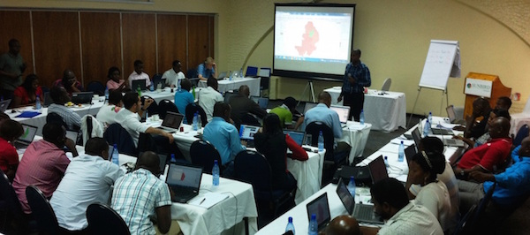
Fifth Step of Data Analysis
Communicate Key Findings
Notes:
Many health information systems are “data-rich” but “information-poor.” This is a consequence of the belief that data can be used directly for decision making. Raw data alone are rarely useful. The point of a health information system is not just to generate high-quality data and hope that they will be used, but to convert them into credible and compelling evidence that informs local health system decision making.
Only after data have been compiled, processed, and analyzed do they produce information that can be integrated with other information and interpreted in terms of the issues confronting the health system. Information then becomes evidence that can be used by decision makers.
Evidence must be effectively communicated to decision makers in order to shape their understanding of health issues and needs. It must be properly formatted in reports and presentations with user-friendly graphics, tables, and maps. This is the process of transforming evidence into knowledge, and once applied can result in decisions that will directly impact health and health equity. The impact on health can then be monitored by the health information system, by measuring changes in health indicators.

Slide 4
S5: Basic Steps of Data Presentation and Communication
Identify your audience.
Find the story in your data.
Pick the right format for presenting your data.
Keep it simple.

Slide 5
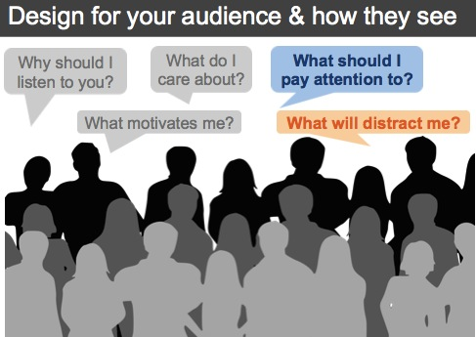
Identify Your Audience

Slide 6
Find the Story in Your Data
  What is the point you are trying to make?
  Do you have the data to support that point?
  Do you need additional data to support your story?

Slide 7
Pick the Right Format for Presenting Your Data (1)
It Depends on the Type of Data
Absolute numbers: “In 2012, 7,623,415 rapid diagnostic tests for malaria were performed nationwide.”
Rates: “In 2011, the reported incidence of genital ulcer disease was 45 cases per thousand population in Ashanti Region compared to 37 per thousand in Upper East Region.”
Coverage: “About 36% of newborns were reported to have been visited by a health professional within 2 days of birth.”
Proportional morbidity and mortality: “Injuries accounted for 2.3% of all outpatient visits.”
Notes:
To interpret the data, you can analyze and present them in various ways.
Absolute numbers: Absolute numbers can sometimes provide a useful sense of the volume of services (e.g., “7,623,415 rapid diagnostic tests for malaria were performed nationwide during 2012”). They usually cannot be easily interpreted and compared with the statistics from another geographic region or time.
Rates: For this reason, health statistics are best presented as rates (e.g., “During 2011, the reported incidence of genital ulcer disease was 45 cases per thousand population in Ashanti Region compared to 37 per thousand in Upper East Region”); or
Coverage: “35.6% of newborns were reported to have been visited by a health professional within 2 days of birth.”
Proportional mortality and morbidity: One of the most meaningful ways to analyze disease-specific data on outpatient and inpatient morbidity and mortality is as a proportion of all diseases presenting at the health facility. For example, “Injuries accounted for 2.3% of all outpatient visits.”

Slide 8
Pick the Right Format for Presenting Your Data (2)
  Trends: If comparable data (i.e., similar case definition, similar completeness) are available from multiple years
Disaggregation: The calculation of separate statistics for different groups
  Age groups and sexes
  Geographic areas: To assess geographic equity (e.g., rural versus urban)
  Type of health facility: Hospital versus health center versus dispensary
  Managing authority: Government versus private/nonprofit versus private/for-profit
  (At least acknowledge the absence or incompleteness of the private-sector data.)
Notes:
Trends: If comparable data (i.e., similar case definition, similar completeness) are available from multiple years, a multiyear trend is most enlightening. While some diseases (e.g., laboratory-confirmed malaria) and services (e.g., total outpatient attendance) may show a seasonal trend, the data for most other diseases would not be expected to show a meaningful short-term trend. In such cases, disaggregation by month should be avoided in tables and graphs.
For most indicators, the data and the analysis should be “disaggregated”: That is, separate statistics should be produced for different groups. Thus, the analytic calculations are done multiple times―once for each group with its own numerator and its own denominator. The most common types of disaggregation involve:
Age groups and sexes: For most diseases and most types of services, there are important age differences, especially between children younger than 5 and older patients. For some diseases, such as HIV, there may also be important differences between males and females.
Geographic areas: Routine facility data are an ideal source for assessment of disparities between geographic regions, districts, and even individual health facilities.
Type of health facility: Hospitals provide a different volume and range of services than smaller health facilities do. Disaggregated statistics by type of health facility helps to examine whether the completeness of reporting is lower from some types of health facilities than others.
Managing authority: Government versus private/for-profit versus private/nonprofit.

Slide 9
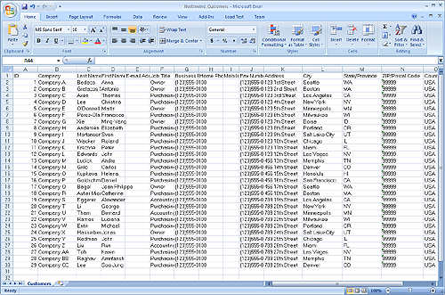
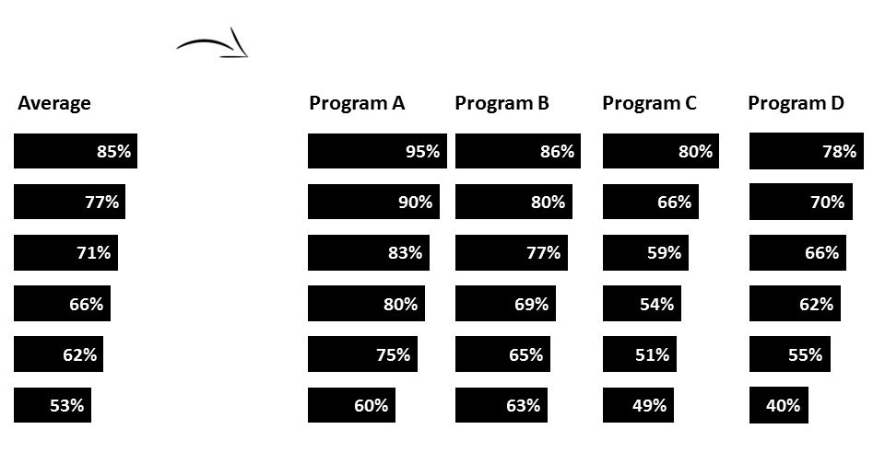
Raw Data Alone Cannot Tell the Story
Notes:
Tables present precise numerical statistics in an orderly fashion. Interested readers can conduct some further analysis of these statistics if they choose. However, it is often difficult for the reader to appreciate the most important conclusions to be derived from a large table of numbers.

Slide 10
What Is Data Visualization?
Data visualization is the presentation of data in a pictorial or graphic format.
The human brain processes information faster when looking at charts and graphs than when reading long spreadsheets or reports.

Slide 11
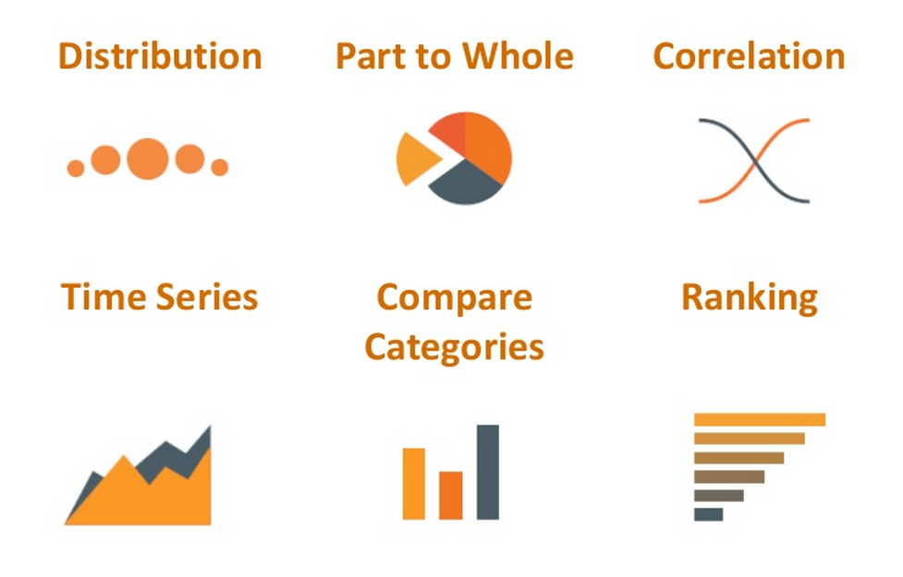
Pick the Right Data Presentation Format
Notes:
See also Handout 5.3.2.

Slide 12
Best Practices
Simple graphs can convey the relative size and trends in key values, if you provide the right context for interpreting meaning.
Specify the period and the geographic area for which the statistics apply.
Specify the data source.
For each table, graph, or map, include narrative in the report that interprets the most important findings.
Discuss limitations (completeness; changes in reporting systems).

Slide 13
Keep It Simple
Don’t try to do too much at once.
Remove extraneous information and graphics (grid lines, values, etc.).
Use only what helps to tell your story.

Slide 14
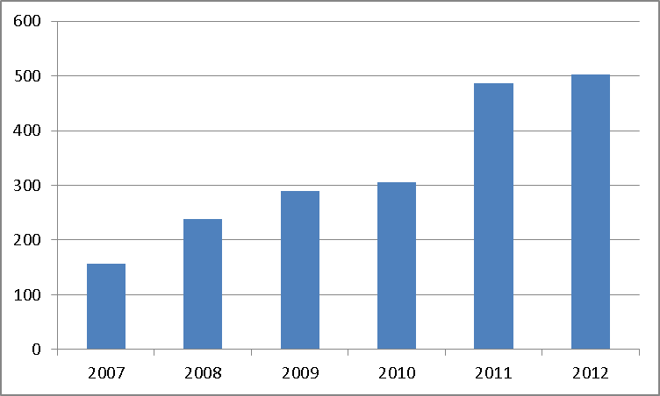
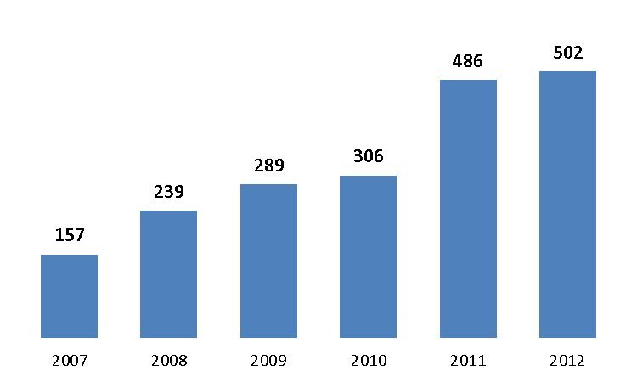
Use Graphics to Your Advantage

Slide 15
Use Colors in Your Graphs: Focus on a Specific Finding
Notes:
This slide shows outpatient visits for one year. It is helpful to see the detail of the less-common reasons for visits. To be able to see this detail, we circumscribed the Y axis at 40%. This level of detail is lost on the larger graph, and can help with plans for secondary outpatient health service priorities. Another detailed presentation that could be done is to graph the secondary services (diarrhea, worms, and skin diseases) over the five years represented in the first graph.

Slide 16
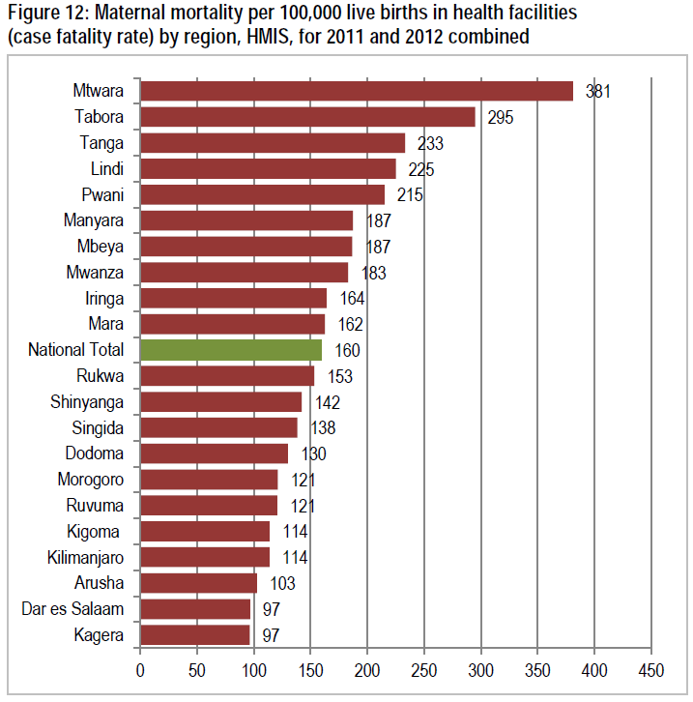
More Examples of Best Practices
(from Tanzania’s Midterm Analytic Review, 2013)
“Regional institutional maternal mortality ratios vary from about 100 in Dar es Salaam, Arusha, and Kilimanjaro to over 250 in Tabora and Mtwara. . .
trends are fairly consistent. . . except for Kagera region.”
Notes:
Use color to HIGHLIGHT your message.
Best practices:
Presentation of institutional maternal mortality
As noted, this is a case fatality rate. It is as much an indicator of the quality of services as it is an indicator of health status.
Disaggregation by regions, to examine geographic equity
Title: What, where, when, data source
Written interpretation of key findings and limitations
Discussion of any inconsistencies from review of trends over time

Slide 17
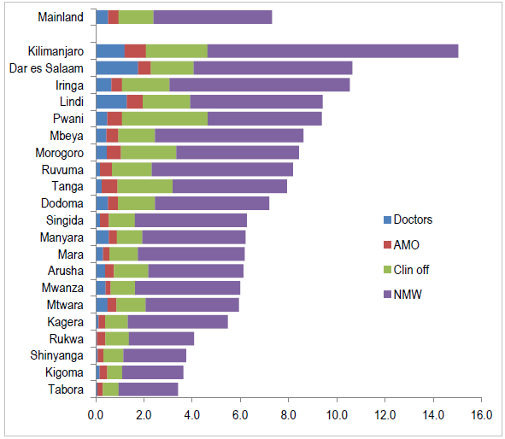
More Examples of Best Practices
(from Tanzania’s Midterm Analytic Review, 2013)
Health workers per 10,000 population, Tanzania, by region, 2012
Source: HRIS database
“The HRIS data show the substantial differences in health worker density among regions. Reporting is incomplete for the 8 referral hospitals and the private sector. In 2012, the classification of nurses and midwives differed from previous years.”
Notes:
Best practices:
Presentation of health worker density
Disaggregated by core cadres
Title: Where, when, data source
Written interpretation of key findings and limitations
Discussion of completeness
Discussion of changes in classification and how this affects trend analysis; specification of the data source
A way to improve: The label for the graph should indicate whether or not data from the major referral centers have been excluded.

Slide 18
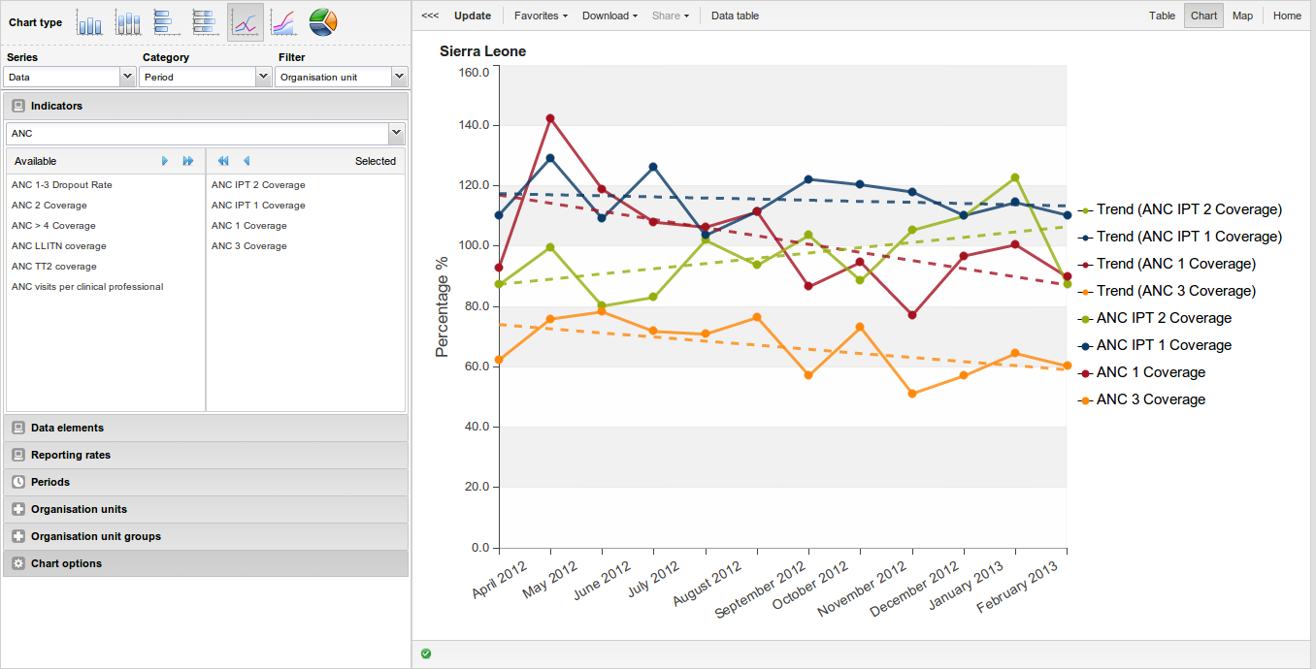
Charts in DHIS 2
Notes:
Note to facilitator: USE THIS SLIDE ONLY IF TEACHING THE DHIS 2 OPTION.
DHIS 2 has a data visualizer tool that enables users to create charts, tables, and maps.
There are many options for displaying data―several options of charts you can make, pivot tables, and GIS maps.
Once a chart is created, you are able to display it, share it, embed it in an email or on a website, and download it in various formats.
DHIS 2 is user-friendly. The point-and-click functionality of DHIS 2, particularly of the data visualizer tool, does most of the work for you. Even users who are uncomfortable or unfamiliar with other forms of data visualization will find the DHIS 2 data visualizer easy to use.
For more information and instructions on how to use the tool, you can visit: https://www.dhis2.org/doc/snapshot/en/end-user/html/ch06.html
There are many different options for charts you can create. It is easy to choose your indicators, the type of chart you want, the period you want to display, etc.
https://www.dhis2.org/data-management

Slide 19
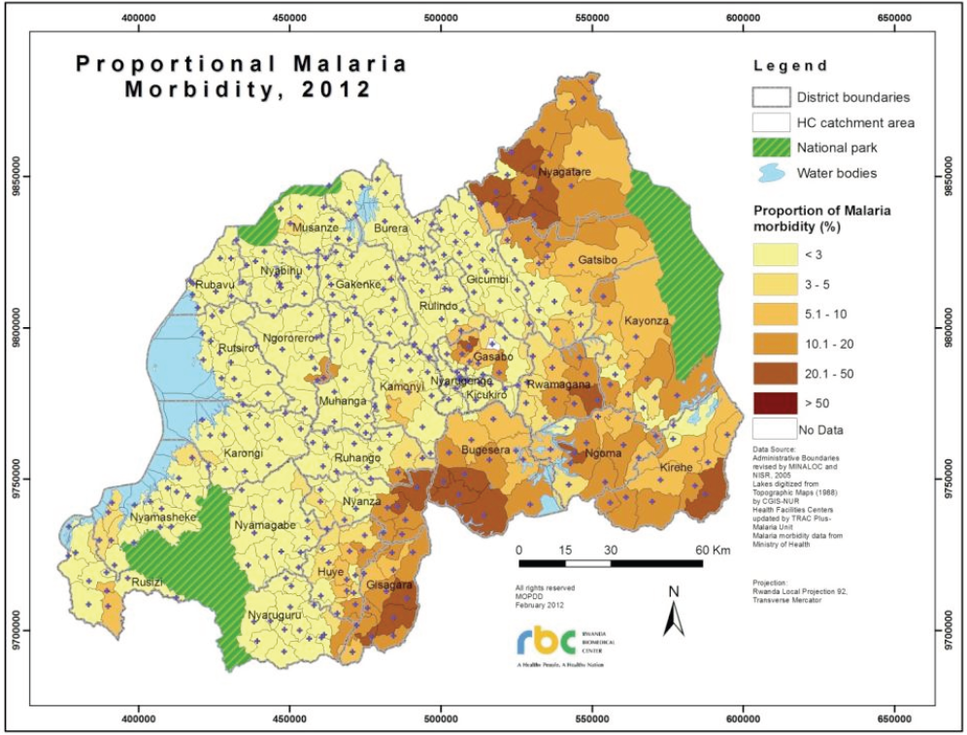
Thematic Map
Proportion of all outpatient visits attributed to malaria, Rwanda, 2012 Source: Rwanda Annual Health Statistics Bulletin, 2012
Notes:
Thematic maps give a different color to each geographic region for quick appreciation of regional disparities in a key indicator. Maps can be created with sophisticated GIS software. Some data management software such as DHIS 2 has built-in mapping capabilities. Alternatively, If each row of data in a spreadsheet includes the geographic coordinates (latitude and longitude), “fusion tables” can be used to map the data using the Google Maps website.

Slide 20
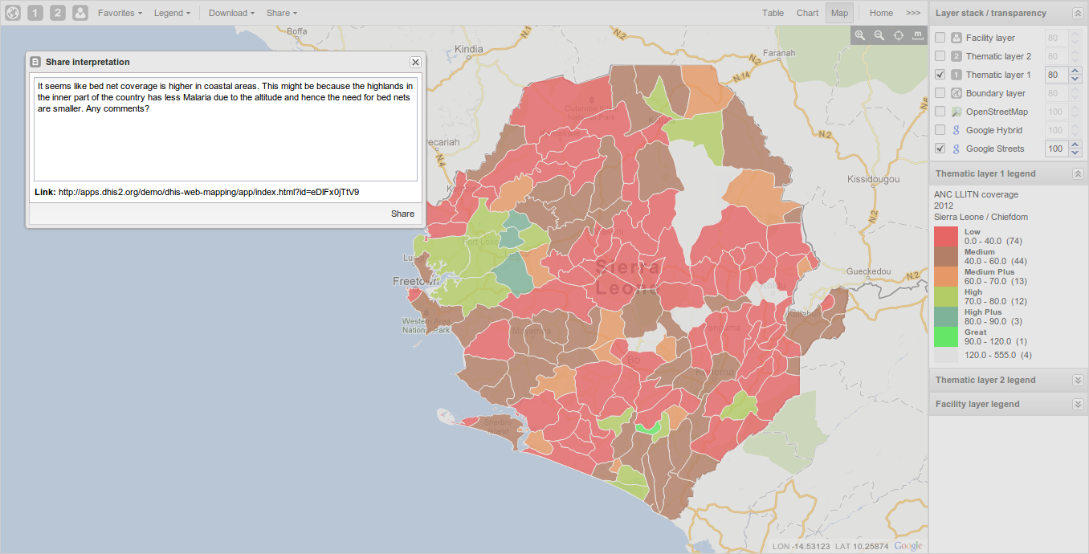
Maps in DHIS 2
Notes:
What is the color of this map?
= red = lot of work to do!
DHIS 2’s GIS features are extremely user-friendly. The GIS functionality enables users to create thematic maps, view facilities based on various classifications, and visualize catchment areas. You can also overlay features with Google Maps/Google Earth.
Displaying data geographically is becoming increasingly important, because many programs encourage countries to prioritize and target based on location. While GIS software can be difficult to use, DHIS 2’s functionality, though not advanced, is easy to use.
https://www.dhis2.org/data-management

Slide 21
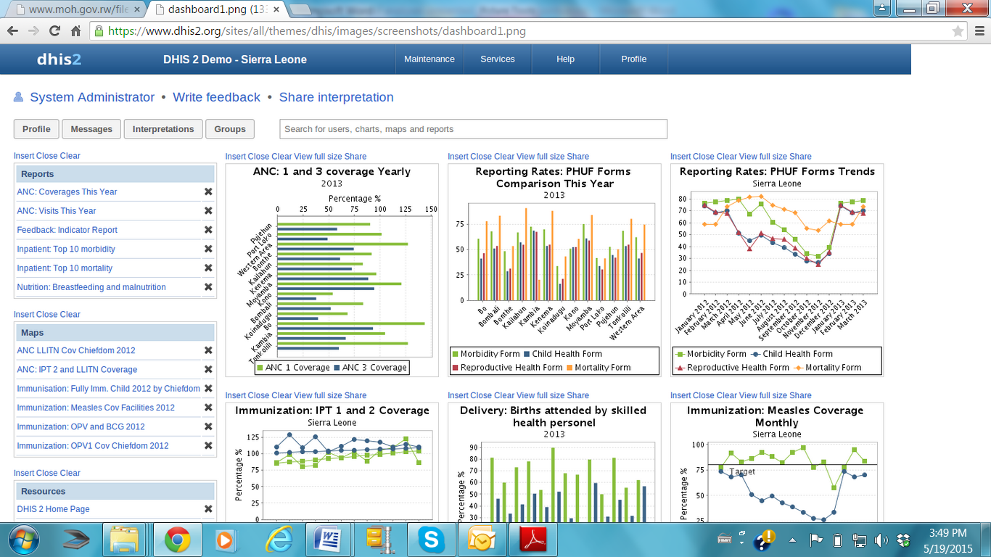
Dashboard

Slide 22
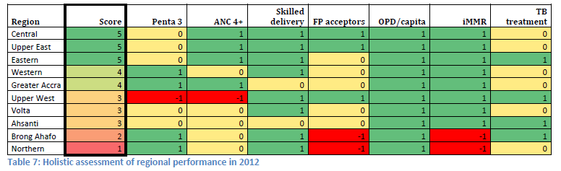
League Table
Ghana’s regional league table (Source: Holistic Assessment of the Health Sector Programme of Work 2012, Ghana MOH, June 2013)
“In the regional analysis of POW 2011, three regions came out with a score of zero or below. In the current review, all regions have a positive score, which indicates a relative improvement over 2011 for these selected service delivery indicators.”
Notes:
A small set of standard indicators representing a range of health service functions can be selected to provide a comprehensive assessment of the overall performance of a national, regional, or district health system. The scores from this fixed set of indicators can be combined mathematically (e.g., by averaging the coverage achieved with various health services) to calculate an index with which to judge trends from year to year or compare one district or region to another. In this way, a “league table” can be generated.

Slide 23
The 5 Steps Applied to District Level
Select a limited set of core indicators: for M&E of the district health system
Review data quality: Review facility-level data for completeness and internal consistency.
Select appropriate denominators: Consider using ANC1 and /or DTP1 as denominators for facility-level and district-level numbers of DPT3 and/or ANC4.
Reconcile findings with other data sources: Surveys don’t provide district estimates, but regional estimates can provide approximations of the district estimate.
Communicate key findings: Share with health facilities to promote improved data quality and use.

Slide 24
Present Key Findings
Notes:
Many health information systems are “data-rich” but “information-poor.” This is a consequence of the belief that data can be used directly for decision making. Raw data alone are rarely useful. The point of a health information system is not just to generate high-quality data and hope that they will be used, but to convert them into credible and compelling evidence that inform local health system decision making.
Only after data have been compiled, processed, and analyzed do they produce information that can be integrated with other information and interpreted in terms of the issues confronting the health system. Information then becomes evidence that can be used by decision makers.
Evidence must be effectively communicated to decision makers in order to shape their understanding of health issues and needs. It must be properly formatted into reports and presentations with user-friendly graphs, tables, and maps. This is the process of transforming evidence into knowledge, and once applied can result in decisions that will directly impact health and health equity. The impact on health can then be monitored by the health information system, by measuring changes in health indicators.

Slide 25
Group Work Exercise: Practice Steps 1-5
Distribute Handouts 5.3.1a (exercise instructions) and 5.3.1.b (data set).
Form small groups of 4–5 participants.
Use the Excel sheet provided on the annual block-level data from the district Gumla, of Jharkhand, India. (This sheet has reported facility-level health data).
Each group is expected to identify at least 3 indicators (for example, antenatal care coverage, births attended by skilled health personnel, and infant immunization) related to MNCH that can be calculated from the data provided in the Excel sheet (based on the WHO defined list of core health indicators).
For each of the indicator you want to calculate, specify the numerator.
Use the following assumptions to estimate the denominator (if required):
  Assuming a crude birth rate of 24.6 per 1,000 population for Jharkhand
  Births=CBR x population
  Pregnancies=Birth x 1.02
  Deliveries=Births X 0.99
  Surviving infants=Births x (1-IMR) [IMR for Jharkhand: 37 per 1,000 live births]

Slide 26
Group Work Exercise: Practice Steps 1-5
Calculate the block-wise and overall district level indicators.
Assess the data quality of the selected indicators.
Decide on three questions that you would like to answer using the data.
Create charts, tables etc., using the Excel spreadsheet, to analyze your data. What type of analysis is possible using the given data?
Do you see any story emerging from the analysis of the data? Summarize the main finding of that story.
Prepare a brief report (using PPT) to discuss the block-wise performance of the indicators and possible reasons for (non) performance across blocks for an upcoming data review meeting.
Prepare a presentation of not more than 10 minutes for an upcoming program review meeting.
Notes:
Presentations should be brief and contain only highlights of the findings (akin to an “elevator speech”: the main points a person would have time to cover on an elevator ride).

Slide 27
Communicate Data to Improve Decision Making
A beautiful chart on your computer won’t affect decision making.
Active communication is crucial for increasing the use of data.
Engage with decision makers to disseminate your message and influence decision making.
Advocate change.
Notes:
Active engagement with decision makers is key to ensuring that data are put to use.
Active engagement with decision makers means that we:
• Communicate data by sharing or exchanging information and ideas through a variety of channels, from printed documents to face-to-face conversations.
• Influence decision making through our communication and interaction with decision makers by providing quality data and facilitating discussions about the data that affect an individual or organizational decision making process.
• Advocate change through a planned and deliberate process that uses evidence to promote the implementation of a specific recommendation or set of recommendations.

Slide 28
Key Steps for Effective Communication
Develop your objective.
Identify and understand your audience.
Craft your message.
Identify communication channels.
Assess the effects of your communication efforts.

Slide 29
Develop Your Objective
If you were successful in communicating your data to a decision maker, what would your ideal objective be?
Objectives must be achievable
and measurable.

Slide 30
Identify and Understand Your Audience
Assess your stakeholders to determine whom you need to reach with your messages.
Tailor messages to the people you are communicating with and hoping to influence.
Notes:
Key questions to consider:
Who can take action?
Who has influence and resources?
Who can affect the outcome?
Who will oppose the action?
Messages should be tailored to the people you are communicating with and hoping to influence. Consider these people’s knowledge of the subject, data literacy, and time available to receive the message.

Slide 31
Craft Your Message
Start with a short description of how the health (service delivery) issue affects an individual or a group.
Introduce the problem and entice your audience to want to know more.
Describe what is going wrong, why that matters, and what should be done.
Use examples to provide context.
Content should be 20% problem and 80% solution.
Notes:
Your message(s) are based on your objective and your audience.

Slide 32
Identify Appropriate Communication Channels
Internet: Email, video/DVD, social media, website
Print/traditional: Report, executive summary, newsletter, poster
In person: Face-to-face conversation, presentation, open forum, community meeting
Notes:
Try to integrate a range of communication messages and channels over time. Always be prepared to provide additional resources for information seekers. Prioritize the communication channel with the widest reach if your target audience is a group. If your target audience is an individual, prioritize the communication channel that is most likely to get a response. Decide when you want the intended audience to receive the message.
Keep in mind that the various communication channels and media outlets are tools to support your communication strategy; they are NOT a communication strategy in themselves.

Slide 33
Message Example
In our district, 100 children under 5 years of age die annually because of diarrhea. A major cause of these preventable deaths is the overcrowding of latrines.
Data show that when more than 25 people use the same latrine, the prevalence of diarrhea in children under 5 climbs above 15 percent. With 70 users per latrine, diarrhea prevalence climbs to over 50 percent. This problem is even more serious in urban settings.
We ask you to help save children’s lives by securing funding and other resources to increase the number of latrines in our district so that they don’t exceed 25 people per latrine. We wish to begin in the urban area of X, where latrine overcrowding is greatest.
Notes:
In your group, work on how you would present this message to a policymaker/donor/community leader in one minute. You can add or modify elements in this message that will make it more effective (i.e., well-received, understood, and remembered).
Select one person from the group to communicate this message to the health minister/community leader.

Slide 34
Assess the Effects of Your Communications
Did the target audience see and/or understand the message?
Did they understand that you based the message on data?
Did they act on your recommendations?
Has there been an evaluation of the impacts of any such action?
Has the health (service) problem status changed?
Notes:
Ask participants to comment on the messages presented by the groups.

Slide 35
ROUTINE HEALTH INFORMATION SYSTEMS
A Curriculum on Basic Concepts and Practice
This presentation was produced with the support of the United States Agency for International Development (USAID) under the terms of MEASURE Evaluation cooperative agreement AID-OAA-L-14-00004. MEASURE Evaluation is implemented by the Carolina Population Center, University of North Carolina at Chapel Hill in partnership with ICF International; John Snow, Inc.; Management Sciences for Health; Palladium; and Tulane University. The views expressed in this presentation do not necessarily reflect the views of USAID or the United States government.

