Slide 1
ROUTINE HEALTH INFORMATION SYSTEMS
A Curriculum on Basic Concepts and Practice
MODULE 8:
Information and Communication Technology for RHIS
SESSION 1:
eHealth, mHealth, and Health Information System Enterprise Architecture
The complete RHIS curriculum is available here: https://www.measureevaluation.org/our-work/ routine-health-information-systems/rhis-curriculum

Slide 2
Session 1: eHealth, mHealth, and HIS Enterprise Architecture
Learning Objectives
By the end of this session, participants will be able to:
Explain key eHealth and mHealth concepts
Define commonly used eHealth and mHealth terms
Illustrate eHealth and mHealth applications
Describe limitations and considerations for eHealth and mHealth
Explain key HIS enterprise architecture (EA) concepts
Explain the need for the EA approach
Describe HIS architecture and its ecology
Topics Covered
eHealth and mHealth
Notes:
Source:

Slide 3
eHealth
eHealth (or e-health) is a relatively recent term for healthcare practice supported by electronic processes and communication, dating back to at least 1999.
World Health Organization definition: eHealth is the cost-effective and secure use of information and communications technologies in support of health and health-related fields, including healthcare services, health surveillance, health literature, and health education, knowledge and research.
European Commission: the use of modern information and communication technologies to meet needs of citizens, patients, healthcare professionals, healthcare providers, and policymakers
Notes:
Source:

Slide 4
Common Terms in eHealth
Electronic health record (EHR), or electronic medical record (EMR): systematized collection of patient and population health data in a digital format that is electronically-stored
Clinical decision support system (CDSS): ICT solution designed to provide health professionals with clinical decision support (CDS) such as assistance with clinical decision-making tasks
Telemedicine: physical and psychological diagnosis and treatments at a distance, including telemonitoring of patient functions
Notes:
Source:

Slide 5
eHealth Interventions
Delivering health information to health professionals and health consumers through the Internet and telecommunication
Using IT and e-commerce to improve public health services―for example, through the education and training of health workers
Applying e-commerce and e-business practices in health systems management (planning, budgeting, accounting, etc.)
Notes:
Source:

Slide 6
Why eHealth?
In many low- and middle-income countries (LMICs), health system challenges relating to weak governance, health workforce shortages, and geographic and economic barriers to care impede effective delivery of health services to those in need.
Information and communication technology (ICT) offers the potential for addressing some of these challenges with innovative solutions, especially if offered at scale.
LMICs account for three-quarters of the rapidly expanding Internet and mobile cellular subscriptions globally, thus creating opportunities for innovative and cost-effective health services through the use of ICT.
Notes:
Source:

Slide 7
Application of eHealth in HIS
Data collection
Use of hand-held devices
Automated information messaging
Use of different data management applications such as DHIS 2, iHRIS, and eLMIS to collect, aggregate, and report routine data.
Data management and storage
To address requirements of interoperability and integrated sets of data
More sophisticated data storage to address complexity and variability of health data across the health enterprise
Relational databases are increasingly the norm, as opposed to the older, flat database formats that limited functionality and scalability, such as Microsoft Excel workbooks
Notes:
Source:

Slide 8
Application of eHealth in HMIS
Data analysis, presentation, and use
Extraction and triangulation of health data
Data analysis and synthesis tools to produce routine or ad hoc reports, identify trends and issues of concerns, and track progress
Data dashboards and other data visualization tools can be customized to include maps (geographic information systems, or GIS)
Data quality
Tools for improving data quality include data standardization, geocoding, data matching, data monitoring, and profiling.
Notes:
Source:

Slide 9
Common Terms in mHealth
mHealth or m-Health: includes the use of mobile devices in:
Collecting aggregate and patient-level health data
Providing healthcare information to practitioners, researchers, and patients via Short Message Services (SMS) platforms such as mHero
Real-time monitoring of patient vital signs and direct provision of care
Notes:
Source:

Slide 10
mHealth Applications
Rapid collection/sharing of current data via mobile phones
Public health and lifestyle messages over mobile phones
Medication alerts using mobile phones
E-prescribing for repeat prescriptions via mobile phones
Telemonitoring to transmit patient results to clinicians
Notes:
Do you have any of these in your country?

Slide 11
mHealth Applications
Transmission of test results to patients via SMS messages
Online electronic health records via computer or phone
Clinical emergency care for accidents, natural disasters
Patient appointment booking and alerts via wireless e-mail (continuity of care)
Efficient workflow via wireless communication
Notes:
Do you have any of these in your country?

Slide 12
Limitations and Considerations
Lack of knowledge by health professionals concerning the possible applications of eHealth
Unknown cost-effectiveness of mHealth/eHealth initiatives
Cost of implementing eHealth solutions is perceived to be high
Notes:
Source:

Slide 13
Limitations and Considerations
ICT infrastructure and particularly Internet access limited by low connectivity and bandwidth (urban areas are better covered than rural areas)
Absence of legal guidelines on privacy and confidentiality in the eHealth and mHealth domains
Change management to consider to deal with the new ICT cultural environment
Notes:
Source:

Slide 14
HIS Architecture
HIS ARCHITECTURE

Slide 15
Ecology of HIS in LMICs
Widespread dissatisfaction among both users and producers of health information
Complex and fragmented by disease-focused programs and donors
Epidemic of indicators and burdensome demands on health personnel
Poor quality data; lack of common standards; data inconsistencies and inefficiencies; difficult to analyze and synthesize

Slide 16
What Is Enterprise Architecture?
Enterprise architecture is the technical foundation of an effective IT strategy. It consists of four types of interrelated architecture:
Business architecture
Data or information architecture
Application architecture
Technology architecture
Health information system (HIS) architecture
Notes:
Source:

Slide 17
Need for Enterprise Architecture?
To give management the big picture
Enterprise architecture gives a “systems thinking” view that combines vision and strategy, business architecture, information systems, and technology domains.
To align IT investments with business goals
Creating a platform for business-ICT stakeholder collaboration is essential. Effective EA supports strategy, analysis, and planning by providing stakeholders a blueprint of the current state of the business and IT landscape, and of the desired future state (vision).
To provide IT developers with specific requirements for software applications
The business architecture provides the IT developer with the specific software requirements of an application.
Notes:
Source:

Slide 18
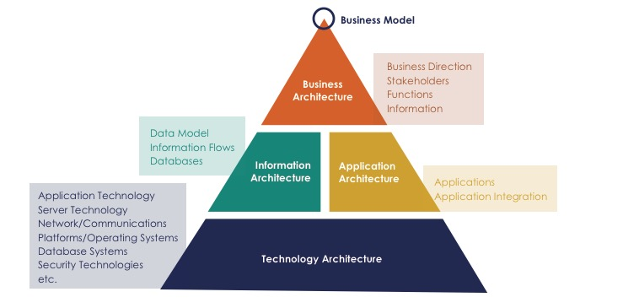
Enterprise Architecture
Notes:
Source:

Slide 19
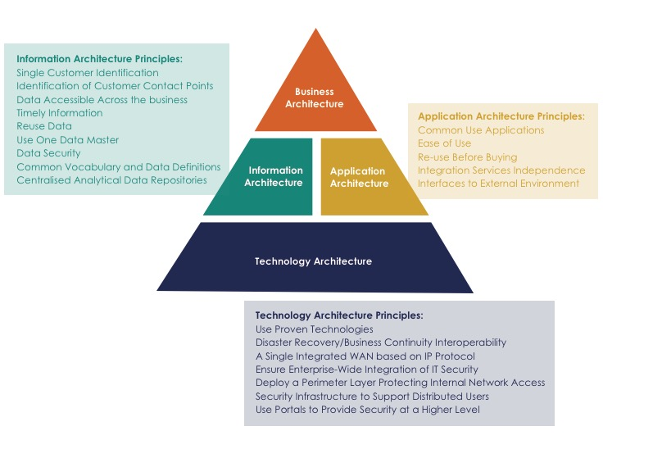
HIS Architecture Principles

Slide 20
HIS Architecture
Can align and leverage investments to build stronger and better integrated HIS supporting better health policy and local health services management, and ultimately stronger health systems
To be built on a coherent set of best practices for promoting data integration
To foster stakeholder groups to collaboratively build on common components and a common architecture within the HIS
Helps identify and create interoperability between the components of the system

Slide 21
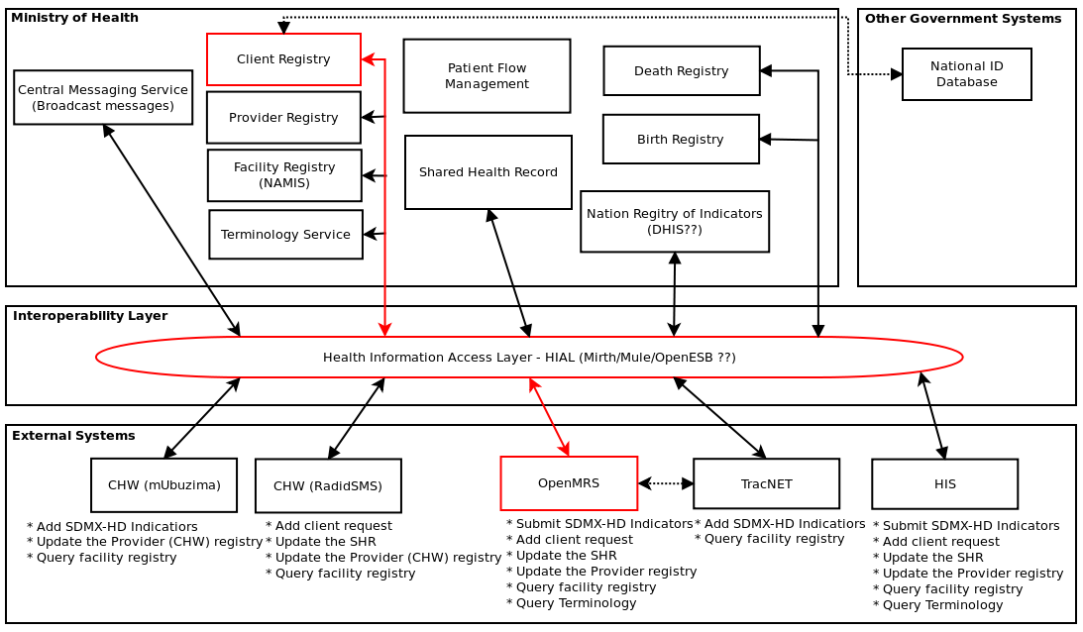
Rwanda Health Enterprise Architecture Framework

Slide 22
Summary
Plethora of tools, methods, and practices for data collection and analysis have created an unsustainable burden on frontline health workers.
This burden causes poor data quality and diverts critical health resources from using information for decision making at all management levels.
An enterprise architecture approach can help address these challenges.
Improving health system performance through the consistent use of EA will be the blueprint for better health outcomes resulting from the routine use of better information to stronger national health information systems.

Slide 23
ROUTINE HEALTH INFORMATION SYSTEMS
A Curriculum on Basic Concepts and Practice
This presentation was produced with the support of the United States Agency for International Development (USAID) under the terms of MEASURE Evaluation cooperative agreement AID-OAA-L-14-00004. MEASURE Evaluation is implemented by the Carolina Population Center, University of North Carolina at Chapel Hill in partnership with ICF International; John Snow, Inc.; Management Sciences for Health; Palladium; and Tulane University. The views expressed in this presentation do not necessarily reflect the views of USAID or the United States government.

