Slide 1
ROUTINE HEALTH INFORMATION SYSTEMS
A Curriculum on Basic Concepts and Practice
MODULE 8:
Information and Communication Technology for RHIS
SESSION 2:
RHIS Integration and Interoperability
The complete RHIS curriculum is available here: https://www.measureevaluation.org/our-work/ routine-health-information-systems/rhis-curriculum

Slide 2
Learning Objectives and Topics Covered
Objectives
By the end of this session, participants will be able to:
Explain data linkage terms
Describe the role of information and communication technology (ICT) in integration and interoperability of the RHIS
Topics Covered
Using ICT for systems integration and interoperability:
Environment for effective systems integration and interoperability
Use of ICT standards for systems integration and interoperability
Data accessibility: open health information exchange (HIE), meta-data sharing)
Data privacy and security

Slide 3
Data Linkage Terminology
Integration
Interoperability
MFL (master facility list)
Health information exchange (HIE)
Sharing metadata
Triangulation
Data privacy, security, and confidentiality

Slide 4
Linking Data Sources
Linking of data sources leads to a strengthened health information system (HIS)
Linking various RHIS subsystems such as HMIS, LMIS, HRIS, LIIS, etc
Linking the routine health information system (RHIS) with population census and data from the Demographic and Health Surveys (DHS)

Slide 5
Integration
A number of definitions apply to integration:
In engineering: Bringing together of the components into a single system and ensuring that subsystems function together as a unit
In information technology: Process of linking together different computing systems and software applications physically or functionally, to act as a coordinated whole.
Source: Heywood A; Boone D. Guidelines for RHIS data management standards. February 2015. MEASURE Evaluation.
Notes:
The Human Challenges
HIS integration is usually more than IT systems integration or engineering. It is also a politically sensitive process that usually requires substantial change in how organizations operate. Key stakeholders at all levels need to be aware of (and promote) the benefits of integration and information sharing and actively participate in the change process. Only by long-term, high-level focus on good HIS governance, capacity building for data management and information use, and strong commitment to change by leadership across stakeholder groups can an integrated HIS be achieved.
To move from a fragmented system toward an integrated approach, national HIS need to be strengthened to suit the needs of all stakeholders, and data collection systems across health programs require standardization and rationalization The rationale behind an integrated HIS applies equally at all levels, and a technical solution such as an integrated data warehouse should be introduced at national and local levels, along with integrated organizational systems and long-term initiatives to address health worker behavior.
See also MODULE 3, Session 3, on Data Integration and Interoperability.

Slide 6
Interoperability
Ability of health information systems to work together within and across organizational boundaries in order to advance the effective and integrated delivery of healthcare for individuals and communities
Ability of different information technology systems and software applications to communicate, exchange data, and use the information that has been exchanged for improved service delivery and health
Source: HMISS Interoperability and Standards Toolkit. Retrieved from
http://www.himss.org/library/interoperability-standards/toolkit

Slide 7
Sharing Metadata
Metadata: “data about data"
Metadata describe how, when, and by whom a particular set of data was collected, and how the data are formatted
Metadata: essential for understanding information stored in data warehouses; has become increasingly important in XML-based web applications─the most recent Internet Exchange Protocol (IEP)
Notes:
XML is the most recent Information Exchange Protocol (IEP).

Slide 8
Health Information Exchange
Electronic health information exchange (HIE) allows doctors, nurses, pharmacists, other healthcare providers, and patients to appropriately access and securely share a patient’s vital medical information electronically, thus improving the speed, quality, safety, and cost of patient care.
Directed Exchange: Ability to send and receive secure information electronically between care providers to support coordinated care
Query-Based Exchange: Ability for providers to find and/or request information on a patient from other providers, often used for unplanned care
Consumer Mediated Exchange: Ability for patients to aggregate and control the use of their health information among providers

Slide 9
Open HIE
Open HIE is a community of practice (COP) dedicated to improve the health of the underserved through open and collaborative development and support of country-driven, large-scale health-information-sharing architectures.
Enabling large-scale health information interoperability
Offering freely available standards-based approaches and reference technologies
Supporting each other’s needs through peer technical assistance communities
Notes:
Managed by the Regenstrief Institute (University of Indiana, USA)

Slide 10
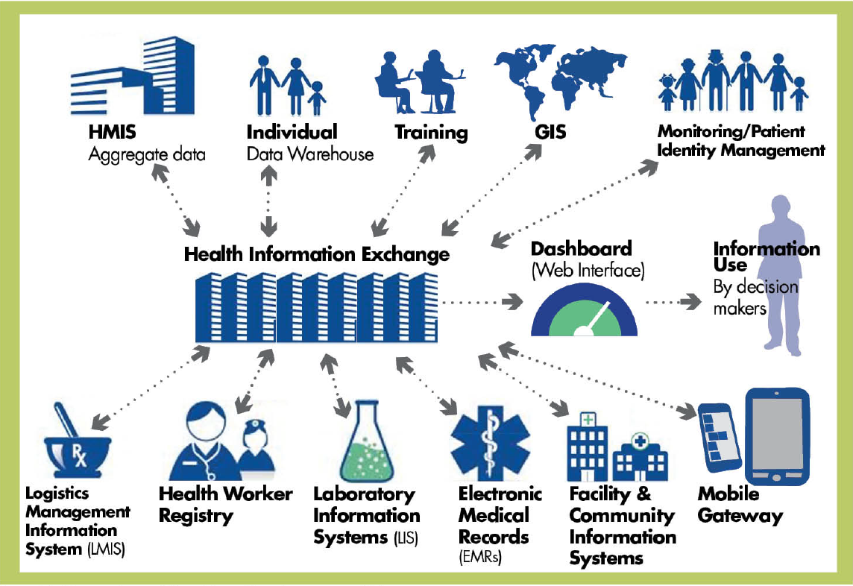
HIS Architecture and Health Information Exchange

Slide 11
Master Facility List (MFL)
An MFL is a comprehensive, up-to-date, and accurate list of all the health facilities (public and private, including community services) in the country.
Each health facility is uniquely identified using a set of identifiers (the signature domain).
Links health services data and other core health-system data (financing, human resources, commodities, and infrastructure) through the unique identifiers defined in the MFL:
Is useful for administrative purposes
Allows better analysis and synthesis of information
Improves health systems reporting and planning

Slide 12
Linking Data Using a Master Facility List
Data harmonization: comparing and contrasting data across different data sources and across time
Data linkages and collaboration between departments and ministries with related data
Health facility surveys: comprehensive lists for sampling
Health information system strengthening: combining data from multiple sources to generate facility, regional, and national profiles for effective planning

Slide 13
RHIS Linkage Examples
Linking HMIS with a census
Coverage rates
Linking logistics management information systems (LMIS) and HMIS:
Relationship between stockouts and services
Composite indicators, such as couple years of protection (CYP)
Linking human resource information systems (HRIS) and HMIS
Workload analysis (patient visits per doctor)

Slide 14
Linking Family Planning Service Data with Census Data
Intervention, restructuring maternal and child health (MCH)/family planning (FP) facility-based information system
Before linking RHIS and census data, the only contraceptive prevalence rates available to an MOH were national estimates from DHS every 5 years
After linkages, calculations from RHIS data provided the needed annual district- and national-level CPR estimates

Slide 15
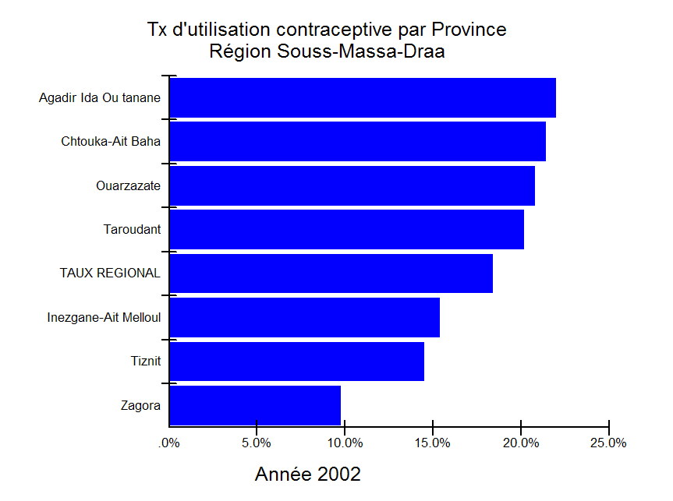
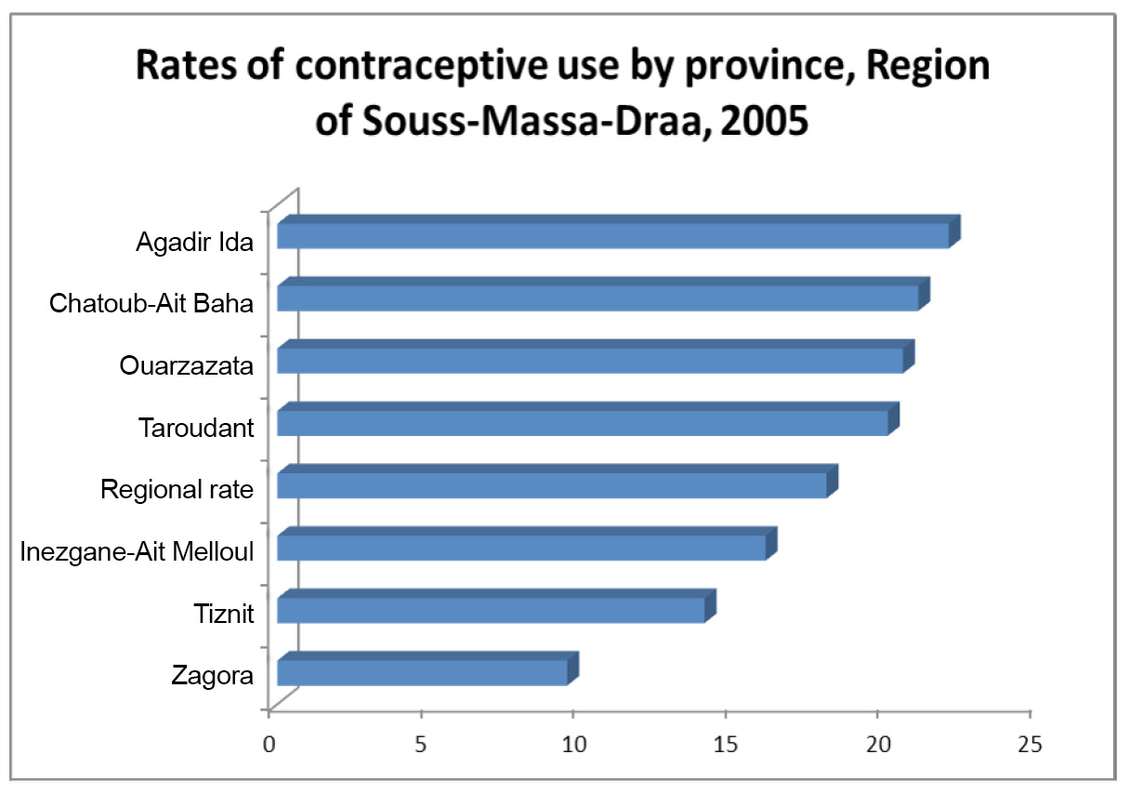
Routine FP Data: Case Study on Morocco

Slide 16
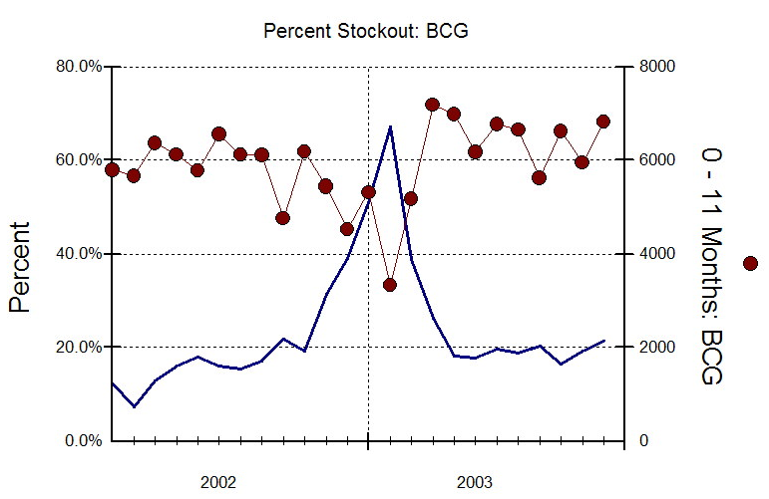
Linking LMIS and HMIS Data for Improved Use of Information
Before: Vaccine stockouts went unreported
After: Tracked relationship between stockouts and children vaccinated
Evidence of elevated stockout percentage and lower number of children vaccinated alerted MOH to request additional vaccines from donors.
Notes:
The Eritrea National Health Management Information System (NHMIS) is an integrated, decentralized information system that includes data on vaccine stocks as well as the number of children vaccinated. Vaccine stockouts are calculated as 0 vaccines available at the end of the month. The NHMIS was an important tool that allowed the Eritrean Ministry of Health to locate facilities with stockout problems. The graph here shows the relationship between stockouts and children vaccinated.

Slide 17
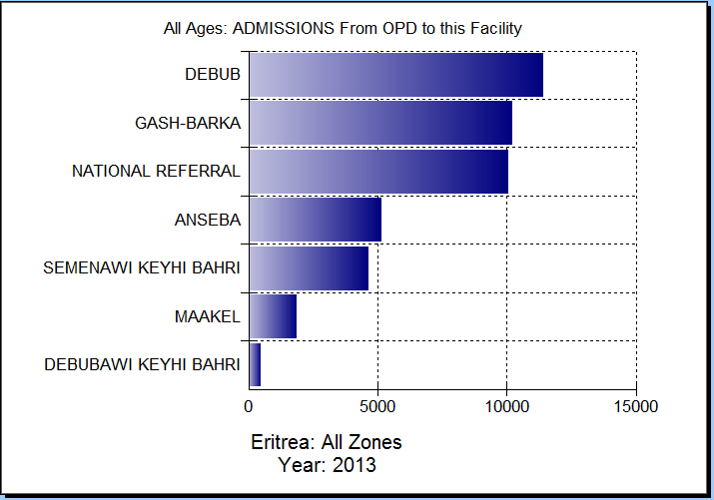
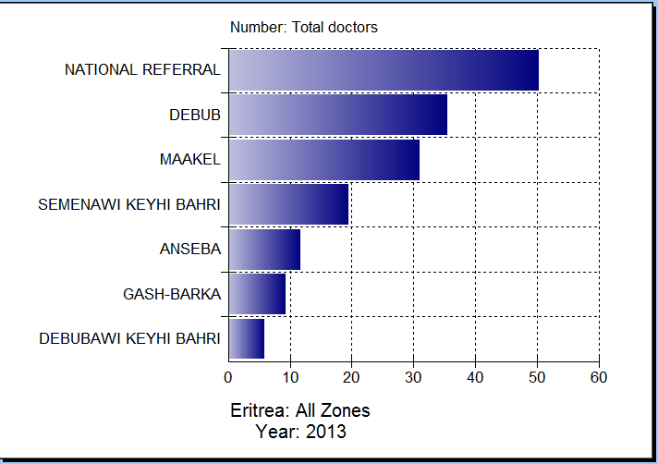
Eritrea: Linking HRIS and HMIS:
Calculation of New Indicators

Slide 18
What Is a Decision Support System (DSS)?
A computerized application allowing health managers to visualize RHIS health indicators and data elements in graphic and geographic presentations
Comparison is one of the most powerful analytic methods
Spatial: by health facility, district, province
Time: trends by week, month, year
Indicators: between inputs and outputs
Benchmark: expected versus achieved
Notes:
First some explanation of DSS.

Slide 19
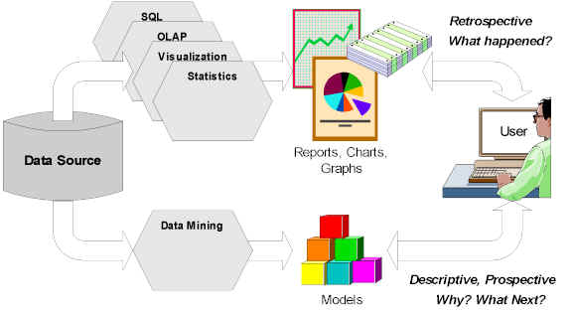
Decision Support System

Slide 20
Why a Decision Support System (DSS)?
Enables health managers to promptly and efficiently analyze data for decision making
Allows health managers with limited data analysis skills to better interpret aggregate information from the RHIS
Is well-suited to health managers at national, regional, district, and local levels, because it is user-friendly for health workers with little ICT training

Slide 21
Privacy
“Privacy” is a vaguely defined term that, in an online context, covers the rights of individuals to:
Determine what information is collected about them and how it is used
Access information held about them and know that it is accurate and safe
Maintain anonymity (not have your web-browsing habits tracked)
Send and receive e-mail messages or other data (credit card numbers) that will not be intercepted or read by persons other than the intended recipient(s)

Slide 22
Data Security
Data Security: Protects data, such as a database, from destructive forces and from the unwanted actions of unauthorized users
Data Encryption: Encodes information in such a way that only authorized parties can read it
Data Backup: Ensures that when data are lost they can be recovered from another source

Slide 23
Confidentiality
Make appropriate security arrangements for the storage and transmission of personal information
Obtain and record professional registration (with password) prior to connecting to a network
Ensure that patient/client record files and ICT equipment (a computer, for example) are in a secure area
Note that Internet e-mail can be intercepted

Slide 24
ROUTINE HEALTH INFORMATION SYSTEMS
A Curriculum on Basic Concepts and Practice
This presentation was produced with the support of the United States Agency for International Development (USAID) under the terms of MEASURE Evaluation cooperative agreement AID-OAA-L-14-00004. MEASURE Evaluation is implemented by the Carolina Population Center, University of North Carolina at Chapel Hill in partnership with ICF International; John Snow, Inc.; Management Sciences for Health; Palladium; and Tulane University. The views expressed in this presentation do not necessarily reflect the views of USAID or the United States government.

