Slide 1
ROUTINE HEALTH INFORMATION SYSTEMS
A Curriculum on Basic Concepts and Practice
MODULE 9:
RHIS Performance Assessment
SESSION 1:
Introduction to Frameworks for Assessing RHIS
The complete RHIS curriculum is available here: https://www.measureevaluation.org/our-work/ routine-health-information-systems/rhis-curriculum

Slide 2
Learning Objectives and Topics Covered
Objectives
Participants will be able to:
Review RHIS standards
Define RHIS performance
Define factors influencing RHIS performance
Explain the framework for assessing RHIS
Topics Covered
Domains of RHIS standards
Determinants of RHIS performance
Introduction to the frameworks for assessing RHIS performance

Slide 3
Group Exercise: Underlying Problems and Causes
Choose three bottlenecks that you face in the current RHIS.
For each problem, identify the root causes contributing to it. Be specific.
Example
Problem: Data are not being transmitted on schedule.
Causes: Staff do not have sufficient information, materials, forms, or training to complete the forms, or forms don’t collect the data that are needed. There is no incentive to submit information on time.
Notes:
Ask each group to identify problems/bottlenecks of the RHIS data management process and choose three of them to further work on the causes of the problems.
Examples:
Incomplete data collection process
Inconsistent/inaccurate data
Information not used for decision making
Participants should keep their responses in order to relate the identified problems and causes to the performance determinants that will be presented later on.

Slide 4
M&E platform
National health policies, strategies, and plans
Monitoring, evaluation, and review
Effective country mechanisms for review and action
Strong institutional capacity for data collection, analysis, and use
Well-functioning data sources
Facility and community information
system
AKA
Routine health information system (RHIS)
Population-based surveys and census
Civil registration and vital statistics
Surveillance
Health systems monitoring sources
Health information system
Sound policy, governance, and institutional environment
Notes:
Health information systems support the monitoring and evaluation of the health system.
This slide presents a framework for how HIS are linked to M&E and to country health plans.
RHIS is one of the data sources that generates data for M&E of the health system.

Slide 5
Defining RHIS Performance
RHIS performance means both the production of high-quality information and the use of such information for decision making.
Notes:
So how do we assess RHIS?
What is the definition of a well functioning RHIS?

Slide 6
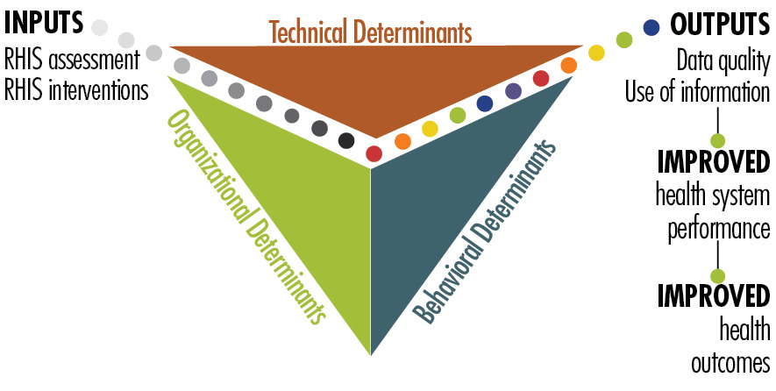
PRISM Framework
Notes:
PRISM will be presented in Session 3.
The PRISM conceptual framework is based on the premise that the success of the RHIS depends on success in three interrelated areas: technical, organizational, and behavioral conditions:
Technical determinants
Behavioral determinants
Organizational determinants
Unlike traditional assessments, which focus primarily on technical issues, the PRISM framework looks at the determinants of RHIS performance in all three areas, based on:
Literature on organizational assessment, development, and capacity building
Lessons learned about performance improvement
Behavior change
A systems approach

Slide 7
PRISM Conceptual Framework A Comprehensive Picture of RHIS Performance
INPUT
PROCESSES
OUTPUT
OUTCOMES
IMPACT
RHIS Determinants
Technical Factors
Complexity of reporting forms, procedures
HIS design
Computer software
Information technology complexity
Behavioral Factors
Level of knowledge of content of HIS forms
Data quality checking skills
Problem solving for HIS tasks
Competence in HIS tasks
Confidence levels for HIS tasks
Motivation
RHIS Processes
Data collection
Data transmission
Data processing
Data analysis
Data quality check
Feedback
Improved RHIS Performance
Data quality
Information use
Improved Health Status
Improved Health System Performance
Organizational Factors
Critical management functions & information needs
Governance
Planning
Training
Supervision
Quality
Finance
Promotion of culture of information
Availability of resources

Slide 8
Technical Determinants
Standard indicators
Trained people
Well-designed data collection forms
Appropriate technology
User-friendly reporting forms
Notes:
The most obvious determinants of performance relate to technical aspects of the system. The nuts and bolts of the system are typically where information system developers focus their energy.
Technical determinants may include:
Establishing a standard set of indicators
Ensuring that people are trained to complete the appropriate forms
Designing data collection forms that streamline the amount of data collected
Providing appropriate technology for data analysis, transfer, and presentation
Providing user-friendly forms for reporting results so that the information is easy to visualize, understand, and interpret

Slide 9
Organizational Determinants
Promotion of an information culture
Availability of resources
Supportive management
Clearly defined roles and responsibilities related to decision making
Performance criteria and rewards
Supervision
Training
Notes:
Organizational determinants are also referred to as environmental or systemic issues. These factors influence the context in which data collection, management, and use take place.
Organizational culture also matters. A culture of information is defined as an organization’s capacity to promote values and beliefs among its members so that they may collect, analyze, and use information to accomplish the organization’s goals and mission. This requires the organization’s commitment and support.
Organizations must commit a range of resources: human, RHIS forms and supplies, and infrastructure (such as utilities, transportation, and ICT).
Examples:
A district health information officer in South Africa mentioned that the lack of team-based strategic decision making at higher levels served as a disincentive for districts to implement their newly learned approaches to information management, planning, and budgeting.
In Tanzania, work is underway to clarify job descriptions and expectations in information-related functions. Clear and consistent roles and responsibilities help health information systems perform well.

Slide 10
Behavioral Determinants
Motivation
Attitudes and values
Confidence to perform RHIS tasks
Confidence to do the job
Knowledge and skills
Notes:
The third determinant of RHIS performance is the individual behavior of people who are meant to collect, manage, and use data. Making a routine health information system work always requires change in the way people behave. We talk about promoting behavior change among clients of the health services. How often do we talk about (and apply) behavior change strategies to improve the actions and patterns of data collectors and users?
People must be motivated to use data effectively. If they value data, they are more likely to be concerned about its quality. We have heard that health workers and managers must trust data enough to make information-informed decisions. Well-trained workers must have the confidence to use data to make decisions. For example, in Ghana, peer-review served as an impetus to improved data use.
Behavioral factors can be difficult to understand and to tackle. Hence, they remain a stumbling block for RHIS performance in many systems.

Slide 11
Categorizing Problem Causes by Type of Determinants
Group exercise
Look at the causes of problems you listed in the previous exercise
Label each cause by type of determinant
Technical
Organizational
Behavioral
You have 10 minutes.

Slide 12
Harmonized RHIS Standards: Background
Experts meeting in South Africa 2012 on RHIS data management standards
WHO toolkit developed for health facility and community information systems
Notes:
Facilitator:
Another framework for assessing RHIS is to examine the RHIS data management standards.
Workshop was held in South Africa to:
Share lessons, experiences, and best practices on RHIS data management
Identify data management standards leading to improvements of the RHIS design, data production, and use of RHIS information for decision making at the country level
Develop a format and process to further refine the draft set of guidelines on RHIS data management standards
Emphasize the importance of identifying standards and performance determinants.

Slide 13
Harmonized RHIS Standards
RHIS standards defined across four domains
Management & Governance
Data & Decision Support Needs
Data Collection and Processing
Data Analysis, Dissemination, & Use
Tool for assessing adherence to RHIS standards
Rapid Assessment Tool (RAT): see Session 2
Notes:
Facilitator:
Refer to Module 3, Session 2 (Standards for RHIS Data Management)
Standards were validated through:
Field testing of identified standards
Nigeria – October 2013
Bangladesh – April 2014
Applied the standards at a selection of health facilities of different types and at different levels of the health system
Discussed and determined to what extent the standards were valid (i.e., appropriate, useful, and relevant) in the context of the country RHIS
Standards were found to be valid in both settings
Guidelines document intended as a tool to be used in the creation of system strengthening action plans following an assessment
Then RAT was developed to:
Give a snapshot of the current status of RHIS
Identify gaps in information systems, by measuring adherence to the identified standards
Create system strengthening operational plans to fill gaps and bring the systems up to standard.
Serve to integrate with a more comprehensive RHIS assessment application (E.g. PRISM)
RAT (Tool) will be presented in the next session.

Slide 14
Comparison between RHIS components and domains
Four domains
Management & Governance
Data & Decision Support Needs
Data Collection and Processing
Data Analysis, Dissemination, & Use
Six components
Resources
Indicators
Data sources
Data management
Data products
Data use
Notes:
This slide shows the relationship between the six components proposed in the Health Metrics Framework (WHO, 2008) and the proposed four domains used in the RHIS Rapid Assessment Tool.

Slide 15
Applying RHIS Assessment Frameworks
The RHIS Assessment Frameworks and Tools will lead to comprehensive RHIS strengthening (see Module 10):
Assessing RHIS performance and determinants
Developing RHIS strategies and interventions
RHIS design and reform process
Optimizing HR for RHIS
Mobilizing additional resources
Notes:
Applying the RHIS Assessment Frameworks can influence positive change throughout the RHIS. It can change the way we analyze strengths, weaknesses, and gaps. It can help the RHIS design and reform process (Module 10), as well as to see opportunities for improving RHIS performance.
This can affect the development of better strategies and interventions, the content of our training programs, and the composition and quality of our working teams.
This will also improve our capacity to secure resources and commitments to strengthen our programs and services.
Specifically for data quality, the DQR tool can be used for a more in-depth picture of the current data quality status of the RHIS.

Slide 16
This presentation was produced with the support of the United States Agency for International Development (USAID) under the terms of MEASURE Evaluation cooperative agreement AID-OAA-L-14-00004. MEASURE Evaluation is implemented by the Carolina Population Center, University of North Carolina at Chapel Hill in partnership with ICF International; John Snow, Inc.; Management Sciences for Health; Palladium; and Tulane University. The views expressed in this presentation do not necessarily reflect the views of USAID or the United States government.

