Slide 1

ROUTINE HEALTH INFORMATION SYSTEMS
A Curriculum on Basic Concepts and Practice
MODULE 9:
RHIS Performance Assessment
SESSION 3:
Overview of PRISM Assessment Tools
The complete RHIS curriculum is available here:
https://www.measureevaluation.org/our-work/ routine-health-information-systems/rhis-curriculum

Slide 2
Learning Objectives
Objectives
Participants will be able to:
Describe how the set of PRISM tools is organized
Explain the purpose of each tool
Understand application of PRISM tools to diagnose RHIS performance and its determinants

Slide 3
Topics Covered
Topics Covered
Overview of PRISM tools to assess and improve RHIS performance
RHIS assessment process

Slide 4
The PRISM Tool Set
Purposes of PRISM’s 6 tools:
    Establish a baseline for performance of an RHIS and monitor progress
    Identify technical, behavioral, and organizational factors that affect RHIS performance
    Aid in designing and prioritizing interventions to improve performance
    Advocate mobilizing technical and financial support to improve RHIS performance

Slide 5
PRISM Tool Set: 6 Tools
I: Electronic Assessment Tool
FUNCTIONALITY
USABILITY
II- RHIS Performance Diagnostic Tool
DATA QUALITY
USE OF INFORMATION
III- RHIS
Overview
Tool
IV- Facility/
Office
Checklist
V- RHIS Management
Assessment Tool (MAT)
VI- Organizational & Behavioral Assessment Tool (OBAT)
Notes:
“III”, “IV”, “V” and “VI” are tools to understand factors influencing the RHIS performance. They can be used in combination or alone.

Slide 6
PRISM Conceptual Framework
A Comprehensive Picture of RHIS Performance
INPUT
PROCESSES
OUTPUT
OUTCOMES
IMPACT
RHIS Determinants
Technical Factors
Complexity of reporting forms, procedures
HIS design
Computer software
Information technology complexity
Diagnostic and Electronic Assessment Tools
RHIS Performance Diagnostic tools
Behavioral Factors
Level of knowledge of content of HIS forms
Data quality checking skills
Problem solving for HIS tasks
Competence in HIS tasks
Confidence levels for HIS tasks
Motivation
RHIS Processes
Data collection
Data transmission
Data processing
Data analysis
Data quality check
Feedback
Improved RHIS Performance
Data quality
Information use
Improved Health Status
Improved Health System Performance
Organizational Factors
Critical management functions & information needs
Governance
Planning
Training
Supervision
Quality
Finance
MAT
Overview Tool
Promotion of culture of information
OBAT
Availability of resources
Facility/Office Checklist
Notes:
Facilitator:
Remind participants that the framework was presented in Session 1 and now we are showing how PRISM tools are related to the framework.
Click 6 times to show the linking of PRISM Tools with the Framework.

Slide 7
PRISM Tools
 | TOOLS | Levels of Application
I | Electronic RHIS Assessment Tool (Functionality and Usability) | Functionality at national level Usability at each level using electronic RHIS
II | RHIS Performance Diagnostic Tool (Data Quality & Use of Information) | Health facility and district or higher levels
III | RHIS Overview Tool | Mainly at national level, but can be used at subnational levels
IV | Facility/Office Checklist | Health facility and district or higher levels
V | Management Assessment Tool (MAT) | District or higher levels
VI | Organizational and Behavioral Assessment Tool (OBAT) | Part 1 at all levels Part II at district and higher levels Parts III and IV at health facility

Slide 8
I: Electronic RHIS Assessment Tool
Use to assess how well:
  The electronic RHIS is designed with functions that the system is expected to perform (Functionality) at national level
  The staff are able to use the system to carry out its functions (Usability) at any level of the system
Measures functions as part of the RHIS process and technical factors such as:
  Unique identifiers for health facility (Master Facility List)
  Aggregate report generation
  Coverage calculation using population estimates
  Data integration (interoperability)
  Data disaggregation by sex and age
  Data analysis and visualization

Slide 9
II: RHIS Performance Diagnostic Tool
Use to:
Determine the current level of RHIS performance at Health Facility and District or Higher Levels
Regularly monitor RHIS performance
Measures:
  Status of RHIS performance
    (data quality and information use)
  RHIS processes
  Technical determinants

Slide 10
Measuring RHIS Performance
II - RHIS Performance Diagnostic Tool
Data Quality
Accuracy
Information Use
Health service performance review
Completeness
Are all facilities reporting?
Are all required data elements reported?
Timeliness
Are facilities reporting by or before deadline?
Revising strategies, developing plans, setting targets
Re/defining site personnel responsibilities
Mobilization and shifting of resources
Advocacy for more resources
Display of information
Do data reflect what is actually happening at the facility?
Notes:
NOTE TO FACILITATOR:
RHIS performance (different levels)
Data Quality
Ask: What is “quality” of data?
Possible responses: Accurate, valid, reliable, timely, complete, relevant, specific, etc.
Accuracy
The diagnostic tool measures accuracy of data transmission between patient/client record at facility and the RHIS monthly report, and between the RHIS paper report and the computer data entry.
Do data reflect what is actually happening at the facility?
Are there any data entry mistakes?
Are there any arithmetic errors in compiling data?
Completeness (Indicates two things.)
Facility coverage (Are all facilities reporting?)
Of facilities reporting, are all required data elements reported?
Timeliness
Are facilities reporting by or before deadline?
2. Information Use
Ask: When can you say that information is “used”?
Use of information means:
The decision maker is explicitly aware of the decision he/she is about to make.
Relevant information is explicitly considered in the process of making the decision, even if it is outweighed by other contextual factors.
Use of information can be in:
Production of quarterly/annual summary reports: Are summary reports produced (other than the monthly report) based on RHIS data?
Monitoring performance: Does the district/health facility have routine performance review forums? Are the RHIS data used for the discussion and decisions in those review meetings? Are the RHIS data used for supportive supervision?
Planning and targeting: Does the district/health facility set targets based on RHIS data? Are the routine data used in preparing annual plans?
Revising strategies
Advocacy and mobilizing additional resources or shifting existing resources

Slide 11
II: RHIS Performance Diagnostic Tool
Measuring RHIS Process
Data collection
    Are there manuals to guide data collection?
Data transmission
    Compilation and reporting of data; reporting timeframe; instruction on timely submission of reports
Data quality check
    Presence of data quality check mechanisms
Data processing and analysis
    Data processing procedures; comparisons of data
Data presentation
Feedback
Notes:
FACILITATOR NOTE
Ask: What are the RHIS processes?
RHIS Processes (Health Facility & District Levels)
Data collection: Manual for data collection with indicator definitions
Data transmission: Are health facilities receiving instructions on timely submission of the report? Have they communicated the consequences of delayed submission of the report?
Data quality check
Data processing and analysis: Do data processing procedures or a tally sheet exist?
Feedback: Presence of feedback on the quality of the report as well as the performance of the reporting office/facility.

Slide 12

II: RHIS Performance Diagnostic Tool
Technical Factors
User-friendliness or complexity of reporting forms, procedures
HIS design
    Does the information system design provide a comprehensive picture?
    Is the information system integrated, or is there duplication of information?
Functionality of electronic RHIS
    Information technology complexity
    Does the software allow for identifying data quality issues?
Notes:
Technical Factors (District Level and Above)
User-friendliness or complexity of reporting forms and procedure manual
Is the data software easy to use and/or easy to manage?
Does the information system design provide a comprehensive picture of health system performance?
Does the RHIS capture information that is already captured in other information systems?
Does software or a data warehouse exist?
Access to Internet connectivity

Slide 13
III: RHIS Overview Tool
Use to understand structure of:
  Existing information systems, type of information collected, and duplication of information
  Information flows among different levels of the organization
  Interaction between the different HIS
It includes:
  Data collection and transmission sheet
  Information system mapping sheet
  Information flow sheet
Notes:
Mostly used at national level or in group exercise jointly with national- and county-level managers.
Identify existing information systems, types of information collected under each system, and duplication of information among systems and links (or lack of links) among the systems
Describe details of the data collection registers/forms and reporting forms used
Illustrate how and when information flows among different levels of the organization work, their overlap, and burden of information
These tools provide opportunities to help integrate systems, reduce duplication, and streamline data collection.

Slide 14
III: RHIS Overview Tool
Data Collection and Transmission Sheet
SECTION 1. PAPER-BASED DATA RECORDING TOOLS
Purpose (Type of information recorded) | Name of the Register / Form
General OPD services
In-patient services
Immunization services
FP services
Maternal health services
Child health services
TB
HIV/AIDS
…………………………………
Which organization introduced the register/from
MOH (Standardized National HIS Tool)
MOH (Program Specific - Name)
UN Agency (Name)
Regional/state government
Other partner/donor (Name)
Local improvised
Other (specify)
SECTION 2. ELECTRONIC DATA RECORDING TOOLS (AT FACILITY LEVEL)
ICT applications/ software used for data recording (eg. Excel, Access, EMR, DHIS2, GIS, Other) | Name of the Electronic System
Purpose (type of information recorded)
General OPD services
In-patient services
Immunization services
FP services
Maternal health services
Child health services
TB
HIV/AIDS
………………………….
Which organization introduced the electronic system
MOH (Standardized National HIS Tool)
MOH (Program Specific - Name)
UN Agency (Name)
Regional/state government
Other partner/donor (Name)
Local improvised
Other (specify)
Notes:
This sheet lists all of the data collection and transmission forms.

Slide 15
III: RHIS Overview Tool
Information Mapping Sheet
SECTION 3. INFORMATION MAPPING SHEET
Name of the report generated by community/ health facility/ district | Paper-based or Electronic (Mark P or E) | If electronic, type of electronic system (Excel, Access, DHIS2, GIS; other software) | Type of data reported |  |  |  |  |  |  |  |  |  |  |  |  |  |  |  | Which organization introduced the report
 |  |  | General OPD services | In-patient services | Immunization services | FP services | Maternal health services | Child health services | TB | HIV/AIDS | Malaria | Other specific disease(s) | Nutrition services | Notifiable diseases (IDSR) | Financial information | Medicine, vaccines, contraceptive stock/supply | Human resources | Other (specify) | MOH (Standardized National HIS Tool) | MOH (Program Specific - Name) | UN Agency (Name) | Regional/state government | Other partner/donor (Name) | Local innovation | Other

Slide 16
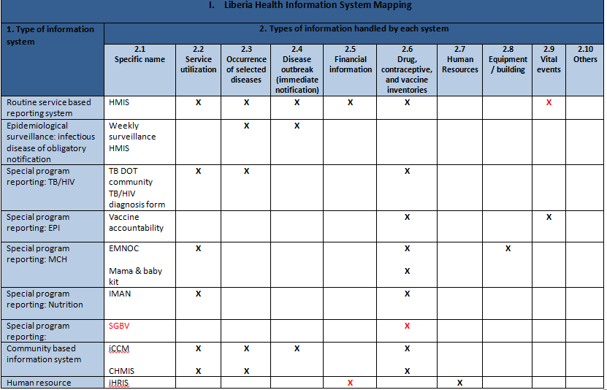
III: RHIS Overview Tool
Example: Information Mapping Sheet
Notes:
The information system mapping sheet summarizes existing information systems in one easy-to-use spreadsheet. It defines particular features of single system and commonalities among the various systems.
The rows list existing information systems and the columns describe the type/content of information that each system handles. To complete the mapping tool, verify if a given information system has the type of information described at the head of each column. If it has the described information, mark an “X” in that column; otherwise leave it blank.

Slide 17
III: RHIS Overview Tool
Information Flow Sheet
SECTION 4. INFORMATION FLOW SHEET
Name of the report generated by community/ health facility/ district | Paper-based or Electronic (Mark P or E) | If electronic, type of electronic system (Excel, Access, DHIS2, GIS; other software) | Report sent to*
* List the various levels (from bottom to top) where the data is transmitted and received. Also capture if there are interdepartmental data transmission within the same organizational level. Use arrows to indicate the data flow

Slide 18
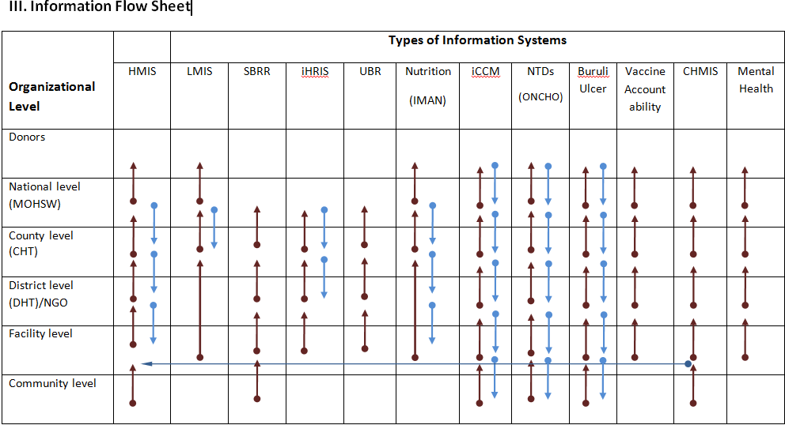
Information Flow Mapping
III: RHIS Overview Tool
Notes:
The information flow map illustrates how information flows within and across information systems, where linkages are created, and the burden of data collection.
The above map depicts fragmentation of information. This example depicts supply chain management in Kenya.

Slide 19
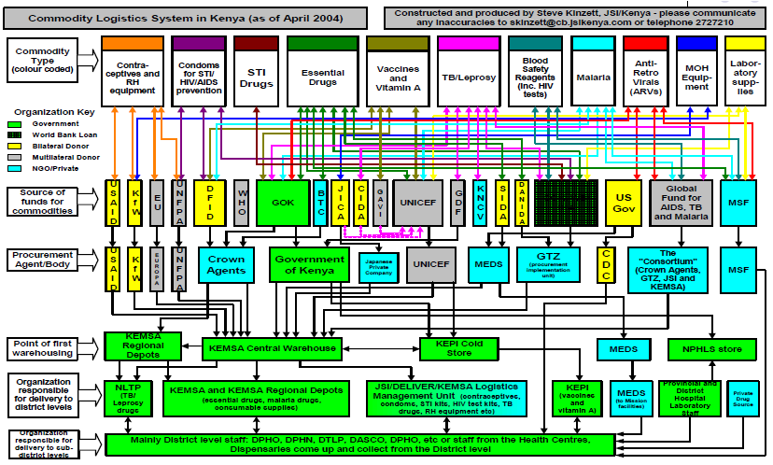
Information Flow Mapping: Example from SCM
Notes:
The information flow map illustrates how information flows within and across information systems, where linkages are created, and the burden of data collection.
The above map depicts fragmentation of information. This example depicts supply chain management in Kenya.

Slide 20
IV: Facility/Office Checklist
Used to:
  Understand availability of resources and their conditions at health facilities, district offices and higher levels
  Identify systemic resource issues at any level of the system
It measures availability of:
  Equipment (computers, printers, backup units, etc.)
  Utilities (electricity, back-up power, internet, etc.)
  Registers and forms (RHIS supplies)
  Human resources

Slide 21
V: Management Assessment Tool (MAT)
Used to:
  Measure the level of effectiveness of RHIS key management functions at district or higher levels, such as:
    RHIS governance
    RHIS planning
    Supervision
    Training
    Use of quality/performance standards
    Finance

Slide 22
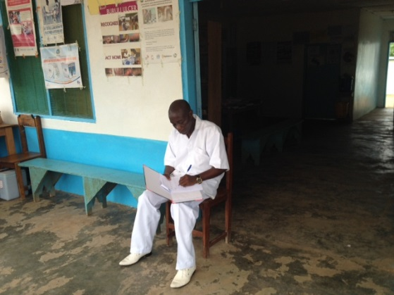
VI: Organizational and Behavioral
Assessment Tool (OBAT)
This is a self-assessment tool.
Uses:
Assess whether the organizational
    mechanisms are in place to produce
    desired results in RHIS performance
Identify the support of upper management for enhancing the RHIS
Quantify staff performance in the RHIS
Measures:
  Promotion of information culture
  Individual behavior

Slide 23
VI: Organizational and Behavioral
Assessment Tool (OBAT)
Who should fill out the tool?
OBAT | WHO? | WHAT? (Sections)
PART 1 | Staff and management at all levels | Respondent background Promotion of information culture RHIS knowledge Perception of competency to perform RHIS tasks
PART 2 | Staff and management at district and higher levels | Competency to perform RHIS tasks
PART 3 | Health facility in-charge | Competency to perform RHIS tasks
PART 4 | Data management staff in the health facility | Competency to perform RHIS tasks

Slide 24
VI: Organizational and Behavioral
Assessment Tool (OBAT)
Promotion of Information Culture
Does the organization promote a culture of information?
  Emphasis on data quality
  Value for use of information
  Evidence-informed decision making
  Problem-solving capacity
  Promote feedback
  Sense of responsibility
  Empowerment and accountability
Notes:
NOTE TO FACILITATOR:
Ask: Can you describe what comes to your mind when you think of a culture of information in your organization?
The organizational processes that are considered part of the culture of information (as perceived by the respondents) are:
Emphasis on data quality: The extent to which a health department places importance on data quality
Value for use of information: The extent to which a health department emphasizes and uses data from RHIS
Evidence-informed decision making: The extent to which a health department uses evidence from various resources and other objective criteria for decision making
Problem solving: The extent to which a health department’s staff has the capacity for problem solving
Feedback: The extent to which a health department promotes various types of feedback
Sense of responsibility: The extent to which people feel responsibility toward their work and its impact by being honest, punctual, ethical, and by making a difference in their clients lives
Empowerment and accountability: The extent to which a health department gives the authority to make decisions and people feel accountable for their decision making

Slide 25
VI: Organizational and Behavioral
Assessment Tool (OBAT)
Individual Behavior
Behavioral assessments:
  Confidence level for carrying out RHIS tasks
  Knowledge of the rationale for RHIS and method of data quality checks
  Skills for data quality assurance, data analysis, interpretation, problem-solving, and use
  Motivation to perform RHIS tasks
Notes:
NOTE TO FACILITATOR:
The OBAT is a self-assessment that looks at behavioral and organizational factors that affect RHIS performance. Do staff have the necessary knowledge, skills, problem-solving ability, confidence, and motivation?
Does the organization promote a culture that values information quality and use? Comparing these factors with RHIS performance identifies gaps and opportunities for improvements.
Ask participants: Please review the OBAT questionnaire in your PRISM binder, try to fill it out, and bring the completed questionnaire to class tomorrow. Think about the following discussion questions as you fill out the OBAT questionnaire. We’ll discuss your answers as a group tomorrow.
What was it like to fill out this questionnaire?
What did you notice about it?
What questions do you have about it?
Behavior
Confidence level for carrying out RHIS tasks: It is a reflection of motivation.
Knowledge: Why are routine data collected or for what purpose?
Skills for data quality assurance, data analysis, interpretation, use, and problem-solving
RHIS data demand
Motivation

Slide 26
Application of PRISM Tools
Tools are administered, based on:
  Observations, interviews, document review, information technology review
  Triangulation of multiple data sources increases validity of findings
  Self-assessment aspect creates sense of ownership for results and atmosphere of collaboration

Slide 27
Steps to Administer PRISM Tools
Identify a potential opportunity
    Determine how PRISM tools would be used for the present need
Perform pre-assessment planning
    Determine organization’s readiness to improve RHIS
    Assemble core team stakeholders
    Identify key informants to interview
    Modify PRISM Tool to fit local application
    Sampling process
Assess and analyze current RHIS performance
    Use the tools in order (Overview, Office/Facility Checklist, Diagnostic, Organizational/Behavioral, Management Assessment)
Define a plan to reach desired level of RHIS performance
Implement the plan and monitor progress

Slide 28
Sampling Process
Sampling Method
Determined by the purpose of the assessment
    PRISM for evaluation
    PRISM for monitoring
    PRISM for ad hoc monitoring or rapid assessment
Sampling Unit
From a sampling standpoint, the prime target of the PRISM assessment is the facility.
The facility must be sampled first.
Sampling parameters such as sample size and stratification criteria for a district are determined to a great extent by the facility sample design.
Notes:
PRISM assessments have multiple purposes. It is first necessary to describe what the assessments are intended to measure.
PRISM for evaluation: The comprehensive PRISM tools can be used to establish a baseline of the overall RHIS performance and to rigorously evaluate progress and effectiveness of RHIS strengthening interventions every 5 years.
PRISM for monitoring: PRISM can be used to regularly monitor RHIS performance in relation to production and continuous use of good-quality data in the health system. This entails applying PRISM-lite to collect and analyze data routinely on the various dimensions of RHIS data quality and information use.
PRISM for ad hoc monitoring or rapid assessment: This kind of assessment can be done to have in-depth understanding of a specific RHIS performance area/issue or intervention that is being implemented (such as the RHIS training need assessment, to identify resource gaps, or to further investigate issues in eRHIS performance, etc.).
Sampling Unit
A crucial dimension of the measurement objectives for the PRISM assessment concerns the geographic or administrative subdivisions for which the RHIS performance estimates are desired. When the PRISM assessment is general-purpose in nature--that is, not confined to a particular area where a specific program or intervention is being carried out--it is more likely to be sizeable in scope, often covering the entire country. For this case, it is important to specify the domains (regions, province, or states) during the survey planning process so that the sample design can take account of it. When the area is large and diverse, the country might want estimates disaggregated for important subdomains, such as districts, for comparison purpose.

Slide 29
Sampling Method Based on Assessment Objectives
Assessment objectives | Sample size | Sampling method
Establish baseline of RHIS performance | ≥ 100 (to be determined by the design effect; mostly 1.2 design effect used) | Cluster sampling , Simple Random Sampling (SRS)
Monitoring progress on RHIS performance | 40–00 | Cluster sampling, Lot Quality Assurance Sampling (LQAS)
Targeted spot checks and cross-checks based on identified issues with a particular geographic area, program, facility type, etc. | 10–40 (as needed) | LQAS, purposive
Midline or endline evaluation of RHIS performance | ≥ 100 (to be determined by the design effect; mostly 1.2 design effect used) | Cluster sampling, LQAS, SRS
Notes:
Probability samplings are preferred methods because every unit of analysis (i.e facilities, districts, etc.) has equal chance of being selected. It provides the ability to generalize the findings across the population. Some of the commonly used probability sampling methods are simple random sampling (SRS), cluster sampling, and lot quality assurance sampling (LQAS).

Slide 30
RHIS Assessment: Try Your Luck in the Lottery
Group exercise:
Pick a chit from the bowl and answer the question(s) on it.
Notes:
NOTE TO FACILITATOR:
Prepare small, folded chits with questions on RHIS assessment tools. (Use Handout 9.3.1 for the questions.)
Put the chits in a bowl or hat.
Go around the room and ask each participant to draw a chit and answer the question on it.
Appreciate the answer; clarify if necessary.
Repeat the process until all questions on the chits have been answered.

Slide 31
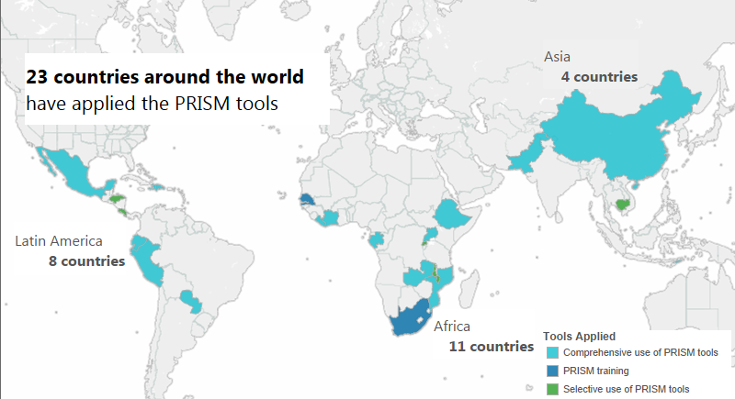
PRISM Tools: Implementation
Notes:
Situation in 2012.

Slide 32
Overview of the PRISM Results
Notes:
Facilitator: Outputs/results of a PRISM assessment application. Results of each part of the framework. Explain the color-code system (right top of the slide).

Slide 33
Results of a PRISM Assessment in Ivory Coast
RHIS Performance | Health Facilities |  |  | Districts
 | 2008 | 2012 | Status | 2008 | 2012 | Status
Data accuracy | 43% | 60% |  | 40% | 81%
Data use | 38% | 38% |  | 44% | 70%
Notes:
Regional level was not assessed in 2008: 50% of regions were assessed in 2012
Data accuracy: The proportion of facilities that met the predetermined accuracy criteria
Note: From 2009–2011, facilities were trained to use an HIV data collection tool but not on how to use the data collected.

Slide 34
Examples of RHIS Strengthening Interventions in Ivory Coast
Integration of HIV and AIDS indicators in the overall RHIS (T)
Organized training in use of information, including problem-solving techniques, at district and health-facility levels (B)
Developed feedback bulletins for health offices at all levels (O)

Slide 35
Examples of RHIS Strengthening Interventions in Liberia
Building individual staff capacity to use DHIS 2, data verification, data analysis, and data use (T, B)
On-site mentoring of county M&E staff (B)
Building organizational capacity (O)
  For example, establish, organize, and implement routine performance review forums
Setting up data quality assurance mechanisms, such as desk review of data and data quality assessments (T)

Slide 36
This presentation was produced with the support of the United States Agency for International Development (USAID) under the terms of MEASURE Evaluation cooperative agreement AID-OAA-L-14-00004. MEASURE Evaluation is implemented by the Carolina Population Center, University of North Carolina at Chapel Hill in partnership with ICF International; John Snow, Inc.; Management Sciences for Health; Palladium; and Tulane University. The views expressed in this presentation do not necessarily reflect the views of USAID or the United States government.

