Slide 1
Bridging the Research-to-Practice Gap
Session 1

Slide 2
Session Objectives
Understand the importance of improving data-informed decision making
Understand the cultural divide between researchers and program/policy implementers
Understand the importance of placing research in the policy-program continuum

Slide 3
Why Improve Data-Informed Decision Making?
Global/local health context
HIV epidemic
Resurgence of TB
Continued prevalence of malaria
Pockets of stalled fertility decline
Population burden
Shortage of health care workers
Notes:
All of us can see the need for quality health care services.
There is evidence to suggest that the global HIV epidemic is stabilizing, although at an unacceptably high rate. There were an estimated 33.3 million people living with HIV at the close of 2009, the majority of whom either need or will soon need treatment.
As of 2010, approximately one-third of the world‘s population was infected with TB. Moreover, many new cases are resistant to major TB therapeutic drugs.
Each year, malaria causes nearly one million deaths, mostly among children under 5 years of age, and an additional 190 to 325 million clinical cases that need to be addressed by the health system.
In much of sub-Saharan Africa, the transition from high to low fertility has stalled.¹ In two-thirds of countries in the region, there was no meaningful change in the total fertility rate (TFR) during the interval between the two most recent Demographic and Health Surveys.
In many countries, young people – those below the age of 20 – account for the largest proportion of the population. In the next few years, we will see larger numbers of people needing health services as this cohort ages. In the face of this demand, we are experiencing …
Inadequate numbers and poor distribution of qualified health workers and an inadequate human resources system to support them.

Slide 4
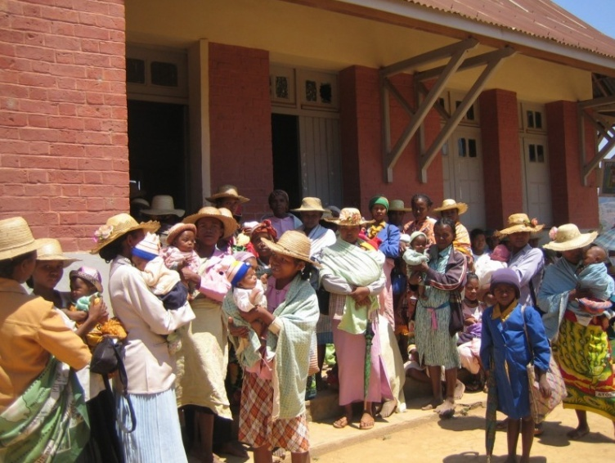
Context
Pressing need to develop and implement health policies, strategies, and interventions
Notes:
So…. It is within this context of a high disease burden, a growing population, and insufficient health services that it becomes extremely important for governments to make the best use of their limited resources. The need to develop strategies, policies, and interventions that are based on quality data and information is urgent.
4

Slide 5
Context
Increased financial investments for service delivery
Increased accountability requirements
Improved national health information systems
Increased demand for evaluation and other research
Notes:
The good news is that, as we face this need to deliver health services, we have seen increased financial commitments by the international community to provide programs and services, although this is largely for HIV services.
The increased influx of funds and resulting expansion in programs have led to increased accountability requirements by donors, governments, and civil society. Many donors are not only requiring regular reporting on services delivered, but funding for continuation of activities is frequently based on performance.
These accountability requirements have led to strengthened programmatic monitoring & evaluation (M&E) systems, a commitment for integrated HMIS, and a demand for other types of quality data.
These improvements in the availability of data should be leading to improved evidence-based decision making. However, this is not the reality in many of the contexts in which we work.
5

Slide 6
Level of Dissatisfaction that Policy Is Based on Scientific Evidence
Percent dissatisfied
Jones et al. 2008. Overseas Development Institute.
Notes:
This sentiment is reflected in the opinions of our peers who participated in an international survey conducted by the Overseas Development Institute (Jones et al., 2008). The study found that there is a high level of dissatisfaction among policy makers, program implementers, and researchers alike with the degree to which policy decisions are informed by research evidence.
Specifically, we see that:
42% of policy makers,
60% of program implementers, and
54% of researchers stated that they were dissatisfied with how much policy is based on evidence.
Why is this? Why are our decision makers not using data and evidence to inform their decisions?

Slide 7
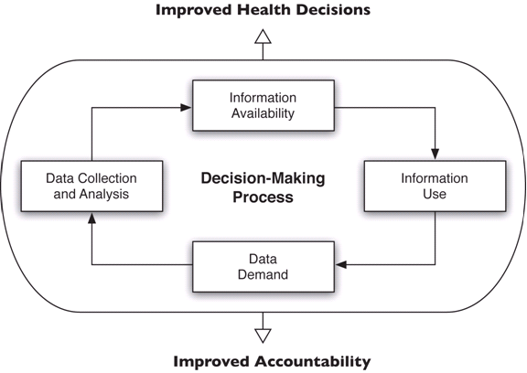
Evidence-Based Decision-Making Process
Stakeholders
Notes:
To address this question, let’s consider the MEASURE Evaluation cycle of evidence-based decision making. You will note 4 primary phases in the continuum of decision making. In the ideal scenario, there is:
A demand for data to inform decision making
The technical and human capacity to collect and analyze the data
The resulting information made available in a format that is easily understood by the relevant stakeholders
The information interpreted in the relevant contexts and used to improve policies and programs
This cycle is supported by the involvement of relevant stakeholders throughout the decision-making process. It also supports the assumption that the more positive experiences a decision maker has in using information to support a decision, the stronger the commitment will be to continue engaging in evidence-based decision making.
However, often there are breakdowns in this process, and evidence-based decision making is not realized.
7

Slide 8
Culture Divide:
Researchers vs. Decision Makers
Decision makers think that health researchers:
Lack responsiveness to priorities
Take too long to answer questions
Favor technical language over transparent communication
Don’t commit to a ‘yes’ or ‘no’ answer
Notes:
Now let’s consider why this breakdown occurs.
First, let’s consider some fundamental differences between researchers and decision makers.
Generally speaking, researchers are educated to be objective, analytical, and contemplative.
Decision makers need to be responsive, action-oriented, and decisive.
These frequently opposing approaches contribute to the breakdown in the decision-making cycle. For example:
NOTE to facilitator: Read slide.

Slide 9
Culture Divide:
Researchers vs. Decision Makers
Health researchers think that decision makers:
Impose unrealistic timelines
Don’t understand what is a researchable question
Don’t distinguish good from bad research
Value “political” considerations over evidence
Notes:
On the other hand…
NOTE to facilitator: Read slide.

Slide 10
Breakdown in Decision-Making Cycle
Failure to link the program and policy process to the research process
  Stakeholders not involved throughout the research cycle
  Data not fully relevant to decision-making needs
  Low understanding of data, thus data ownership
Notes:
This decision maker/researcher divide manifests itself in ……
NOTE to facilitator: Read slide.

Slide 11
Breakdown in Decision-Making Cycle
External factors
Political
Cultural
Religious ideology
Notes:
Of note is that, while the breakdown in the decision-making cycle is often caused by the research and program divide, it is also affected by: External factors – political, cultural, or religious ideology.
For example, in the political realm, during a re-election year, a politician may not want to vet and disseminate data on increased HIV prevalence. He/she may fear that these new data could reflect poorly on his/her leadership in the province and so may not want that information to inform any decision-making processes.
An example of a cultural barrier to data use is that in some countries, intravenous drug users (IDU) are a population at great risk of HIV acquisition and transmission. However, in many countries, intravenous drug use is considered illegal and punishable by time in prison. While data may exist that clearly indicate the role that IDUs pay in HIV transmission, decision makers may refuse to provide HIV prevention services to this population due to local, cultural prejudices.
An example of a religious barrier to data use is that among some specific religious groups, the concept of limiting or spacing the number of children in a family is unacceptable. These specific groups may ignore data that clearly indicate that women who have children too closely spaced are at higher risk of pregnancy and delivery complications that result in higher morbidities and mortality.

Slide 12
The Exceptions
Public health breakthroughs
Definitive results
Demand-driven research
Notes:
As we talk about the insufficient use of data in decision making, we also need to point out that many research studies do indeed end up informing policy and program improvements.
The research with the most obvious impact involves the large public health studies that result in a program improvement that saves lives. A good example of this is the landmark study that found Nevirapine to be a safe, effective means of preventing mother-to-infant HIV transmission and that has been applicable and affordable in resource-limited settings. The life-saving potential of Nevirapine was quickly adopted as the standard of care in resource-limited countries worldwide and has been endorsed by UNAIDS and many other international health organizations.
There are also examples of studies that show clear, definitive results. Many times a ‘body’ of research is needed to clearly indicate a course of action, and one study is not sufficient. Many research studies fall into this category. Also, sometimes the results of a study are not strong enough and more research is needed. However, there are studies that often clearly show that action is needed. A good example of this type (and one that we will be discussing in more detail later in the course) is a study that was conducted in Madagascar; it showed that the provision of injectable contraception by lay health workers was safe and acceptable. Specifically, the study found that 100% of the health workers provided the injectable according to the standards that the Ministry of Health (MOH) had established. The lay health workers’ supervisors showed confidence in the workers’ ability to provide safe injections. And, 92% of the clients said they would recommend the community provision of DMPA to a friend. This study clearly showed that this new approach was safe and acceptable.
The last category is what we call demand-driven research. This is research that responds to a specific need for information. It is implemented in response to an expressed need by stakeholders or in response to a specific decision-making need of program managers and policy makers.
In the next few slides, and in the remainder of this course, we will be talking about how to ensure that our research is demand driven so that it has impact.

Slide 13
Strengthening Evidence-Based Decision Making
Apply improved research paradigm
  Consider the program/policy context in the planning phase (begin with the end in mind)
  Involve various stakeholders throughout the research process
  Develop action-oriented recommendations
  Make data, results, and recommendations available and accessible in various formats for data users
  Follow up
Notes:
We’ve just discussed the rationale for why we experience the research-to-practice gap. Now let’s consider this question: What can we do as researchers to strengthen the evidence-based decision-making process?
We can move away from a traditional research approach that focuses on data needs, includes limited stakeholder involvement, and concludes the research process with a dissemination meeting.
Specifically, we can:
NOTE to facilitator: Read slide.

Slide 14
Placing Research in the
Policy-Program Continuum
Notes:
To successfully change the way we do research, we first need to understand how our work contributes to the program and policy continuum.

Slide 15
Continuum: What & Why?
Provides a way to think about how research will influence programs and policies
Placing research in the continuum assists to:
  Determine how results of research will be used
  Develop action-oriented research questions
  Include appropriate stakeholders in the research process
Notes:
What is the program and policy continuum? It is a way to think about how our research will influence programs and policies.
By identifying where in the continuum your research falls, you will be able to:
Determine how the results of your research will be used
Develop action-oriented research questions
Include appropriate stakeholders in the research process

Slide 16
The Policy-Program Continuum
Advocacy & Policy Formulation
Program Formulation
Program Monitoring
Program Evaluation
Notes:
In this continuum, we have grouped program and policy stages into the 4 listed on the slide:
Advocacy & policy formulation
Program formulation
Program monitoring
Program evaluation
By identifying the program and policy phase that your research is supporting, you begin to think about the use of your results and the programmatic and policy decisions they may influence.

Slide 17
The Policy-Program Continuum
Advocacy & Policy Formulation
Program Formulation
Program Monitoring
Program Evaluation
Notes:
Of note is that our research often contributes to more than one box by supporting more than one phase of the continuum at a time.

Slide 18
The Policy-Program Continuum
 | Questions | Primary Audience
Program Evaluation | Program outcomes Public health impacts Cost-effectiveness | MOH & NGO directors, donors
Program Monitoring | Program implementation: objectives, activities, targets | Program & facility directors, managers
Program Formulation | Program models, best practices | MOH & NGO directors, donors
Advocacy & Policy Formulation | Problem identification Making the case for action | Policymakers & advocacy groups
Notes:
How do we do this? Consider the types of questions being addressed in each phase of the continuum and then consider the primary audience of the research – the target group, person, or organization who is going to take action on the findings related to the primary research question.
NOTE to facilitator: Read slide along the rows.
By identifying your target audience – such as the MOH or a nongovernmental organization (NGO) – you can fine-tune your research questions to be sure to provide the information they need to make decisions.
By identifying your target audience, you will be able to:
Identify and budget for the appropriate communication channels for your findings
Identify the types of decisions that will be influenced by your research findings

Slide 19
  Advocacy & Policy Formulation
Research questions | Stakeholders involved | Decision
What are the reproductive health (RH) issues facing young people? | MOH & NGO directors Youth advocates Youth | Should we advocate for and formulate a policy to provide RH services to young people?
Notes:
Let’s look at examples from each phase of the continuum, starting with advocacy & policy formulation.
NOTE to facilitator: Read slide.
As mentioned earlier, sometimes a research question can address more than one phase of the continuum.
NOTE to facilitator:
Ask the group – What other decisions can this question inform? Possible responses include: The selection of new health services for young people.
Ask the group – What phase of the continuum does this decision fall in? Answer: Program formulation.
Sometimes researchers are called in to support a service delivery decision with data. Other times, the research question is more exploratory in nature.

Slide 20
  Program Formulation
Research questions | Stakeholders involved | Decision
Which program approach increases service uptake among youth the most? | MOH & NGO directors Donors | Which approach should be implemented to provide RH services to young people?
Notes:
Now let’s look at program formulation, still using our RH example.
NOTE to facilitator: Read slide.
This study may be investigating the best service delivery model, such as youth-friendly clinics and community- and school-based approaches.

Slide 21
Program Monitoring
Research questions | Stakeholders Involved | Decisions
Is the program achieving its stated objectives (reaching youth, reaching specific targets for numbers of services provided, etc.)? | Program and facility managers Youth | Should youth health program be modified?
Notes:
Now let’s look at program monitoring.
NOTE to facilitator: Read slide.

Slide 22
  Program Evaluation
Research questions | Stakeholders involved | Decisions
Has the RH status of youth improved? | MOH & NGOs Ministry of Education Donors Media | Should we continue youth programs and scale them up nationally?
Notes:
Now let’s look at program evaluation.
NOTE to facilitator: Read slide.
As you can see, the benefit of mapping your research to the policy-program continuum is to identify the primary consumers of your research. Once they are identified, you can then involve them in the research process to identify the specific information they would need to scale up youth programs, as the example above discusses. Your discussions will identify the information they need to make decisions about scale-up. You can include these issues in your research as secondary research questions.

Slide 23
Key Messages
Public health research is insufficiently applied to improve service delivery, policies, and practices
Many barriers exist that inhibit the use of research results in decision making
Researchers must identify and involve relevant stakeholders throughout the research process
Researchers can promote evidence-based decision making by understanding how their research fits in the policy-program continuum
Notes:
NOTE to facilitator: Read slide.

Slide 24
Mapping Research Questions to the
Policy/Program Process
Small Group Activity 1:
Notes:
NOTE to facilitator:
Divide the plenary into smaller groups. Ideally, you will have groups of 5–8 individuals each. Hand out copies of Small Group Activity 1 – DIRECTIONS. Also, refer to the Small Group Activities 1 & 2 – ANSWERS for answers to the exercise.
Give the group 30 minutes to answer the questions and then discuss them in plenary. Select one group to provide the answer to each research question and discuss why they selected the response they did. You will have 15 minutes for the report back.

Slide 25
Small Group Activity 1: Instructions
Choose a reporter.
Review the research questions listed in your handout.
Discuss whether the question responds to advocacy & policy formulation, or to program formulation, monitoring, or evaluation.
Refer to the bulleted list in your handout to assist you in this process. It is possible that research questions will not be mutually exclusive to one category, as research studies frequently have multiple objectives. In this case, note the policy-program categories that the research question addresses.
Time for activity: 30 minutes
Time for larger group discussion of answers: 15 minutes
Notes:
NOTE to facilitator: Read slide.

Slide 26
Small Group Activity 1: Answers
Can injectable contraception (DMPA) be provided safely by paramedical workers to increase contraceptive prevalence rates (CPR)?
  Program formulation
  Policy formulation
Is HIV mortality, incidence, or prevalence improving in countries with the largest Global Fund programs, compared to control countries?
  Program evaluation
Notes:
NOTE to facilitator: During the report-back phase of this exercise, refer to the questions and answers provided in this and the following slide.

Slide 27
Small Group Activity 1: Answers
Is the completion rate of the recommended 4 ante-natal visits better in clinics in which there is a higher staff-to-client ratio?
  Program monitoring
What is the status of health-care-seeking behavior among children under 5 years of age?
  Advocacy & policy formulation

Slide 28
MEASURE Evaluation is funded by the U.S. Agency for
International Development and is implemented by the
Carolina Population Center at the University of North
Carolina at Chapel Hill in partnership with Futures Group
International, ICF Macro, John Snow, Inc., Management
Sciences for Health, and Tulane University. The views
expressed in this presentation do not necessarily reflect
the views of USAID or the United States Government.

