Slide 1
Evaluation

Slide 2
Vocabulary
Types
Timing

Slide 3
Definition
“Evaluation is the collection of, analysis and interpretation of information about any aspect of a programme as part of a recognised process of judging its effectiveness, its efficiency and any other outcomes it may have.”- Mary Thorpe in “Handbook of Education Technology” (Ellington, Percival and Race, 1988)
Notes:
Group Assignment
Day #2 Slide 3
Develop a conceptual framework for the problem that your program addresses. The type of framework is not important. It should be comprehensive in that addresses factors beyond the scope of the actual service delivery.
If the framework is too complex to put on the power point slide, the group may decide to provide a hand written handout instead.

Slide 4
Reasons for evaluation
Each time you begin an evaluation, you should carefully identify the purpose of the evaluation and who will use the results.
Evaluations may be used to:
• guide decisions about budgets,
• communicate with the public and with political decision makers,
• identify strengths and weaknesses of a program, or
• determine whether or not to repeat or continue a program.

Slide 5
Michael Quinn Patton (1997) describes three primary uses of evaluation:
• to judge merit or worth of program (such is the purpose of a “summative evaluation”),
• to improve programs (such is the purpose of a “formative evaluation”), or
• to generate knowledge.
Notes:
Group Assignment
Day #3 Slide 4 (3 Slides on Day #3)
Decide on the goals and objectives for the program and state them in the slide.
The goals and objectives must be related to your problem statement.
Remember that objectives need to be SMART.

Slide 6
Brainstorm
You have been selected as an M&E officer to lead the conduct of an evaluation of MDG projects in your local government.
How will you carry out this assignment?

Slide 7
JISC
Joint Information Systems Committee
Higher Education Funding Council for England & Wales

Slide 8
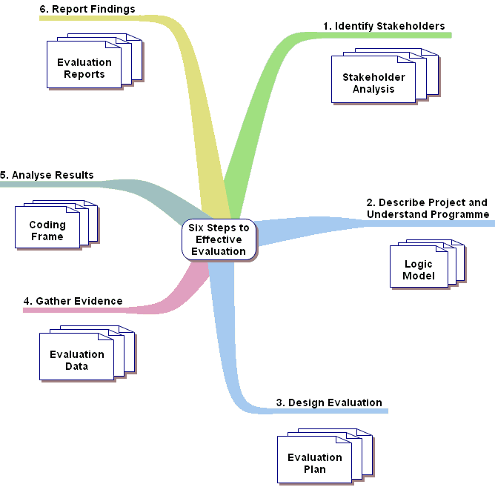
Six steps in evaluation

Slide 9
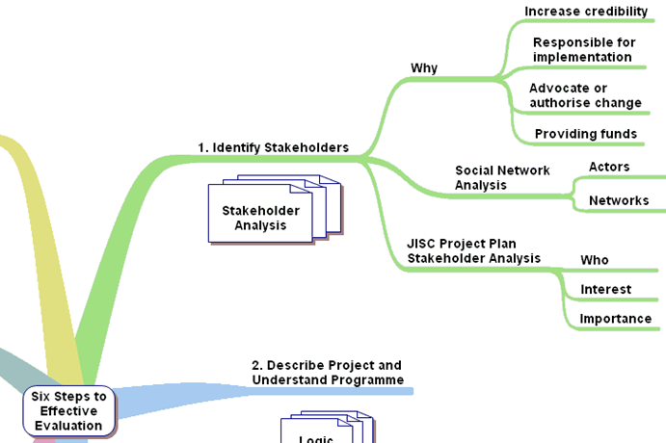
Step 1

Slide 10
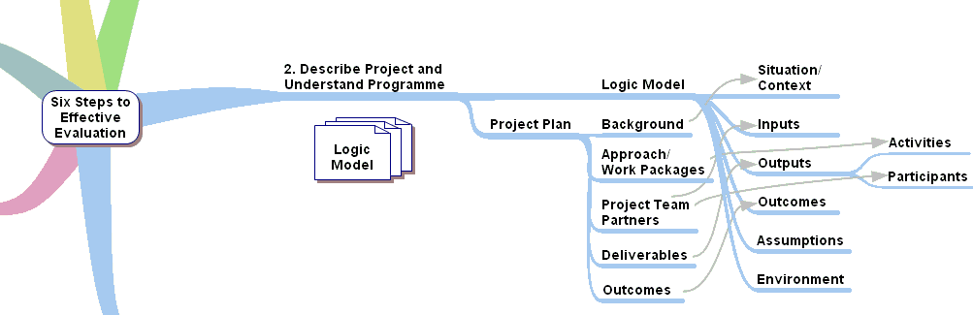
Step 2

Slide 11
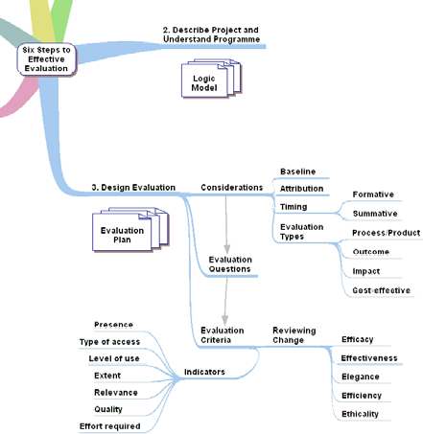
Step 3

Slide 12
Evaluation plan matrix
Evaluation Questions | Indicators | Baseline | Source of information | Collection method | Schedule
What do you want to know? | How will you know? | What is the situation prior to any activity? | Where can this data be obtained? | How will the data be gathered? | When, where and who will gather the data?

Slide 13
Questions answered by different evaluation types
Evaluation type | Suggested question
Process | Does it work? Is resource use minimised? Does it attain longer term goals? Is it pleasing to use? Are there any ethical/legal/safety issues for those who are involved? To what extent are the desired changes occurring? For whom? What are the potential barriers/facilitators? What is most appropriate development activity?
Outcome | What are the desired changes in behaviour or state? To what extent are these changes occurring? Are the changes effective? To what extent are desired changes occurring? For whom?
Impact | What are the unintended outcomes? To what extent have the intended benefits been achieved? What is the overall effect of the development activity? What are the cost benefits? What is the cost effectiveness of the development activity?

Slide 14
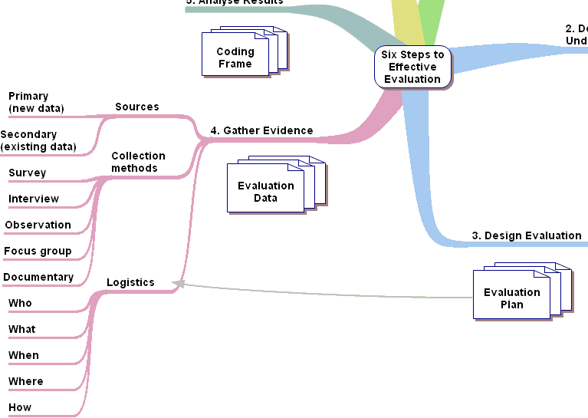
Step 4

Slide 15
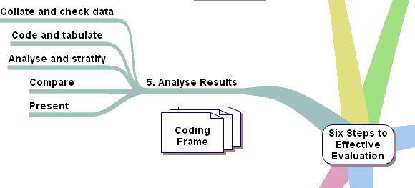
Step 5

Slide 16
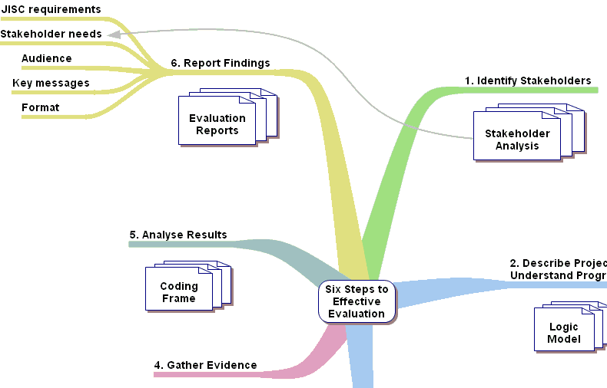
Step 6

Slide 17
Summary of steps
Step 1. Identify purpose. Clearly identify the reason for conducting the evaluation. Identify the scope of the evaluation. Do you want to evaluate the whole program or just a part of it? Which component? What do you want the evaluation to tell you? Ensure everyone on the team agrees.
Step 2. Review program goals. Closely examine the program or project goals as stated by the designers of the program or project. What changes did the designers hope to make?
Step 3. Identify evaluation stakeholders. Stakeholders are those who have a stake in the outcome of the evaluation, not the audience(s) targeted by the program or project. Stakeholders include people both inside and outside the organization.

Slide 18
Summary (2)
Step 4. Contact stakeholders. Obtain input about what questions they have about the program, project, or policy. This can be accomplished through a workshop session where evaluation questions are brainstormed, or by contacting stakeholders individually.
Step 5. Revisit the purpose of the evaluation. Based on your conversations with stakeholders and your own reason for initiating the evaluation, rewrite the purpose of the evaluation.
Step 6. Decide if evaluation will be in-house or contracted out. Based on the scope of the evaluation and the nature of the evaluation questions, decide whether you need to hire a professional evaluator or if you can conduct the evaluation with existing staff. Develop a budget based on your decision.

Slide 19
Summary (3)
Step 7. Determine data-collection methods. Decide on data-collection procedures to answer your evaluation questions. Refer to the appendix of this publication to help select methods that will best address your evaluation questions.
Step 8. Create data-collection instrument. Construct or adapt existing data-collection instrument(s) (such as surveys or interviews). Whether you design your own or adapt from other instruments, test the draft instrument for validity and reliability before administering it.
Step 9. Test data-collection instrument. Administer the draft instrument with a group of willing respondents and ask for their feedback on the instrument.

